Slide 1
Bc bottle & recycling depot association
Draft Program Plan Consultation
November 17, 2022

Slide 2

Background & Context

Slide 3
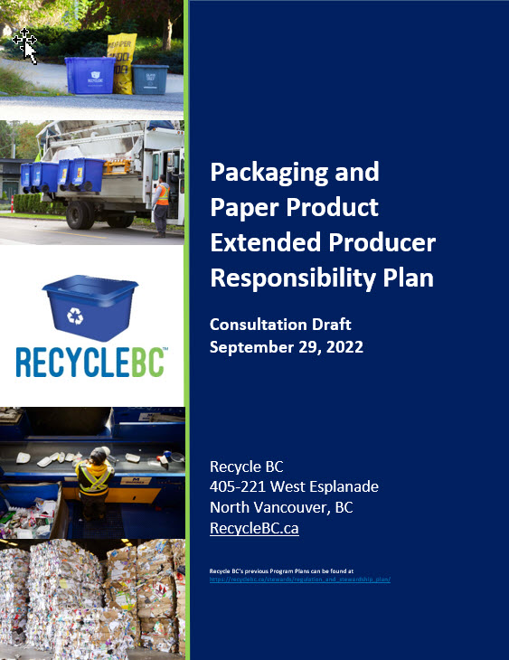
PROGRAM PLAN
Plan outlines objectives, commitments and targets
Operational roadmap
5-year period and renewal cycle
Evergreen format
Timelines
Sept 30, 2022: plan posted
Oct-Dec 2022: consultation period
April 2023: plan submission to MOECCS

Slide 4
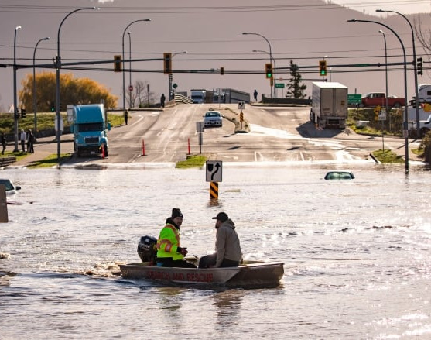
PLAN CONTEXT
8 years of operational success and full compliance
Upcoming launch of comparable provincial programs
Recent challenges:
COVID-19 & supply chain disruptions
Labour and transportation challenges
Extreme weather events
Public distrust
Inflation
Opportunities for:
Advancement and innovation
Building program resiliency
Driving the circular economy

Slide 5
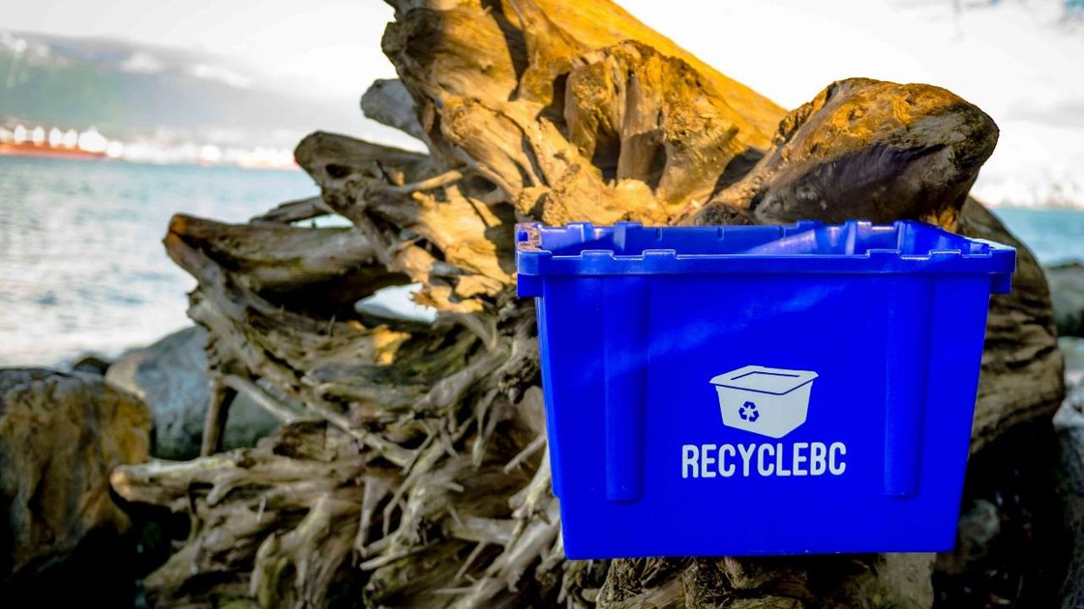
EPR AGENCY
BC Recycling Regulation, amendments, guidance docs
Recycle BC administers plan on behalf of producer members
Program financing:
Member fees based on weight of PPP supplied
Materials covered:
Packaging
Paper product

Slide 6
Collection SYSTEM

Slide 7
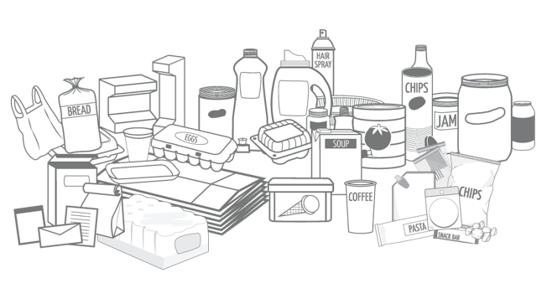
ACCEPTED MATERIALS
Compatible materials with viable end markets
List is expansive and harmonized
Not accepted PPP:
Composition audits
Research & analysis – barriers, best practices
Engage with processors and end markets
Pilots
Jan 1 changes:
Packaging-like products
Single-use products
Flexible Plastics – combining 2 streams
“Squishy” foam

Slide 8
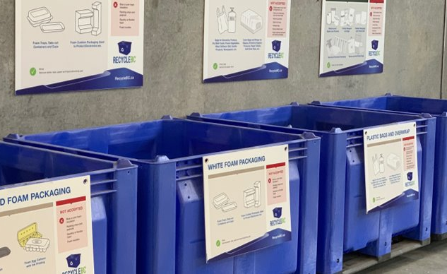
INTEGRATED RECYCLE BC COLLECTION SERVICES (ICS)
Focus on flexibility to meet changing demands and ensure reasonable levels of service
ICS: Service or combination of services that provide regular opportunities to collect all PPP categories:
All categories accepted at curbside
Depots, retail locations or mobile depots to augment curbside/MF collection
All categories accepted at depots, retail locations or mobile depots
Methods may differ by community size, contractor availability, etc.
Goal is to provide service in all eligible communities and recruit as necessary annually

Slide 9
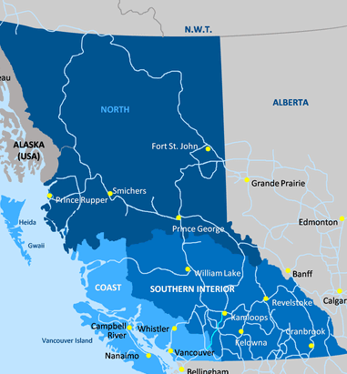
ICS ELIGIBILITY CRITERIA
Plan includes detailed criteria to outline communities eligible for Integrated Collection Services (ICS)
Eligibility criteria focuses on:
Community population
Distance to depot and larger service center
Availability of garbage and grocery services
Meaningful contribution to collection volumes
Convenience without duplication of transportation
Depots are currently the primary ICS method
Recycle BC will honour existing agreements in communities that do not meet eligibility criteria
Satellite depots

Slide 10
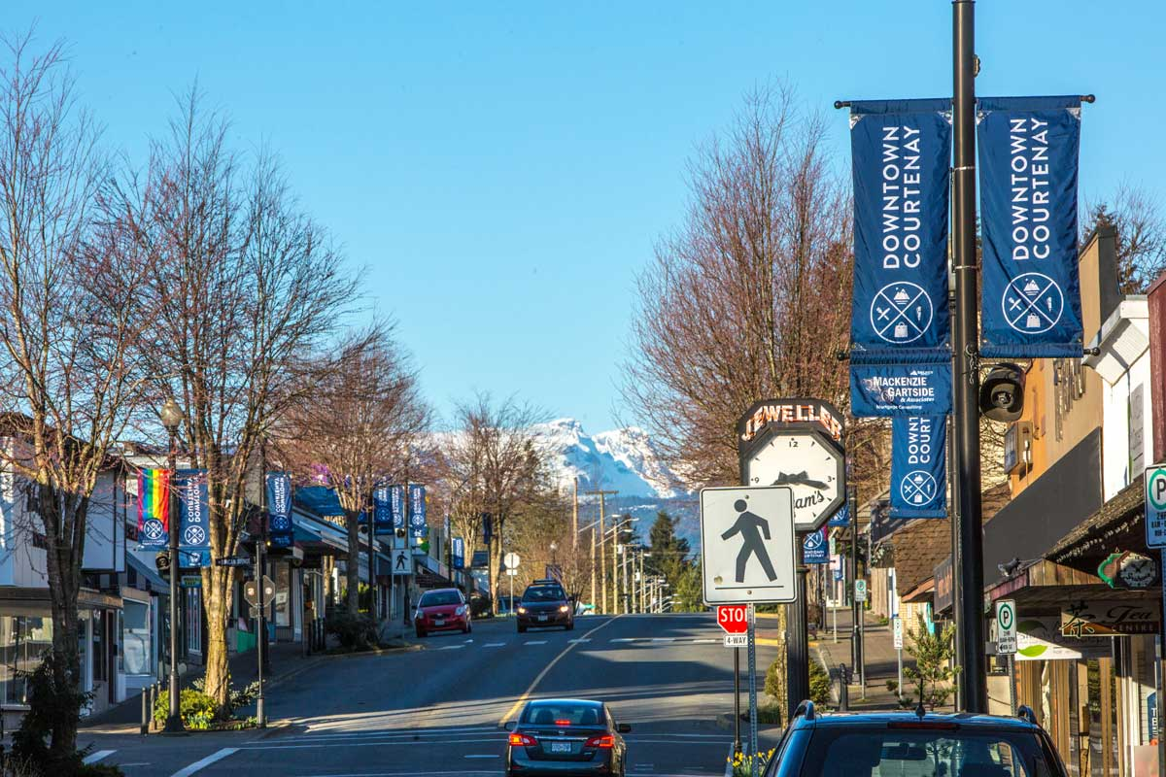
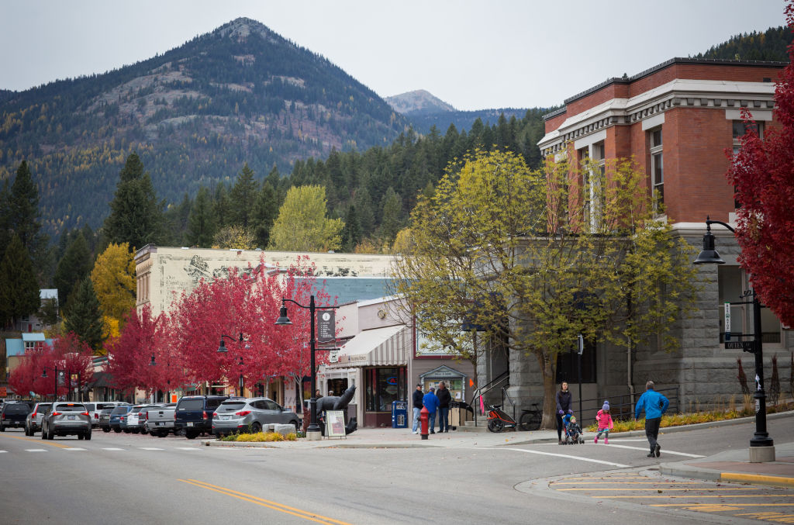
ICS ELIGIBILITY: MUNICIPALITIES
Municipalities with >50,000 population:
Local organization able and willing to meet all requirements
Municipalities with > 10,000 population:
Local organization able and willing to meet all requirements
Minimum population of 10,000 and maximum population of 49,999 residents
More than 5 km from Recycle BC depot in a larger municipality
Municipalities with >2,000 population:
Local organization able and willing to meet all requirements
Minimum population of 2,000 and maximum population of 9,999 residents
More than 15 km from a municipality with 10,000 residents
More than 15 km from Recycle BC depot

Slide 11

ICS ELIGIBILITY: SMALL & ISLAND COMMUNITIES
Small communities:
Local organization able and willing to meet all requirements
Minimum population of 1,000 residents within 30-minute service catchment
Garbage service and year-round grocery store available
More than 40 km from a municipality with 10,000 residents
More than 40 km from Recycle BC depot
Island communities:
Local organization able and willing to meet all requirements
Minimum population of 1,000 residents
Garbage service and year-round grocery store available

Slide 12
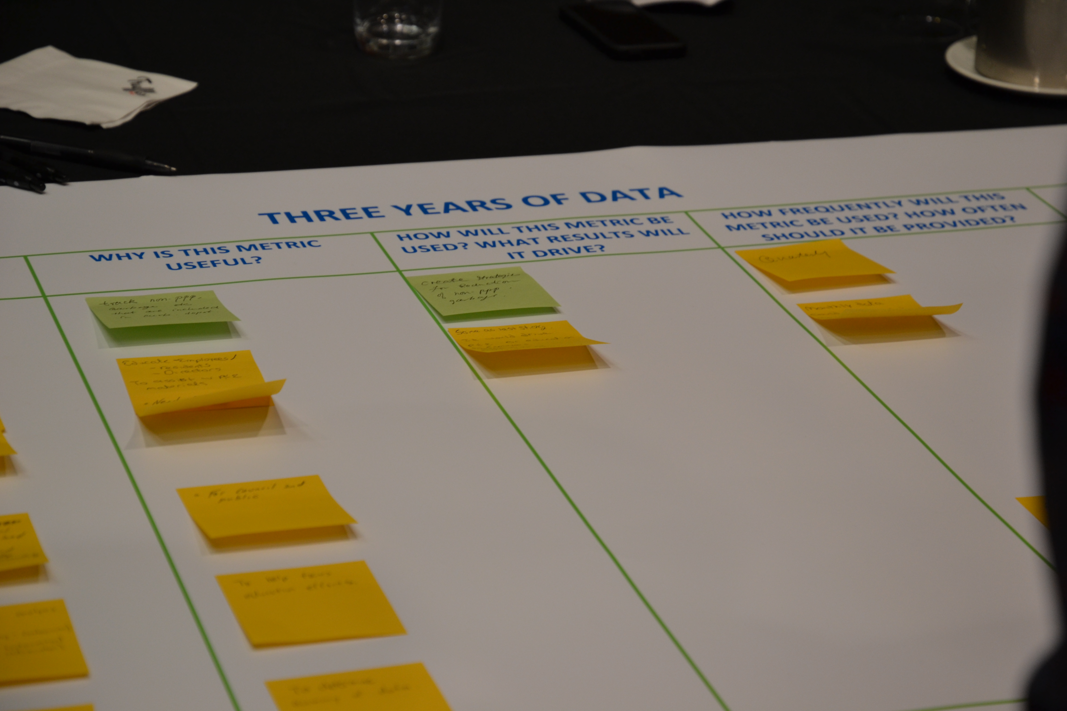
FINANCIAL INCENTIVE PROCESS
Recycle BC offers financial incentives to collectors to incentivize participation to ensure targets met
Curbside and Multi-Family: $ per household (plus $/tonne glass)
Depot: $ per tonne
At end of each agreement term:
Collection cost study and analyses to determine adjustments
Propose updated incentive rates/structure for consultation
Conduct consultation with stakeholders
Review feedback, prepare new agreements/incentive offers
Distribute new agreement terms
Collectors determine whether wish to renew agreement according to new terms

Slide 13
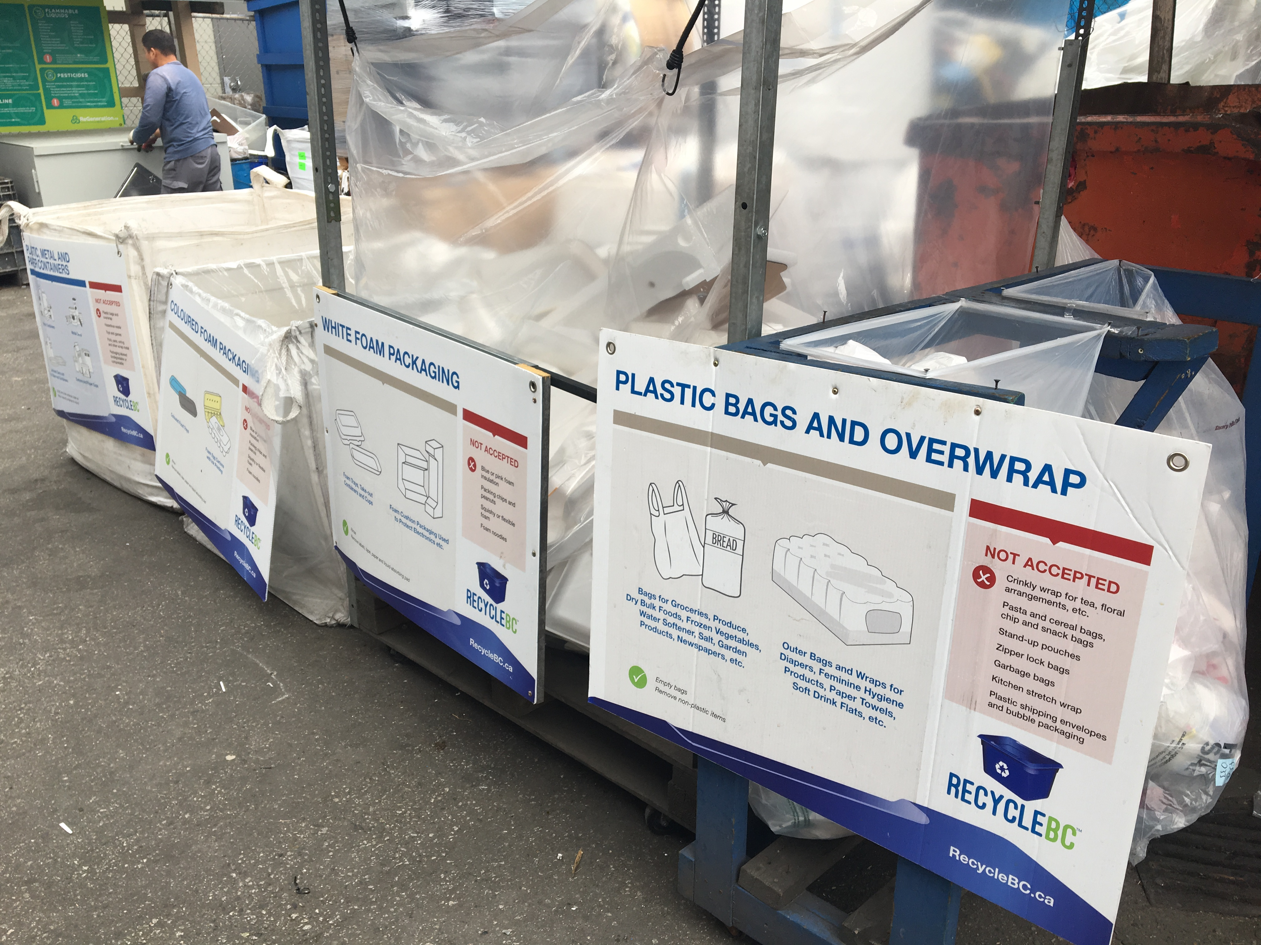
COST STUDY PROCESS
Completed in advance of new service agreements
Compares current costs to historic 5-year cost
Collectors provide data to independent third-party accountant
Overseen by Recycle BC Advisory Committee members
Objective: fair and reasonable incentive rates
Data includes:
Curbside
Multi-family
Streetscape
Promotion and education
Service administration

Slide 14
COST STUDY INPUTS
Collection costs, including differences by:
Collection channel and PPP categories
Geography and density
Collection attributes - # of streams, container types
Collector type
Unique drivers of cost – e.g. receiving facility location
Program data, including performance by channel
Operational metrics, including contamination
Impact of inflation
Proposed service requirement changes
Impact of existing incentive rates/structure on incentivizing best practices, efficiencies, high collection rates, GHG reductions
Not included – collection in communities that do not meet eligibility criteria

Slide 15
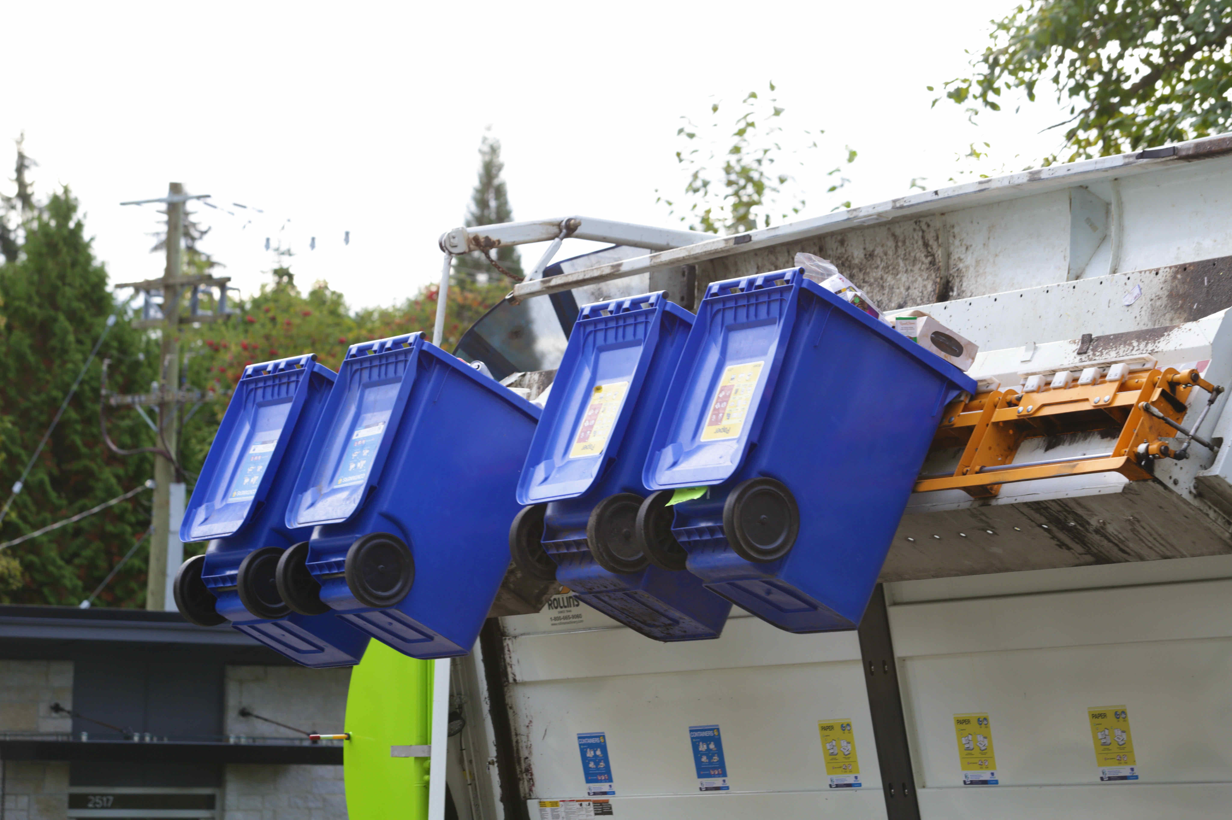
FINANCIAL INCENTIVES – TIMELINE
2020 – Last collection cost study
Jan 1, 2022 – Updated depot rates
July 1, 2022 – Updated curbside and multi-family rates
2024 – Next collection cost study
Jan 1, 2025 – New service agreements and incentive rates

Slide 16
Performance targets

Slide 17
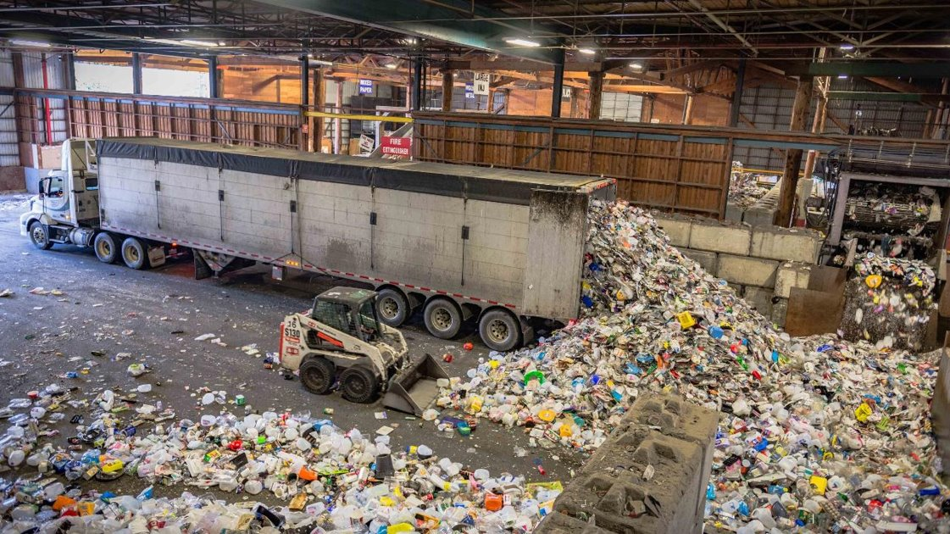
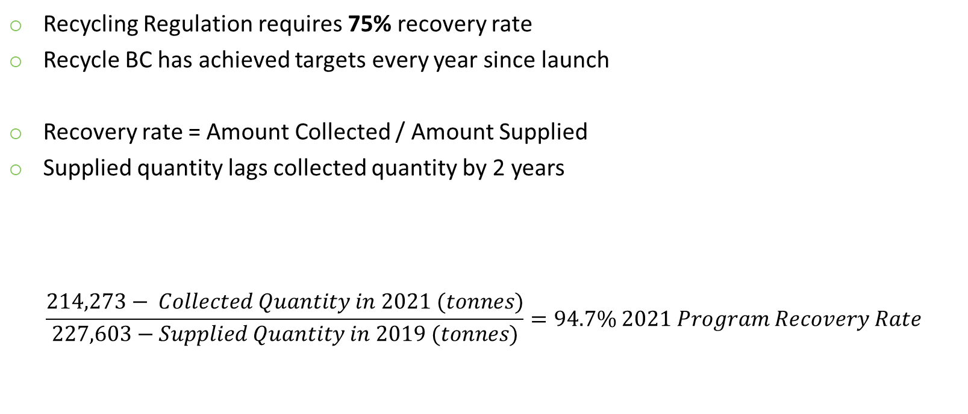
PROGRAM RECOVERY RATE
Recycling Regulation requires 75% recovery rate
Recycle BC has achieved targets every year since launch
Recovery rate = Amount Collected / Amount Supplied
Supplied quantity lags collected quantity by 2 years
$$\frac{214,273− Collected Quantity in 2021 (tonnes)}{227,603−Supplied Quantity in 2019 (tonnes)}=94.7\% 2021 Program Recovery Rate$$

Slide 18
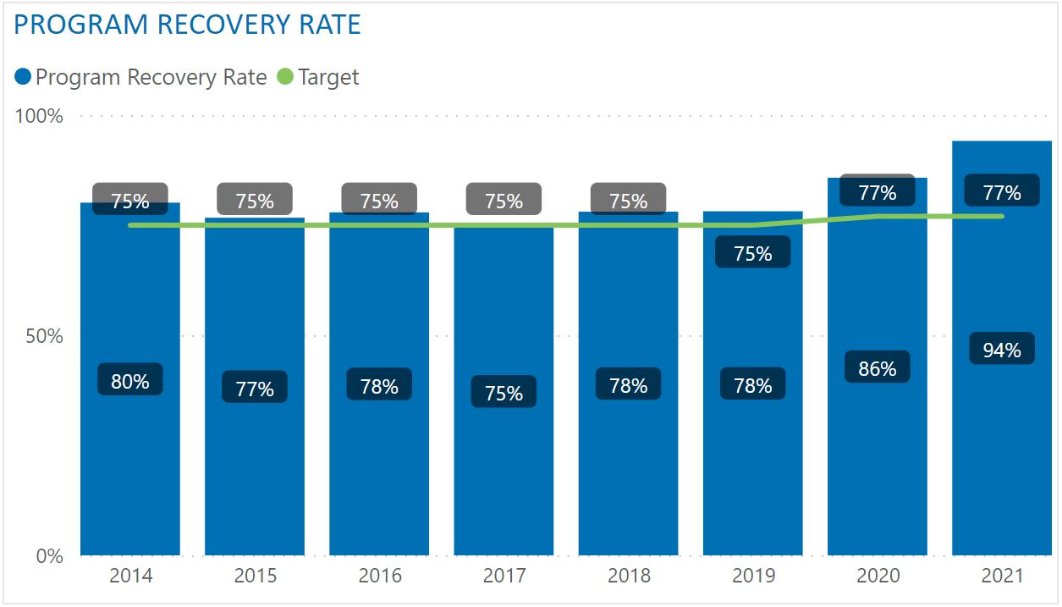
PROGRAM RECOVERY RATE – TO DATE

Slide 19
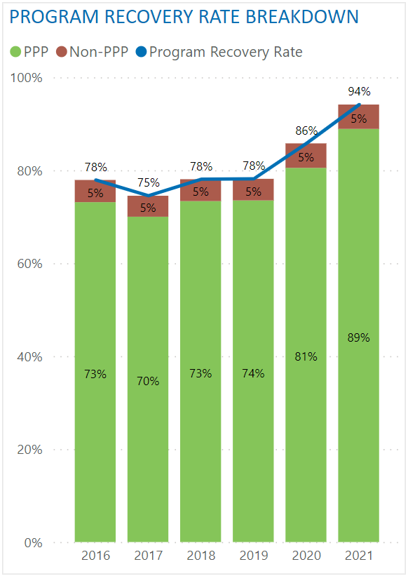
PROGRAM RECOVERY RATE – NON-PPP
Collected quantity is net of non-PPP
Non-PPP: material that is not packaging and paper product that has been incorrectly placed in recycling
Examples: food waste, construction waste, plastic products, electronics, hazardous waste
Removing non-PPP equates to a reduction of ~5% in recovery rate
Recycle BC proposes to net out non-PPP moving forward:
Better reflects recovery of Recycle BC material
Ensure contamination reduction does not negatively impact recovery rate
Better alignment with material performance targets

Slide 20
PROGRAM RECOVERY RATE – TARGETS
Historic targets (non-PPP included):
2018 | 2019 | 2020 | 2021 | 2022
75% | 75% | 75% | 77% | 77%
Proposed targets:
2023 | 2024 | 2025 | 2026 | 2027
78% | 79% | 79% | 80% | 80%
Equivalent targets if non-PPP was not removed:
2023 | 2024 | 2025 | 2026 | 2027
83% | 84% | 84% | 85% | 85%

Slide 21
MATERIAL CATEGORY PERFORMANCE TARGETS
Recycle BC began reporting material performance in 2017
Material Category |  | 2017 | 2018 | 2019 | 2020 | 2021 | 2022
Paper | Recovery Rate | 87% | 86% | 83% | 90% | 101%
 | Target | n/a | 90% by 2022
Plastic | Recovery Rate | 41% | 42% | 46% | 52% | 55%
 | Target | n/a | 50% by 2025 |  |  | 58% by 2025
Rigid Plastic | Recovery Rate | 50% | 54% | 56% | 64% | 67%
 | Target | n/a | 55% by 2022 |  |  | 73% by 2023
Flexible Plastic | Recovery Rate | 20% | 19% | 22% | 24% | 28%
 | Target | n/a | 22% by 2022 |  |  | 27% by 2023
Metal | Recovery Rate | 66% | 67% | 73% | 85% | 83%
 | Target | n/a | 67% by 2020 |  | 81% by 2022
Glass | Recovery Rate | 72% | 78% | 87% | 97% | 116%
 | Target | n/a | 75% by 2020 |  | 98% by 2022
 |  | Legend: | Target Achieved

Slide 22
MATERIAL CATEGORY PERFORMANCE TARGETS - NEW
Annual Report (AR) Year | 2023 | 2024 | 2025 | 2026 | 2027
Collection / Supply Year | 2021 | 2022 | 2023 | 2024 | 2025
Paper Target | 95% by 2025 Annual Report |  |  | 96% by 2027 Annual Report
Plastic Target | 55% by 2025 Annual Report |  |  | 56% by 2027 Annual Report
Rigid Plastic Target | 71% by 2025 Annual Report |  |  | 72% by 2027 Annual Report
Flexible Plastic Target | 24% by 2025 Annual Report |  |  | 25% by 2027 Annual Report
Metal Target | 88% by 2025 Annual Report |  |  | 89% by 2027 Annual Report
Glass Target | 98% by 2027 Annual Report
Once a material category performance target has been achieved for two consecutive years, the target will be adjusted using previously described methodology

Slide 23
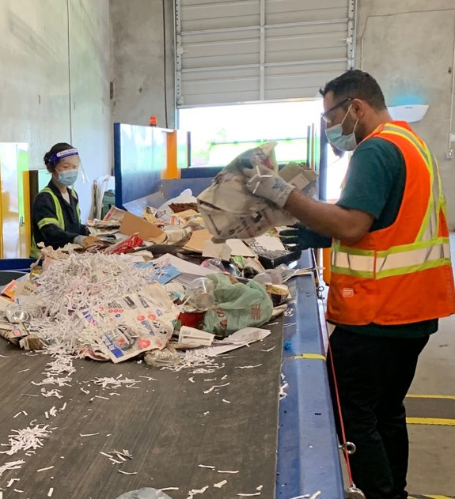
PROGRAM PLAN CONSULTATION
Stakeholder consultation October to December 2022
Additional virtual consultation sessions:
Recycle BC producer members
Producer associations
Recycle BC collectors and municipalities
First Nations
Regional Districts
Environmental groups
Written feedback accepted until Dec 31, 2022
consultation@recyclebc.ca

Slide 24
Questions & discussions

