Slide 1
BC Product stewardship council
Draft Program Plan Consultation
November 3, 2022

Slide 2

Background & Context

Slide 3
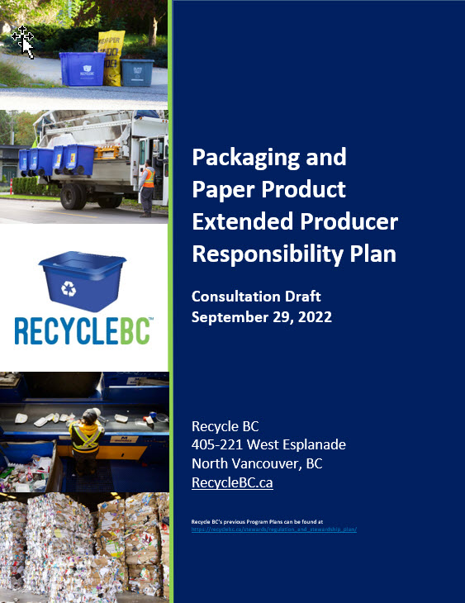
PROGRAM PLAN
Plan outlines objectives, commitments and targets
Operational roadmap
5-year period and renewal cycle
Evergreen format
Timelines
  Sept 30, 2022: plan posted
  Oct-Dec 2022: consultation period
  April 2023: plan submission to MOECCS

Slide 4
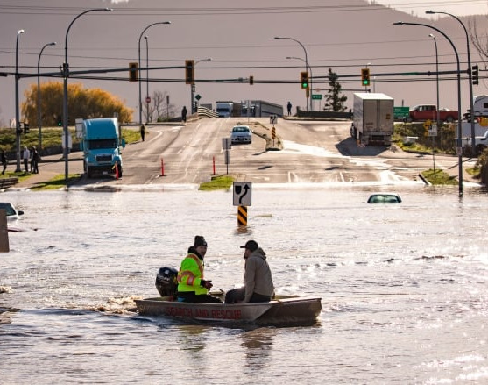
PLAN CONTEXT
8 years of operational success and full compliance
Upcoming launch of comparable provincial programs
Recent challenges:
  COVID-19 & supply chain disruptions
  Labour and transportation challenges
  Extreme weather events
  Public distrust
  Inflation
Opportunities for:
  Advancement and innovation
  Building program resiliency
  Driving the circular economy

Slide 5
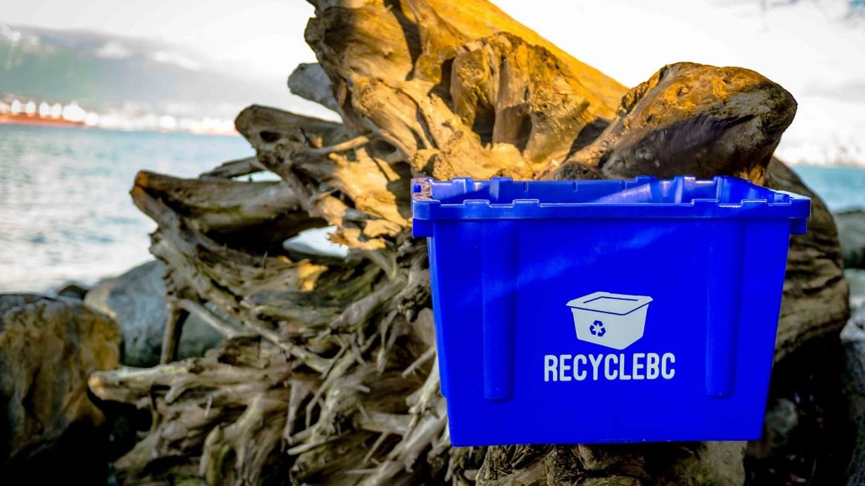
EPR AGENCY
BC Recycling Regulation, amendments, guidance docs
Recycle BC administers plan on behalf of producer members
Program financing:
  Member fees based on weight of PPP supplied
Materials covered:
  Packaging
  Paper product
  Single-use products – Jan 2023
  Packaging-like products – Jan 2023

Slide 6
Collection SYSTEM

Slide 7
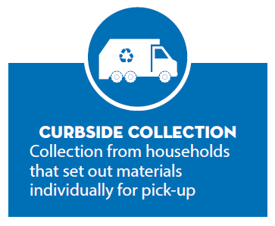
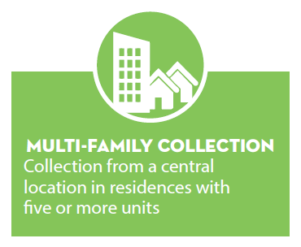
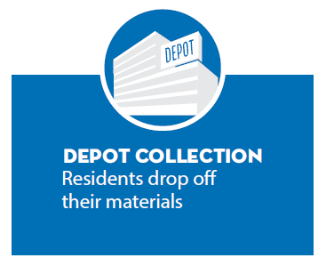
COLLECTION STREAMS

Slide 8
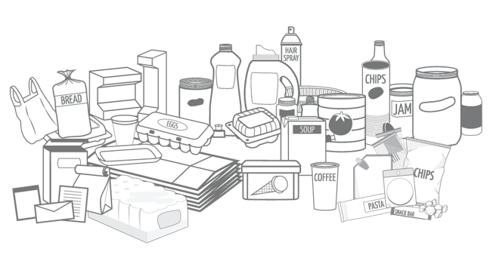
ACCEPTED MATERIALS
Compatible materials with viable end markets
List is expansive and harmonized
Not accepted PPP:
  Composition audits
  Research & analysis – barriers, best practices
  Engage with processors and end markets
  Pilots
Compostable PPP
  If significant and feasible – report annually and develop financial incentives
Upcoming changes:
  One category – soft plastics/flexible plastics
  Squishy foam

Slide 9
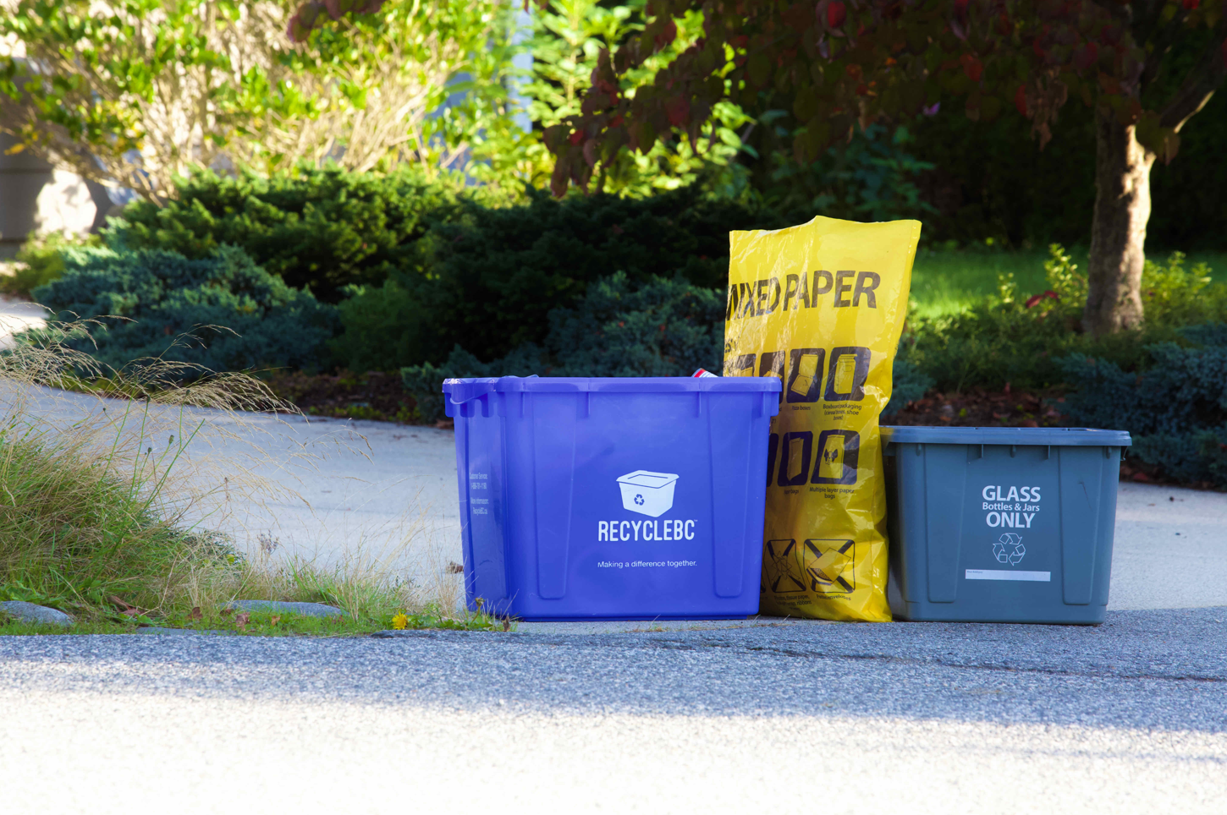
CURBSIDE ELIGIBILITY CRITERIA
All programs established by 2014
New municipal programs:
  5,000 residents and garbage program
Equivalent unincorporated areas:
  5,000 residents and garbage program
  Density of 0.42 HH/hectare
  Max 20 km between service area sections
Adjacent areas:
  Max 4,999 residents and garbage program
  Density of 0.42 HH/hectare
  Max 5 km between service area and adjacent area
  Service area collector willing to expand

Slide 10
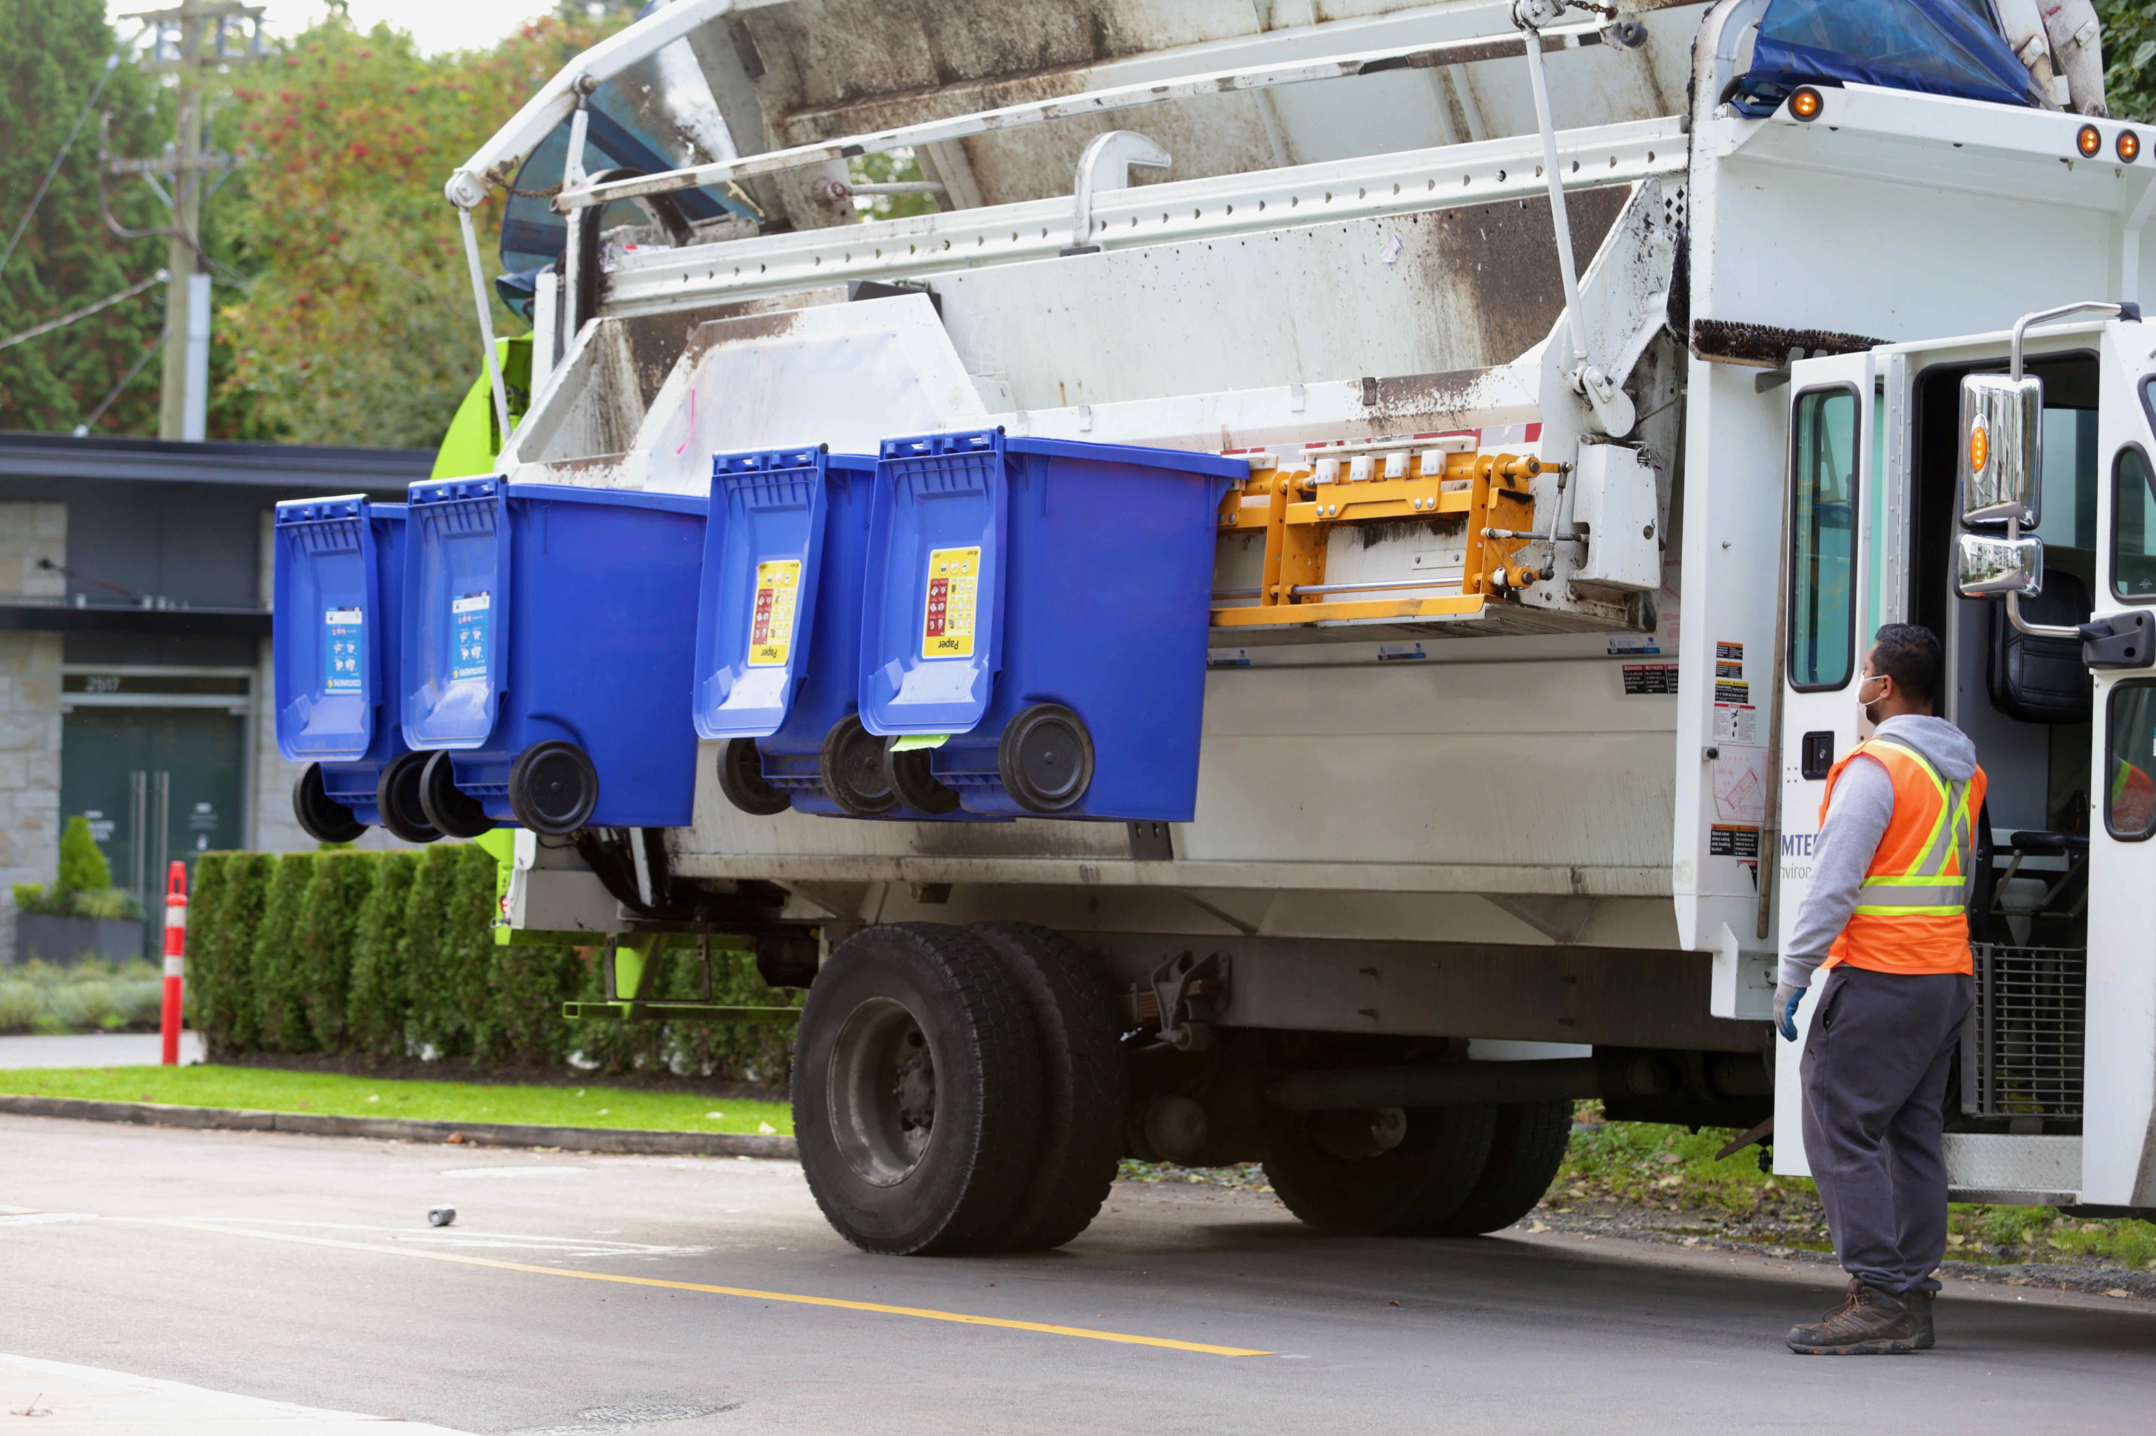
MULTI-FAMILY ELIGIBILITY CRITERIA
Local governments and First Nations operating curbside:
  Eligible to expand to multi-family
Private companies:
  Service areas identified for active recruitment
Annual process:
  Review multi-family participation against targets
  Extend offers as needed in areas requiring increased participation

Slide 11
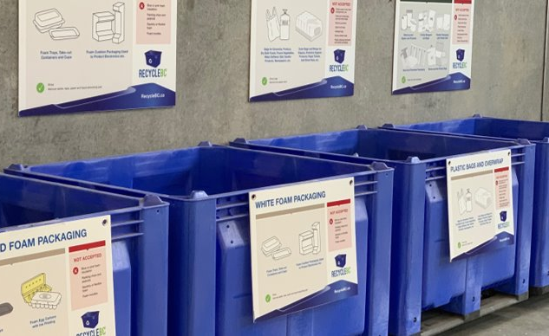
INTEGRATED RECYCLE BC COLLECTION SERVICES (ICS)
Focus on flexibility to meet changing demands and ensure reasonable levels of service
ICS: Service or combination of services that provide regular opportunities to collect all PPP categories:
  All categories accepted at curbside
  Depots, retail locations or mobile depots to augment curbside/MF collection
  All categories accepted at depots, retail locations or mobile depots
Methods may differ by community size, contractor availability, etc.
Goal is to provide service in all eligible communities and recruit as necessary annually

Slide 12
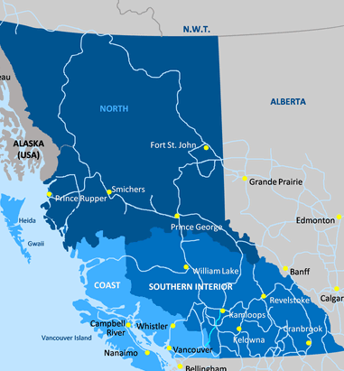
ICS ELIGIBILITY CRITERIA
Plan includes detailed criteria to outline communities eligible for Integrated Collection Services (ICS)
Eligibility criteria focuses on:
  Community population
  Distance to depot and larger service center
  Availability of garbage and grocery services
  Meaningful contribution to collection volumes
  Convenience without duplication of transportation
Depots are currently the primary ICS method
Recycle BC will honour existing agreements in communities that do not meet eligibility criteria
Satellite depots

Slide 13
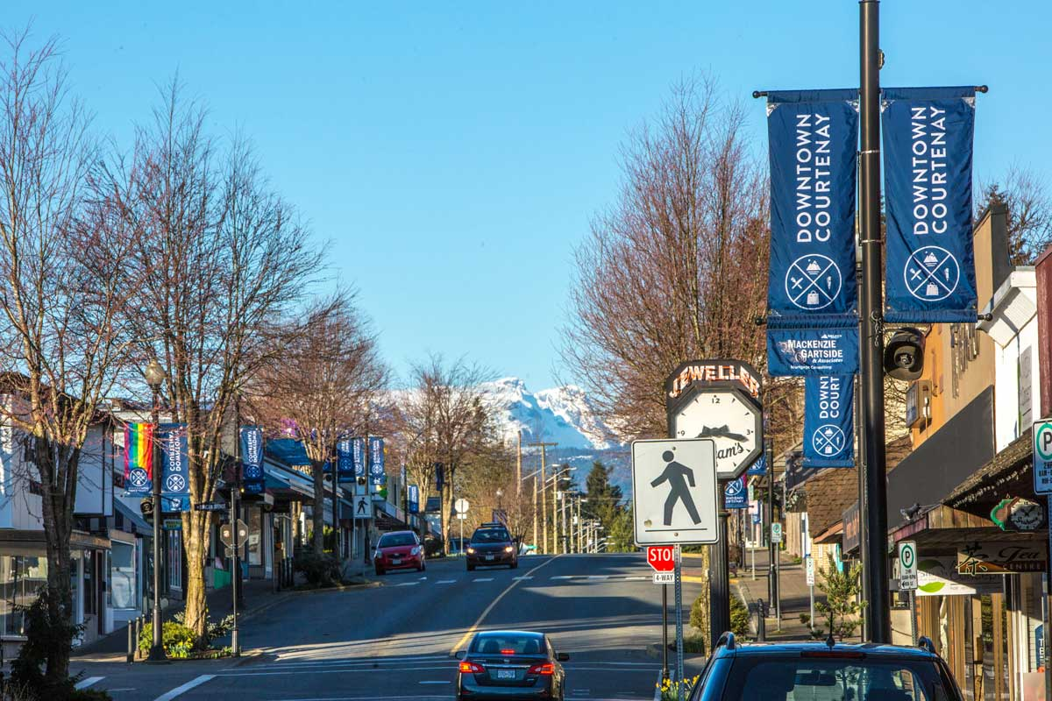
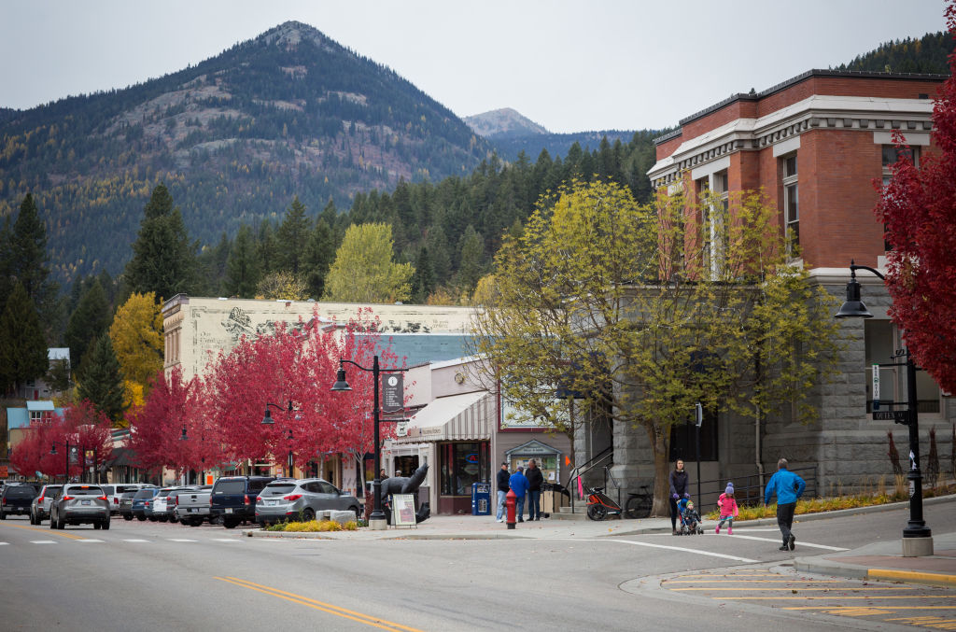
ICS ELIGIBILITY: MUNICIPALITIES
Municipalities with >50,000 population:
  Local organization able and willing to meet all requirements
Municipalities with > 10,000 population:
  Local organization able and willing to meet all requirements
  Minimum population of 10,000 and maximum population of 49,999 residents
  More than 5 km from Recycle BC depot in a larger municipality
Municipalities with >2,000 population:
  Local organization able and willing to meet all requirements
  Minimum population of 2,000 and maximum population of 9,999 residents
  More than 15 km from a municipality with 10,000 residents
  More than 15 km from Recycle BC depot

Slide 14

ICS ELIGIBILITY: SMALL & ISLAND COMMUNITIES
Small communities:
  Local organization able and willing to meet all requirements
  Minimum population of 1,000 residents within 30-minute service catchment
  Garbage service and year-round grocery store available
  More than 40 km from a municipality with 10,000 residents
  More than 40 km from Recycle BC depot
Island communities:
  Local organization able and willing to meet all requirements
  Minimum population of 1,000 residents
  Garbage service and year-round grocery store available

Slide 15


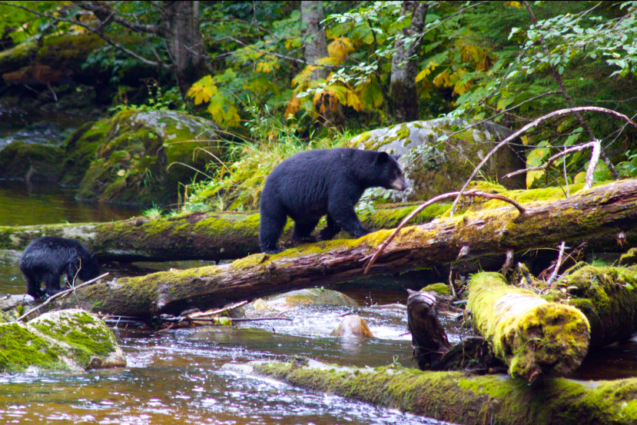

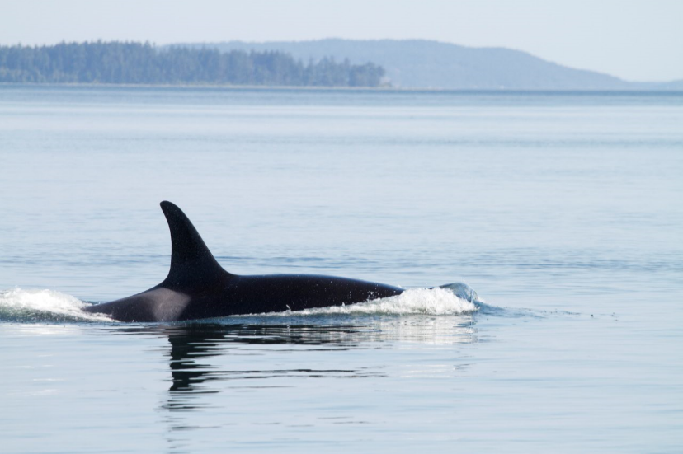
FIRST NATIONS COLLECTION
Recycle BC engagement and annual expansion:
  Engage directly with First Nation collectors and through local government service areas
  Provide new offers to communities with recycling capacity
  Outreach with communities interested in establishing collection
  Expansion of existing service areas to First Nation communities
  Pilot initiatives such as bulk depot drop offs and mobile depots
First Nations Recycling Initiative:
  Founded in 2017, managed by Recycle BC
  Collaborative venture of 9 stewardship agencies
  Publishes recycling guide, visits First Nation communities to assess recycling activities, organizes community clean up events

Slide 16
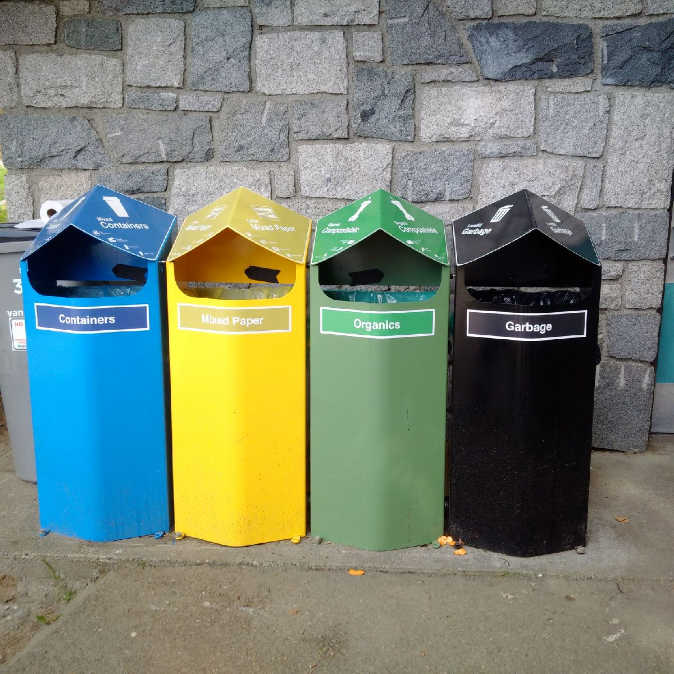
STREETSCAPE COLLECTION
Municipal property – sidewalks, plazas, town squares and parks
Eligible municipalities:
  Urban commercial areas that generated high levels of PPP
  >20,000 population
  >200 people per square km
Multiple pilots and audits completed
Significant challenges include:
  Poor sorting
  Extremely high contamination
  Liquids and food waste
  Difficulty finding end markets
  High GHG intensity for poor environmental outcomes

Slide 17
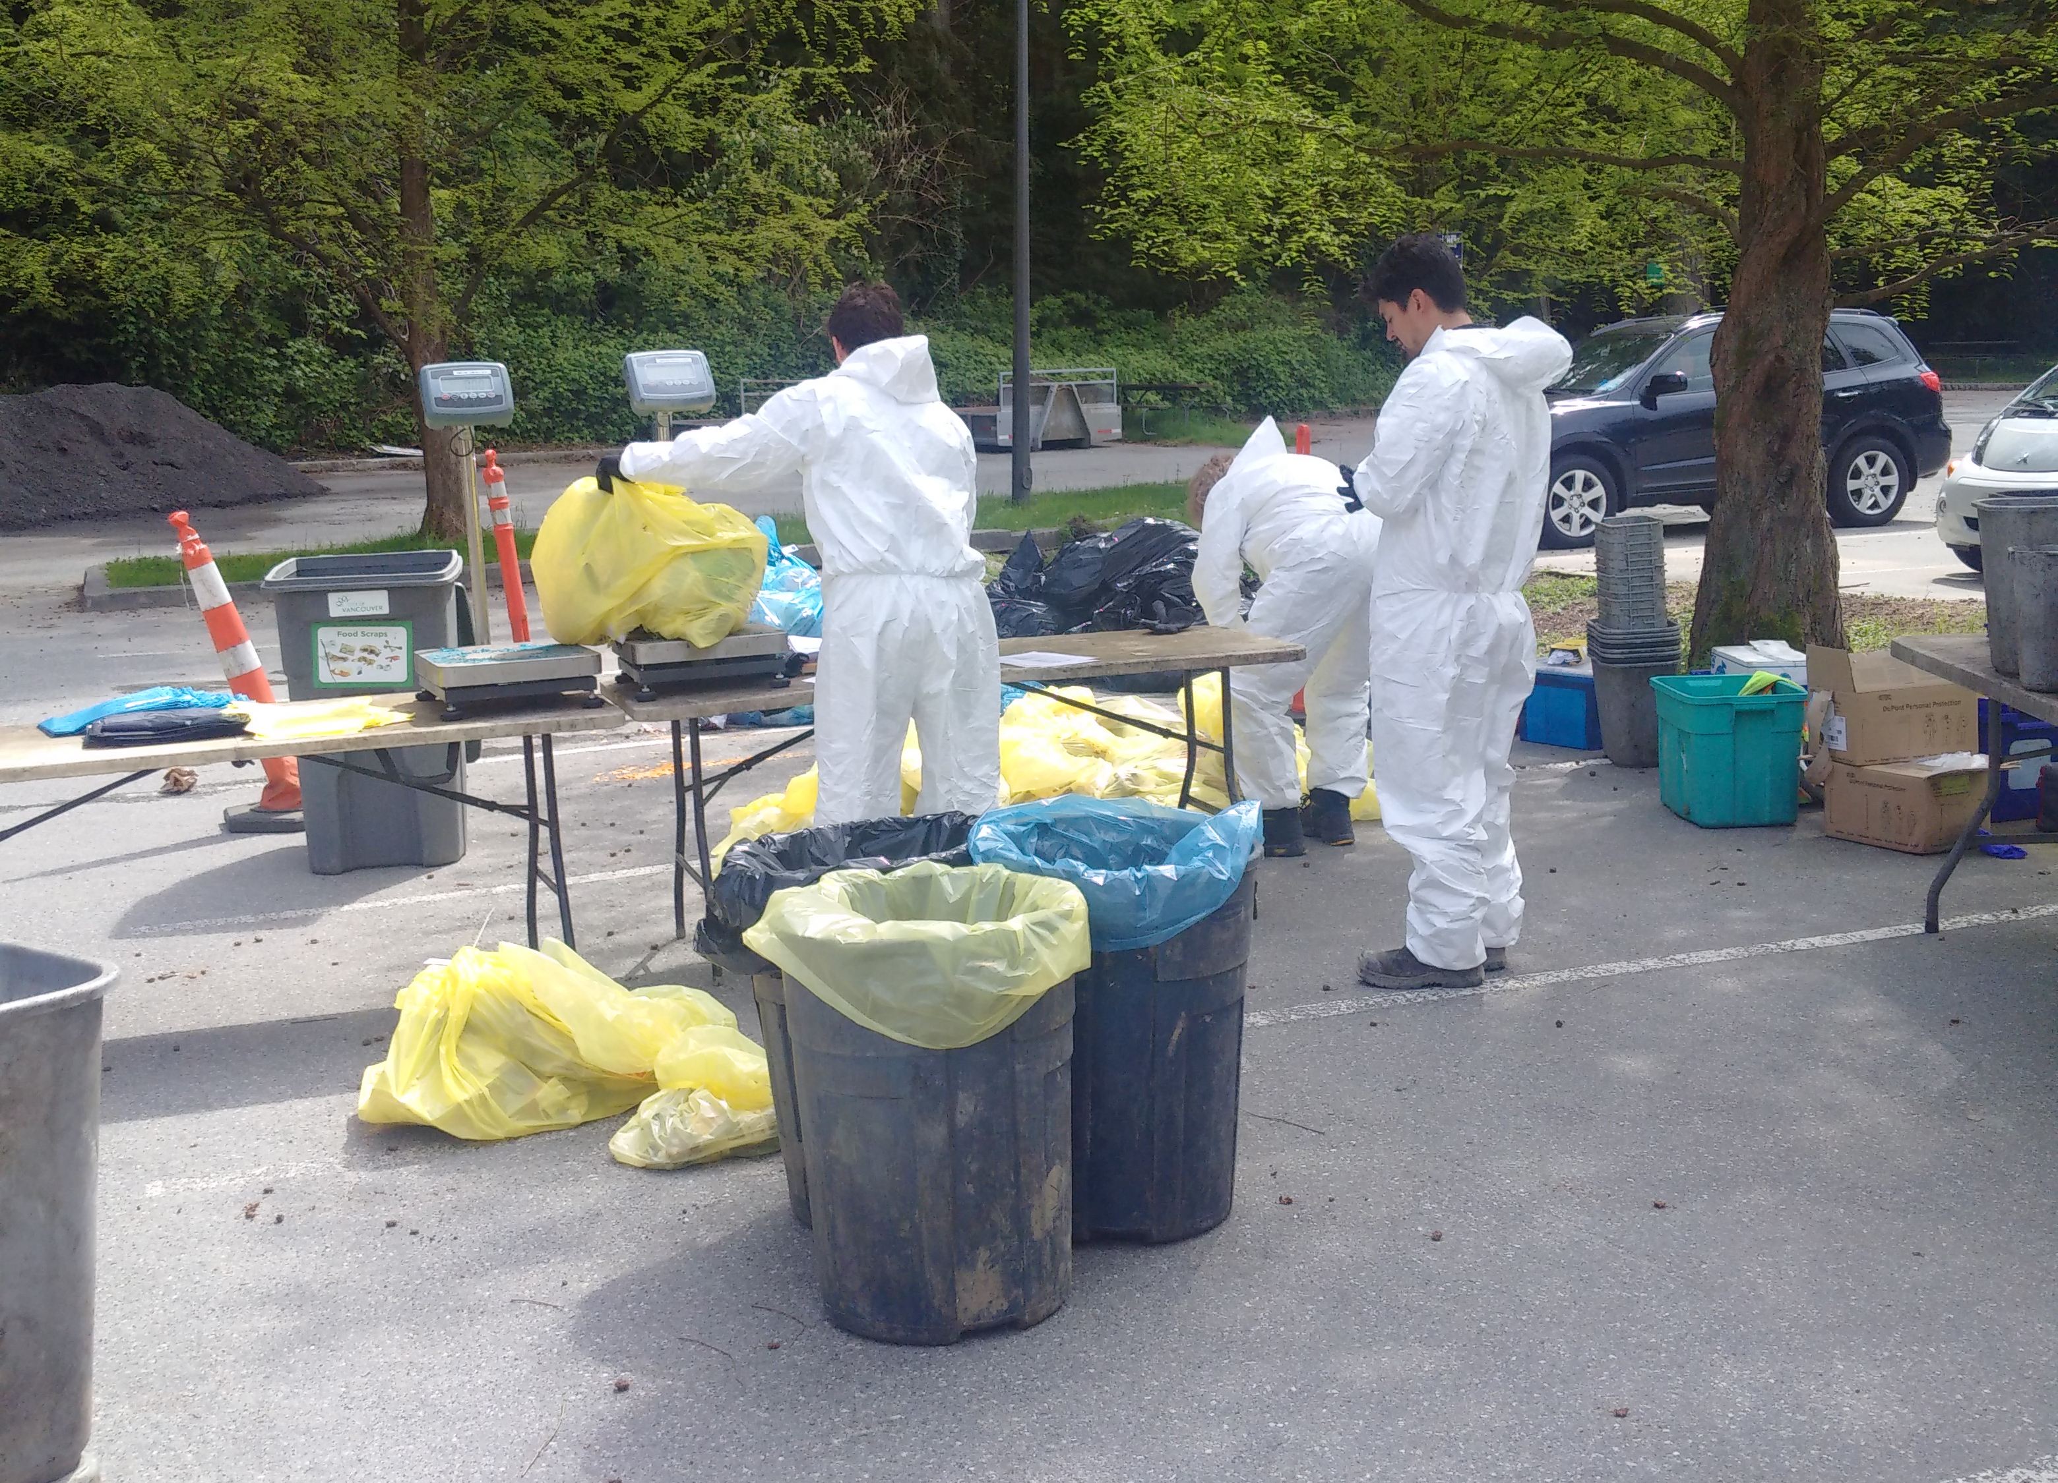
STREETSCAPE – NEXT STEPS
By Q4 2022 Recycle BC will establish:
  Baseline contamination standard
  Minimum recycling rate for end-of-life management
  Practical audit methodology
Q1 2023:
  Test audit methodology in community with single-use product bans and reasonable contamination rate
Q3 2023:
  Prepare revised service and funding commitments
  Stakeholder consultation
  Eligible municipalities can request offer to join
2024-2028 – Onboarding as applicable

Slide 18
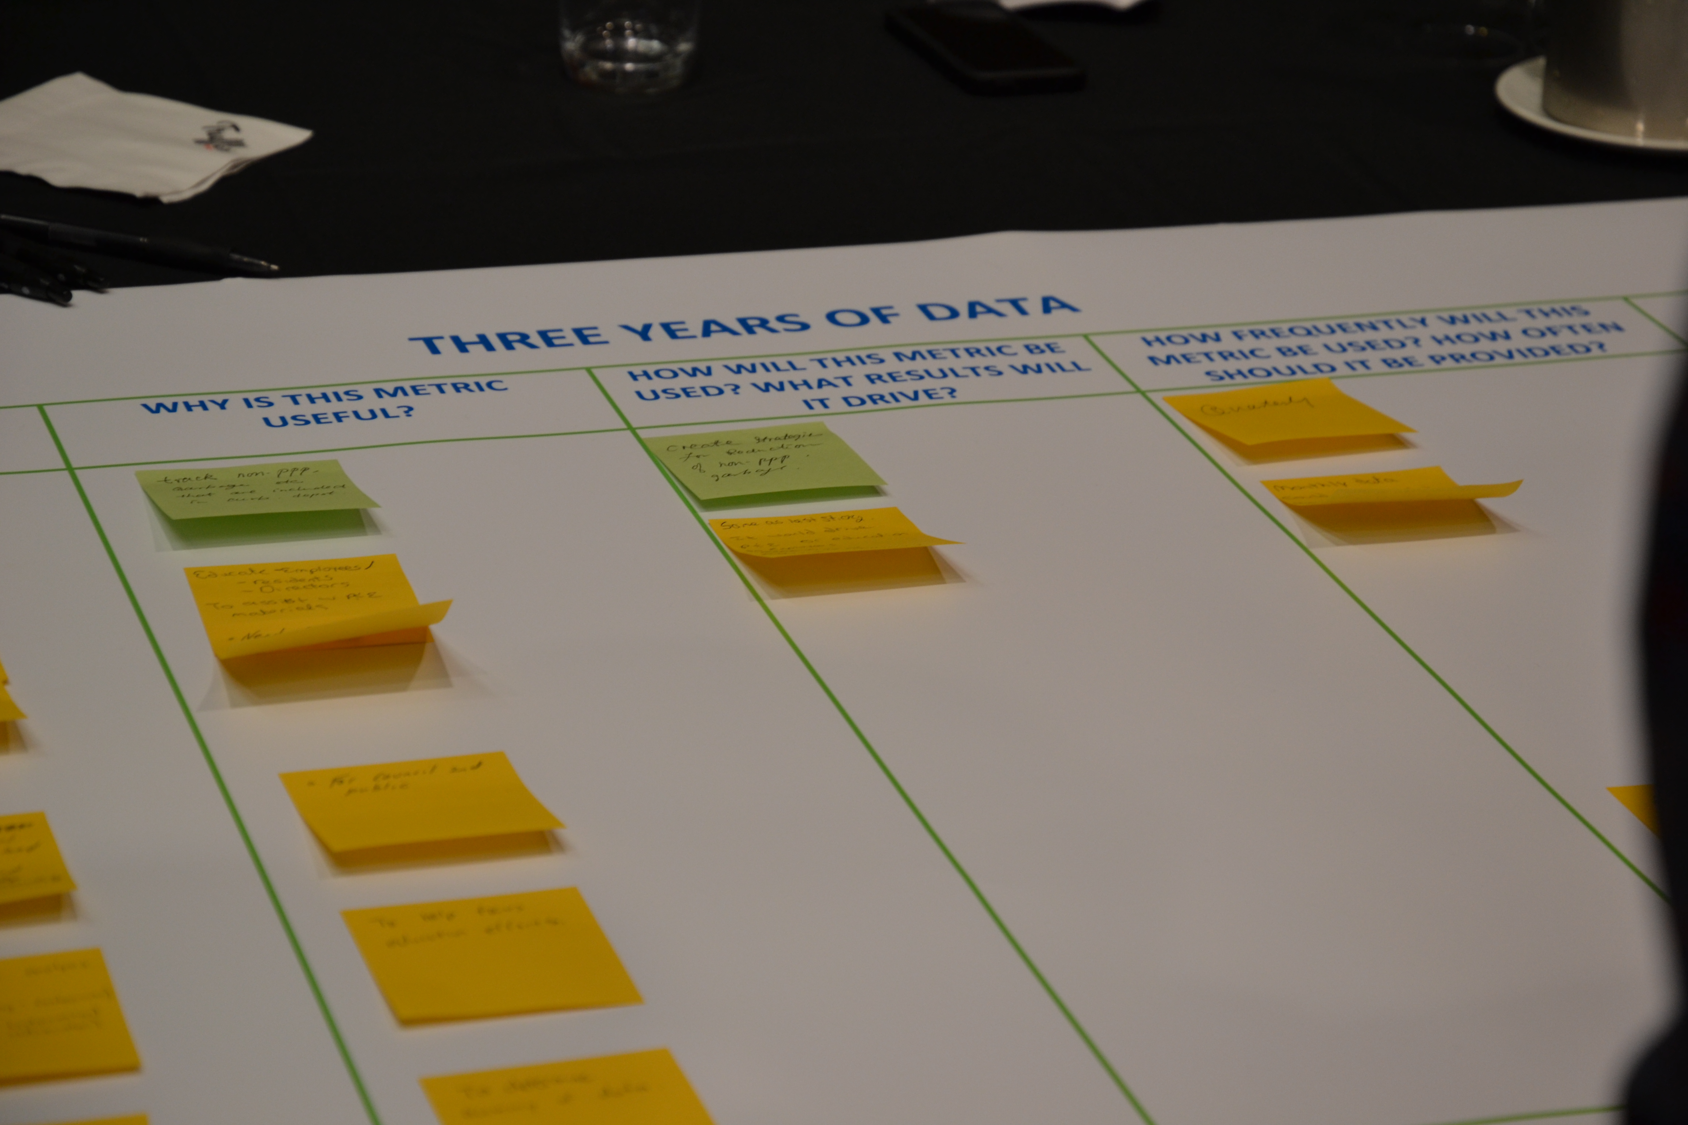
FINANCIAL INCENTIVE PROCESS
Recycle BC offers financial incentives to collectors to incentivize participation to ensure targets met
Curbside and Multi-Family: $ per household (plus $/tonne glass)
Depot: $ per tonne
At end of each agreement term:
  Collection cost study and analyses to determine adjustments
  Propose updated incentive rates/structure for consultation
  Conduct consultation with stakeholders
  Review feedback, prepare new agreements/incentive offers
  Distribute new agreement terms
  Collectors determine whether wish to renew agreement according to new terms

Slide 19
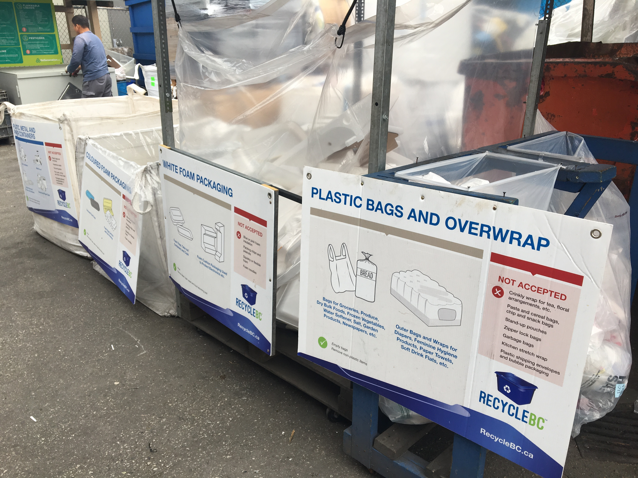
COST STUDY PROCESS
Completed in advance of new service agreements
Compares current costs to historic 5-year cost
Collectors provide data to independent third-party accountant
Overseen by Recycle BC Advisory Committee members
Objective: fair and reasonable incentive rates
Data includes:
  Curbside
  Multi-family
  Streetscape
  Promotion and education
  Service administration

Slide 20
COST STUDY INPUTS
Collection costs, including differences by:
  Collection channel and PPP categories
  Geography and density
  Collection attributes - # of streams, container types
  Collector type
  Unique drivers of cost – e.g. receiving facility location
Program data, including performance by channel
Operational metrics, including contamination
Impact of inflation
Proposed service requirement changes
Impact of existing incentive rates/structure on incentivizing best practices, efficiencies, high collection rates, GHG reductions
Not included – collection in communities that do not meet eligibility criteria

Slide 21
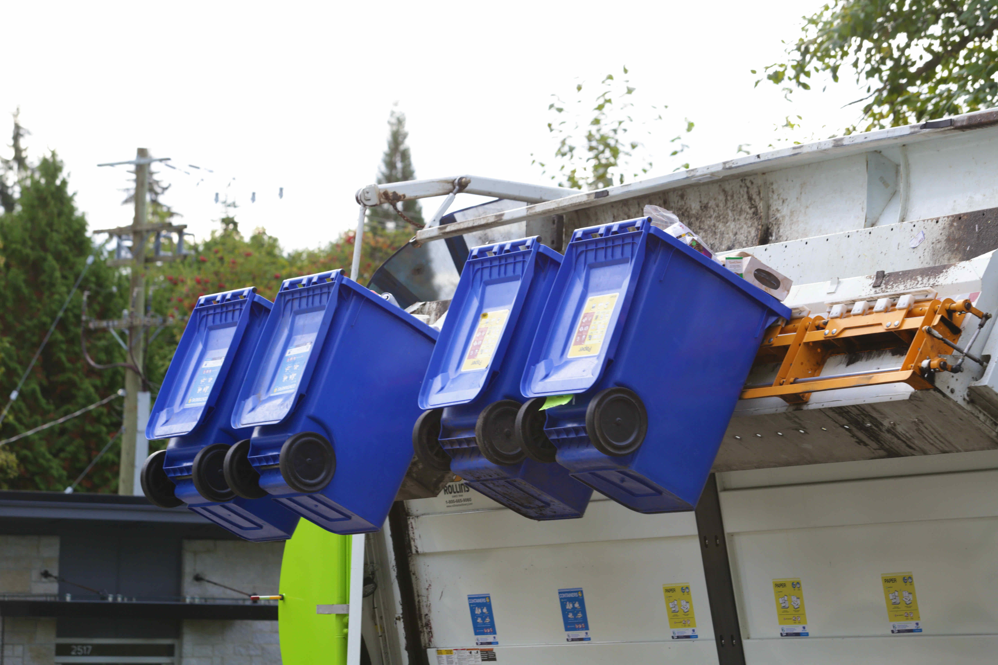
FINANCIAL INCENTIVES – TIMELINE
2020 – Last collection cost study
Jan 1, 2022 – Updated depot rates
July 1, 2022 – Updated curbside and multi-family rates
2024 – Next collection cost study
Jan 1, 2025 – New service agreements and incentive rates

Slide 22
communications

Slide 23
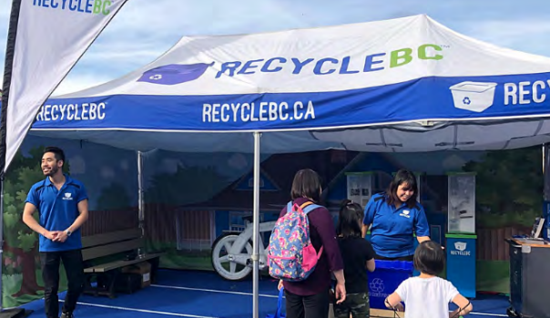
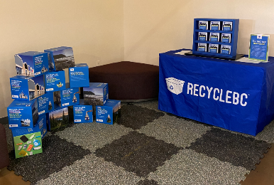
PROMOTION AND EDUCATION
Recycle BC’s objectives:
  Increase awareness of program’s features and benefits
  Encourage informed decisions on collection of PPP
Employed strategies:
  Awareness campaigns
  Strategic partnerships
  Collector resources
  Resident communication
  Research
Strategies used to target areas of underperformance

Slide 24
Pollution prevention hierarchy

Slide 25
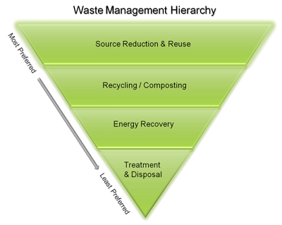
Pollution Prevention Hierarchy
Reducing environmental impacts:
  Initiatives undertaken by producers
  Weight based producer fees encourage reduction of PPP
Redesign:
  Initiatives undertaken by producers
  Cost allocation rewards easier to recycle materials
  Regular review of fee structure to ensure accurate info on cost impacts of materials to encourage redesign and adoption of best practices
    Canada Plastics Pact's Golden Design Rules

Slide 26
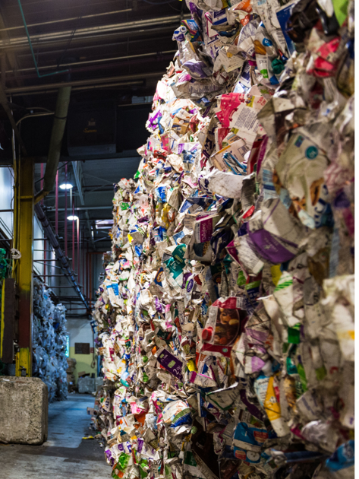
Pollution Prevention Hierarchy
Reuse:
  Initiatives undertaken by producers
  Cost allocation presumes materials enter marketplace once
  Actively engaged in exploring reuse opportunities
  Work with stakeholders to identify the value Recycle BC can bring to the reusable packaging market
Recycling:
  Payment structure and operations focus on ensuring collected PPP can meet end-market requirements
  Work with producers to improve PPP recyclability and increase recycled content

Slide 27
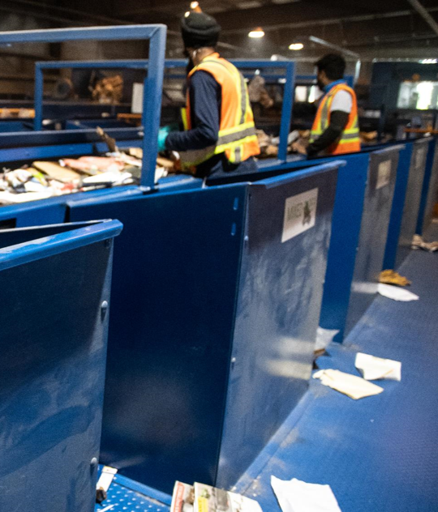
Pollution Prevention Hierarchy
Material Recovery:
  Post-collection partner is incentivised to further process system residues to meet recovery end-market requirements for engineered fuel products and minimize the amount of residue sent to landfill
  R&D to explore ways to recover material that is currently non-recyclable
Energy Recovery:
  Recycle BC does not send PPP to waste-to-energy facilities
Disposal:
  Non recoverable PPP is managed responsibly in regional landfills

Slide 28
Performance targets

Slide 29
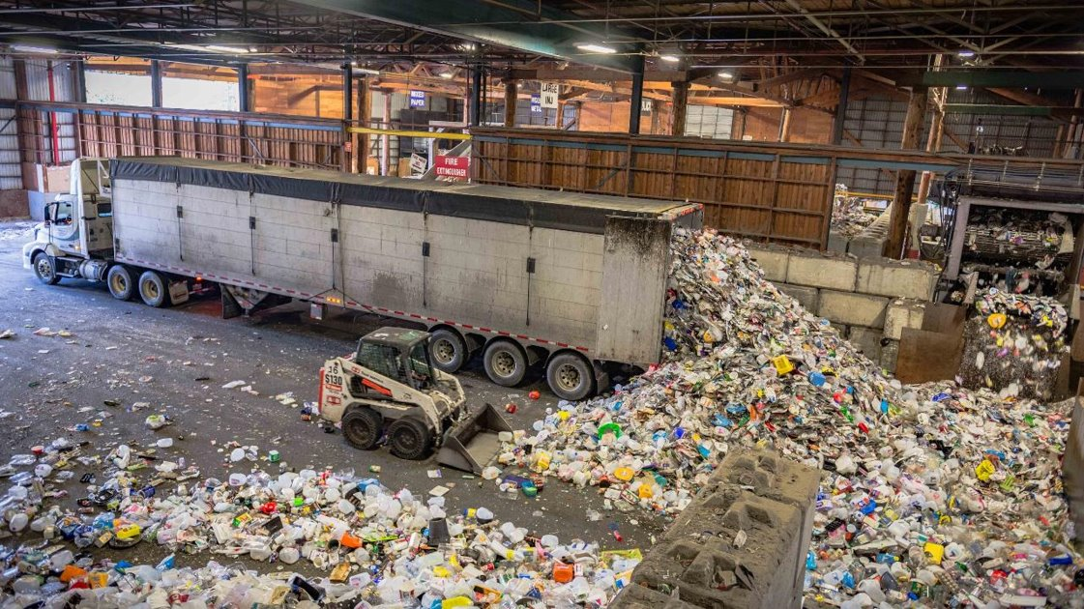
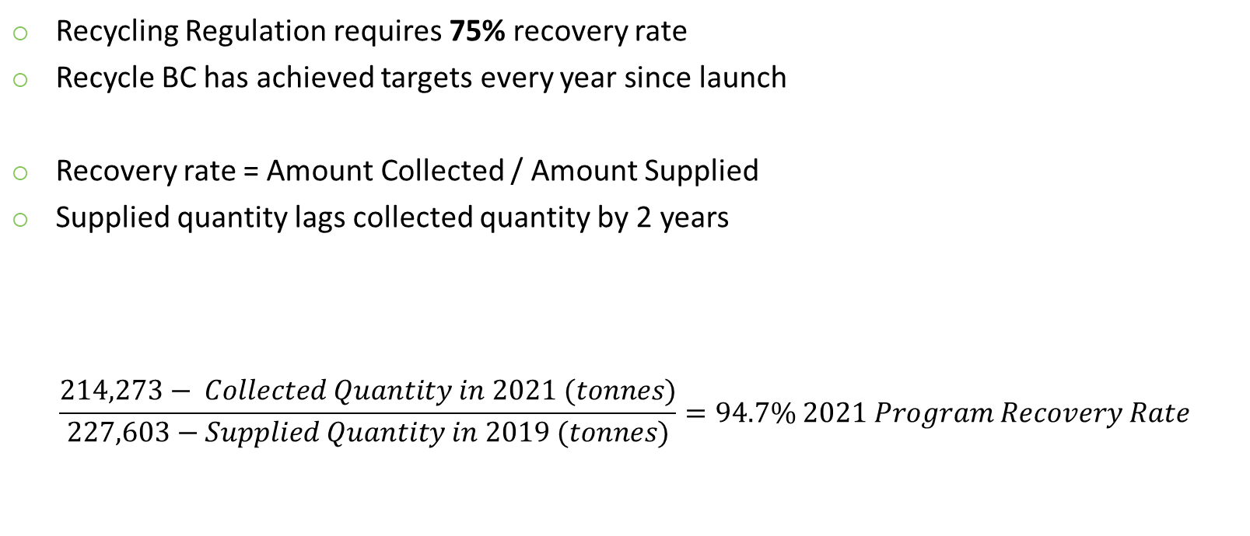
PROGRAM RECOVERY RATE
Recycling Regulation requires 75% recovery rate
Recycle BC has achieved targets every year since launch
Recovery rate = Amount Collected / Amount Supplied
Supplied quantity lags collected quantity by 2 years
$$\frac{214,273− Collected Quantity in 2021 (tonnes)}{227,603−Supplied Quantity in 2019 (tonnes)}=94.7\% 2021 Program Recovery Rate$$

Slide 30
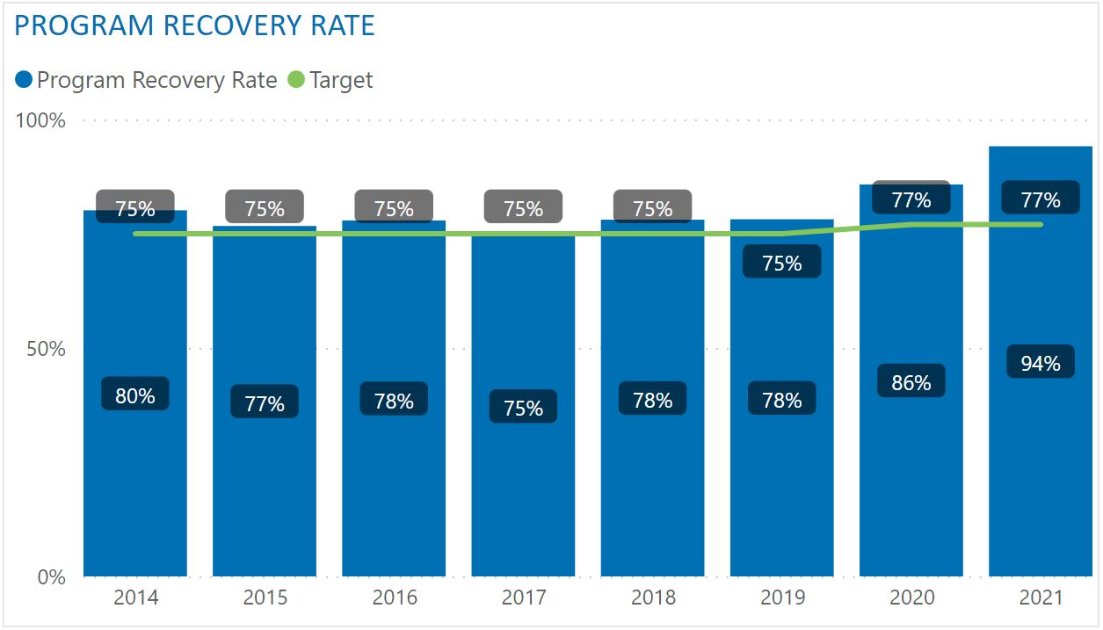
PROGRAM RECOVERY RATE – TO DATE

Slide 31
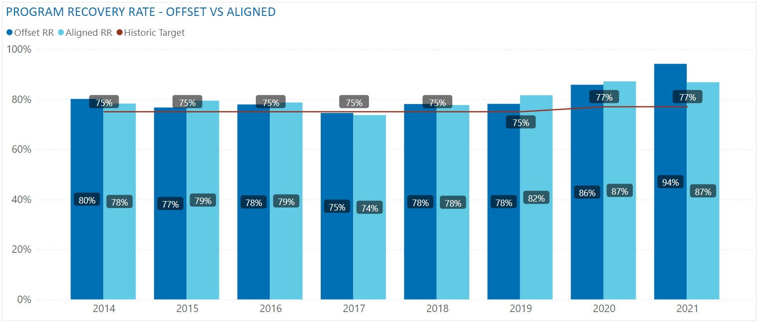
OFFSET RR VS ALIGNED RR
Two possible methodologies:
  Offset RR - Collected quantity year and the supplied quantity year are offset by two years, used historically
  Aligned RR - Collected quantity year is aligned with the supplied quantity year, reviewed but not recommended

Slide 32
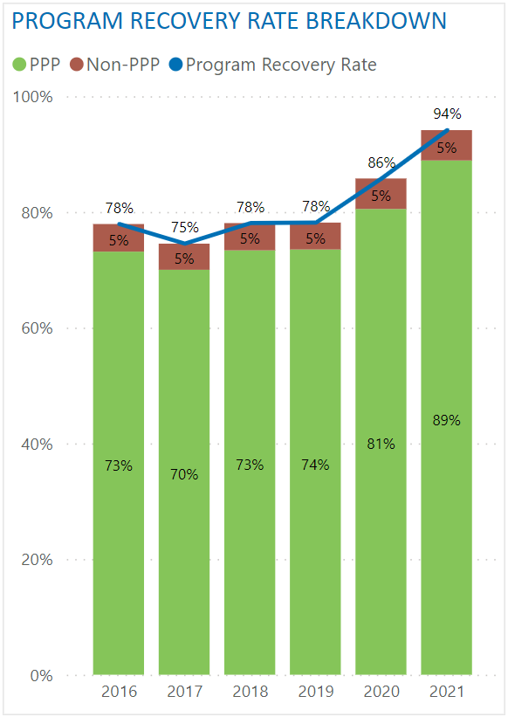
PROGRAM RECOVERY RATE – NON-PPP
Collected quantity is net of non-PPP
Non-PPP: material that is not packaging and paper product that has been incorrectly placed in recycling
Examples: food waste, construction waste, plastic products, electronics, hazardous waste
Removing non-PPP equates to a reduction of ~5% in recovery rate
Recycle BC proposes to net out non-PPP moving forward:
  Better reflects recovery of Recycle BC material
  Ensure contamination reduction does not negatively impact recovery rate
  Better alignment with material performance targets

Slide 33
PROGRAM RECOVERY RATE – TARGETS
Historic targets (non-PPP included):
2018 | 2019 | 2020 | 2021 | 2022
75% | 75% | 75% | 77% | 77%
Proposed targets:
2023 | 2024 | 2025 | 2026 | 2027
78% | 79% | 79% | 80% | 80%
Equivalent targets if non-PPP was not removed:
2023 | 2024 | 2025 | 2026 | 2027
83% | 84% | 84% | 85% | 85%

Slide 34
MATERIAL CATEGORY PERFORMANCE TARGETS
Recycle BC began reporting material performance in 2017
Material Category |  | 2017 | 2018 | 2019 | 2020 | 2021 | 2022
Paper | Recovery Rate | 87% | 86% | 83% | 90% | 101%
 | Target | n/a | 90% by 2022
Plastic | Recovery Rate | 41% | 42% | 46% | 52% | 55%
 | Target | n/a | 50% by 2025 |  |  | 58% by 2025
Rigid Plastic | Recovery Rate | 50% | 54% | 56% | 64% | 67%
 | Target | n/a | 55% by 2022 |  |  | 73% by 2023
Flexible Plastic | Recovery Rate | 20% | 19% | 22% | 24% | 28%
 | Target | n/a | 22% by 2022 |  |  | 27% by 2023
Metal | Recovery Rate | 66% | 67% | 73% | 85% | 83%
 | Target | n/a | 67% by 2020 |  | 81% by 2022
Glass | Recovery Rate | 72% | 78% | 87% | 97% | 116%
 | Target | n/a | 75% by 2020 |  | 98% by 2022
 |  | Legend: | Target Achieved

Slide 35
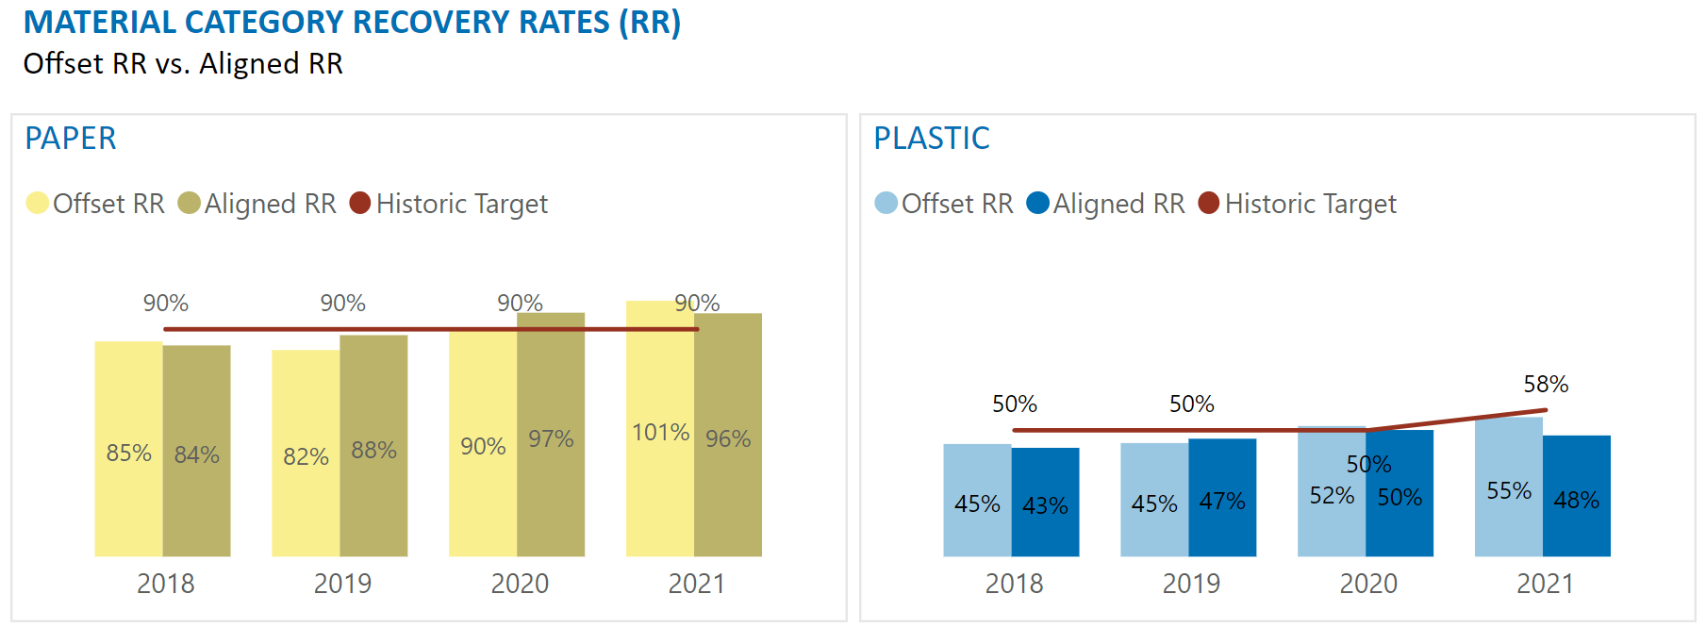
OFFSET RR VS ALIGNED RR
Two possible methodologies:
  Offset RR - Collected quantity year and the supplied quantity year are offset by two years, used historically
  Aligned RR - Collected quantity year is aligned with the supplied quantity year, proposal moving forward

Slide 36
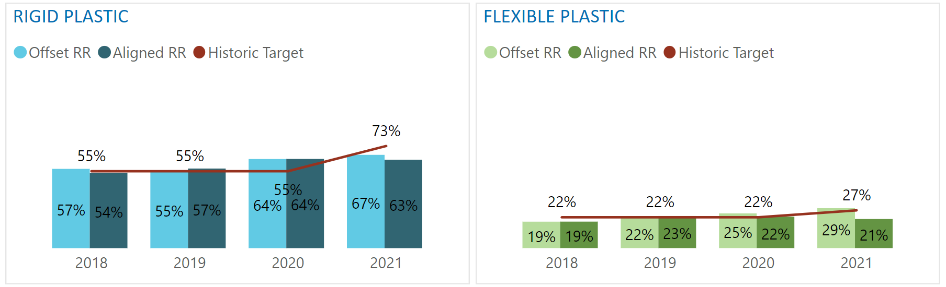
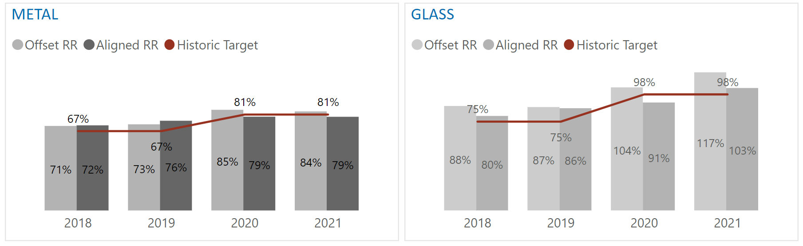
OFFSET RR VS ALIGNED RR
Aligning years allows same year-to-year comparison
Numbers in annual report will only be available for two years looking back
Example:
  2022 annual report
  Published in 2023
  Material recovery rates for 2020: 2020 collected quantity and 2020 supplied quantity

Slide 37
MATERIAL CATEGORY PERFORMANCE METHODOLOGY
Variable | Definition | Short Form
Latest Material Specific Collected Quantity | Amount of collected quantity (tonnes) in the specific material category in the latest available full collection year. | Latest Collected Qty
Material-Specific Collection Growth | Material-specific growth in collection over the last three calendar years | Collection Growth
Program Collection Growth | Estimated growth in gross collection over three years (including the year of proposal) | Program Growth
Latest Material Specific Supplied Quantity | Amount of supplied material (tonnes) in the specific material category in the latest available full supply year. | Latest Supplied Qty
Material-Specific Supplied Growth | Material-specific growth in producer member supplied quantities based on the sales data pertaining to the latest available three fiscal years. | Supplied Growth
$$\frac{Latest Collected Qty x \left(1+Collection Growth\right) x \left(1+Program Growth\right)}{Latest Supplied Qty x \left(1+Supplied Growth\right)}$$

Slide 38
MATERIAL CATEGORY PERFORMANCE TARGETS - NEW
Annual Report (AR) Year | 2023 | 2024 | 2025 | 2026 | 2027
Collection / Supply Year | 2021 | 2022 | 2023 | 2024 | 2025
Paper Target | 95% by 2025 Annual Report |  |  | 96% by 2027 Annual Report
Plastic Target | 55% by 2025 Annual Report |  |  | 56% by 2027 Annual Report
Rigid Plastic Target | 71% by 2025 Annual Report |  |  | 72% by 2027 Annual Report
Flexible Plastic Target | 24% by 2025 Annual Report |  |  | 25% by 2027 Annual Report
Metal Target | 88% by 2025 Annual Report |  |  | 89% by 2027 Annual Report
Glass Target | 98% by 2027 Annual Report
Once a material category performance target has been achieved for two consecutive years, the target will be adjusted using previously described methodology

Slide 39
Question & Answer

Slide 40
Discussion

Slide 41
CONSULTATION

Slide 42
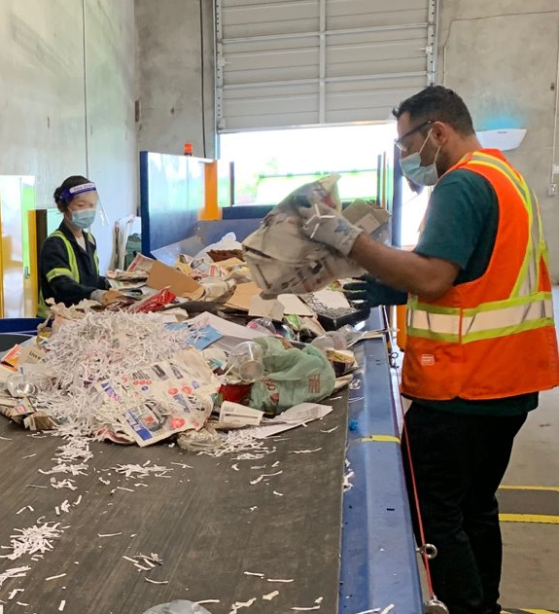
PROGRAM PLAN CONSULTATION
Stakeholder consultation October to December 2022
Additional virtual consultation sessions:
  Recycle BC producer members
  Producer associations
  Recycle BC collectors and municipalities
  First Nations
  Regional Districts
  Environmental groups
Written feedback accepted until Dec 31, 2022
  consultation@recyclebc.ca

