Slide 1
Environmental & community groups
Draft Program Plan Consultation
November 16, 2022

Slide 2

Background & Context

Slide 3
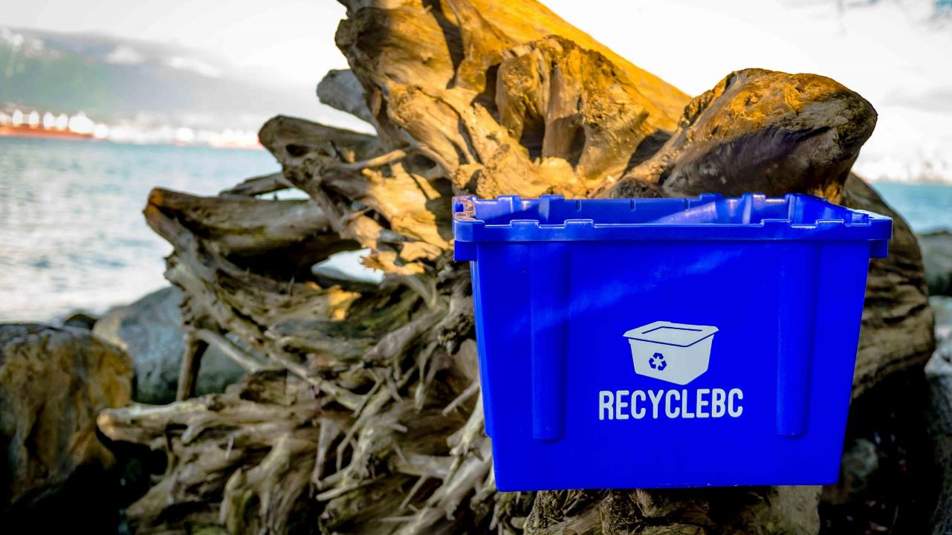

WHO WE ARE
Recycle BC is a not-for-profit organization responsible for residential packaging and paper recycling throughout British Columbia.
Recycle BC ensures household materials are collected, sorted and responsibly recycled.
Our program is funded by 1,200 businesses that include retailers, manufacturers and restaurants that supply packaging and paper products to BC residents, shifting costs away from homeowners.

Slide 4

EPR AGENCY
BC Recycling Regulation, amendments, guidance docs
Recycle BC administers plan on behalf of producer members
Program financing:
Member fees based on weight of PPP supplied
Materials covered:
Residential sources only
Packaging
Paper product
Single-use products – Jan 2023
Packaging-like products – Jan 2023

Slide 5
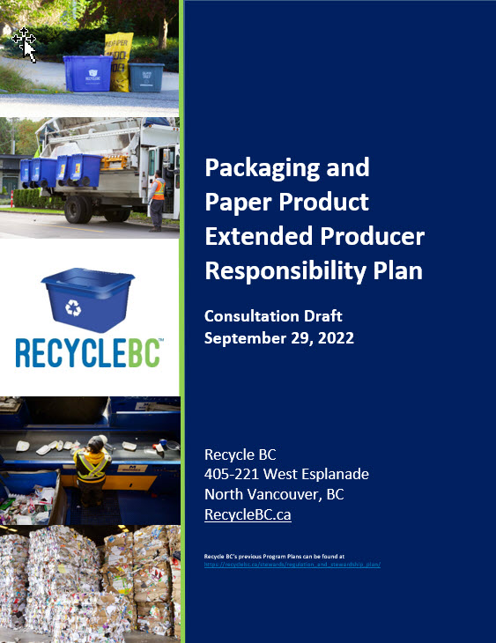
PROGRAM PLAN
Plan outlines objectives, commitments and targets
Operational roadmap
5-year period and renewal cycle
Evergreen format
Timelines
Sept 30, 2022: plan posted
Oct-Dec 2022: consultation period
April 2023: plan submission to MOECCS

Slide 6
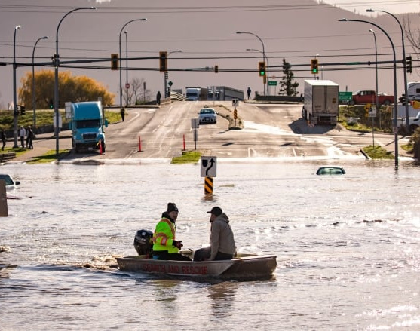
PLAN CONTEXT
8 years of operational success and full compliance
Upcoming launch of comparable provincial programs
Recent challenges:
COVID-19 & supply chain disruptions
Labour and transportation challenges
Extreme weather events
Public distrust
Inflation
Opportunities for:
Advancement and innovation
Building program resiliency
Driving the circular economy

Slide 7
Collection SYSTEM

Slide 8






PARTNERSHIPS
LOCAL
GOVERNMENT AND
FIRST NATIONS
WASTE
COMPANIES
DEPOTS
TRANSPORTERS
RECEIVING
FACILITIES
POST-COLLECTION
PARTNER
PRODUCERS

Slide 9
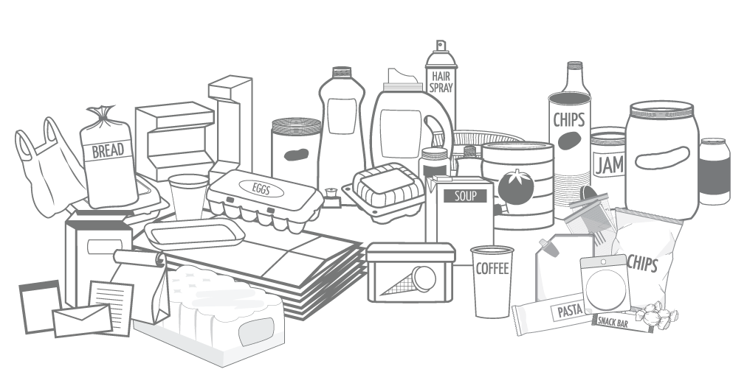
CONSISTENT MATERIAL LIST

Slide 10
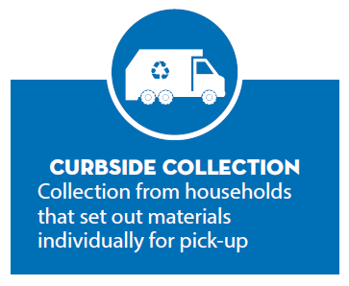
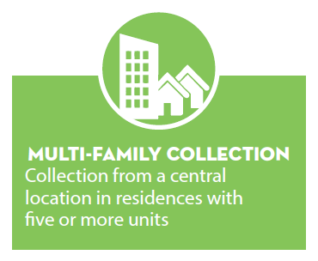
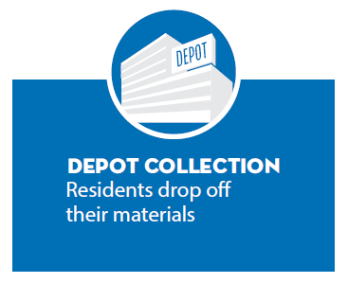
COLLECTION STREAMS

Slide 11
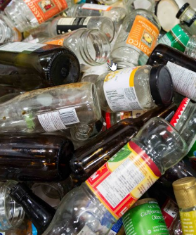
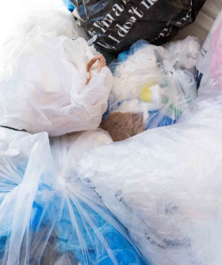
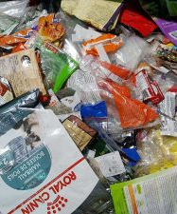
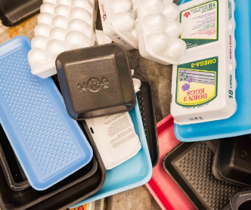
MATERIALS COLLECTED AT DEPOTS ONLY
Plastic Bags and Overwrap
Foam Packaging
Other Flexible Plastic Packaging
Glass
(in some communities)

Slide 12
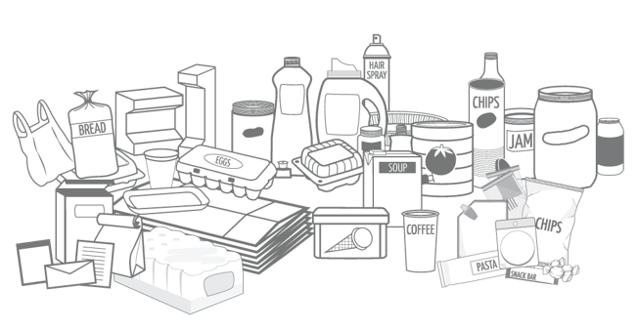
ACCEPTED MATERIALS
Compatible materials with viable end markets
List is expansive and harmonized
Not accepted PPP:
Composition audits
Research & analysis – barriers, best practices
Engage with processors and end markets
Pilots
Compostable PPP
Once OMRR finalized, determine amount of compostable PPP recovered
If significant and feasible – report annually and develop financial incentives

Slide 13
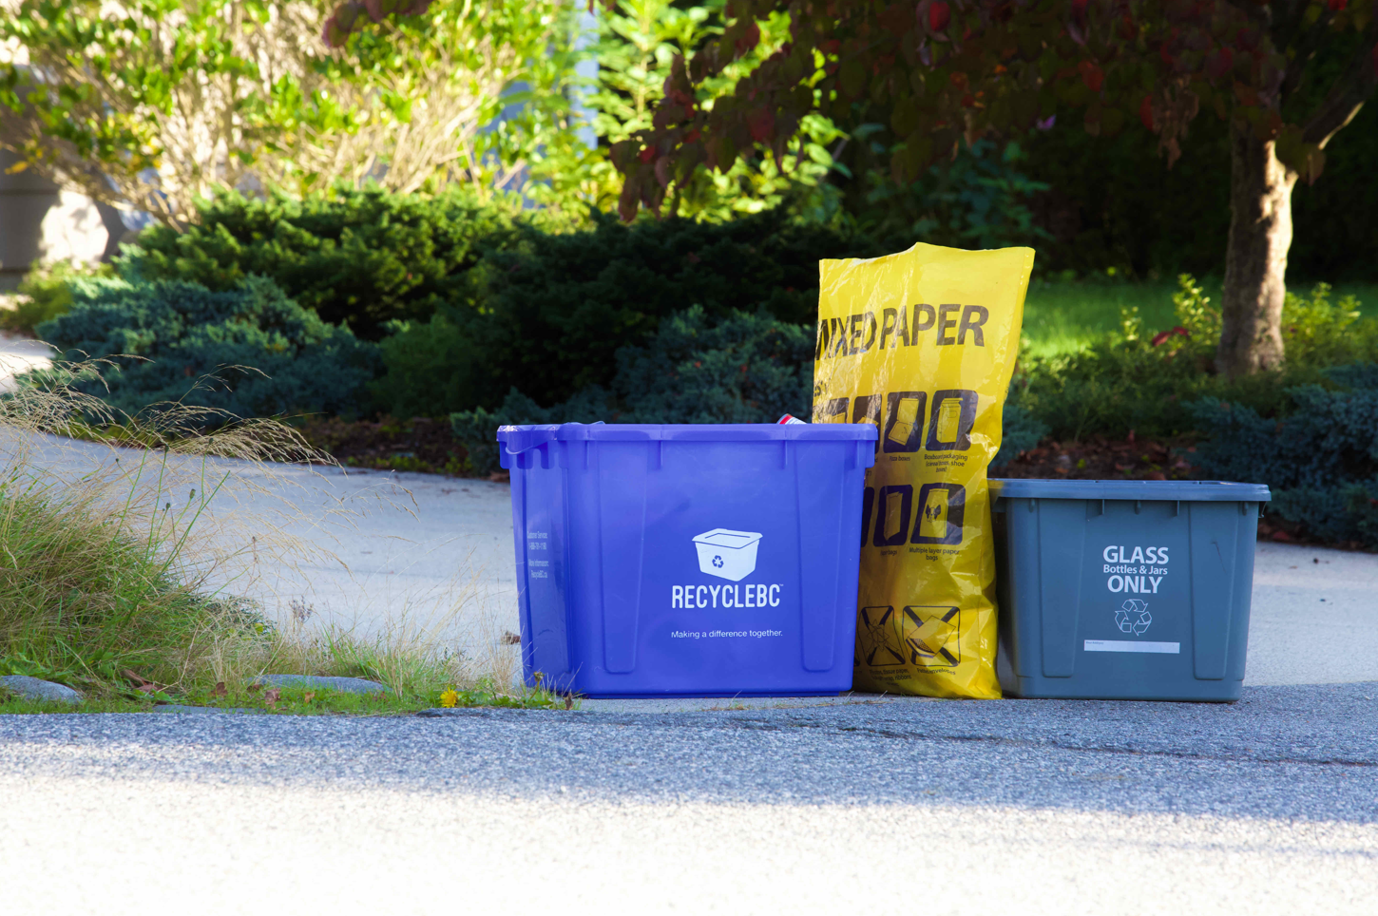
CURBSIDE ELIGIBILITY CRITERIA
All programs established by 2014
New municipal programs:
5,000 residents and garbage program
Equivalent unincorporated areas:
5,000 residents and garbage program
Density of 0.42 HH/hectare
Max 20 km between service area sections
Adjacent areas:
Max 4,999 residents and garbage program
Density of 0.42 HH/hectare
Max 5 km between service area and adjacent area
Service area collector willing to expand

Slide 14
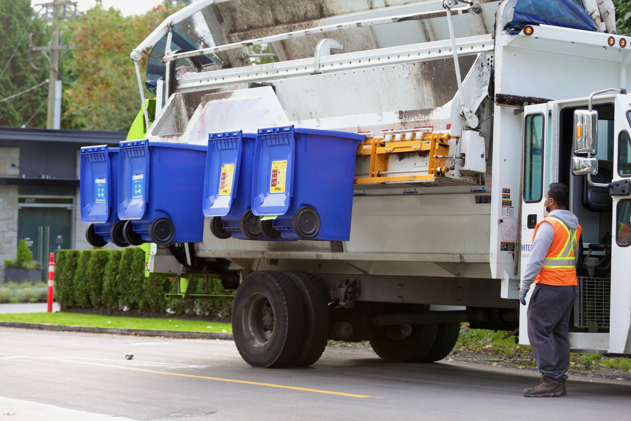
MULTI-FAMILY ELIGIBILITY CRITERIA
Local governments and First Nations operating curbside:
Eligible to expand to multi-family
Private companies:
Service areas identified for active recruitment
Annual process:
Review multi-family participation against targets
Extend offers as needed in areas requiring increased participation

Slide 15
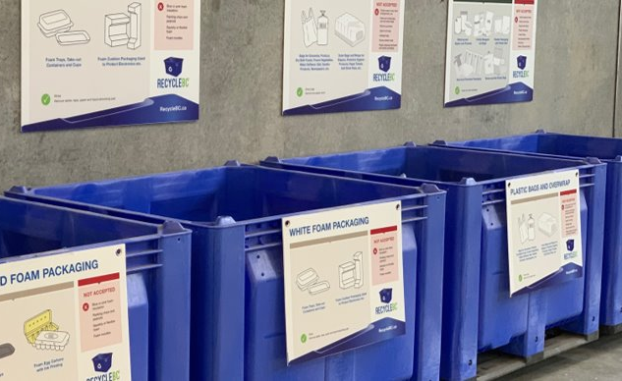
INTEGRATED RECYCLE BC COLLECTION SERVICES (ICS)
Focus on flexibility to meet changing demands and ensure reasonable levels of service
ICS: Service or combination of services that provide regular opportunities to collect all PPP categories:
All categories accepted at curbside
Depots, retail locations or mobile depots to augment curbside/MF collection
All categories accepted at depots, retail locations or mobile depots
Methods may differ by community size, contractor availability, etc.
Goal is to provide service in all eligible communities and recruit as necessary annually

Slide 16
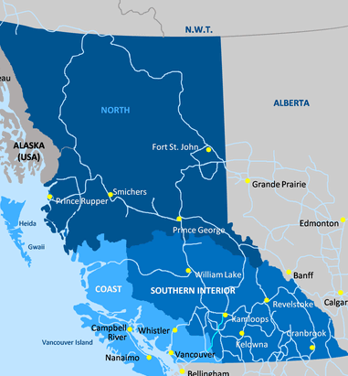
ICS ELIGIBILITY CRITERIA
Plan includes detailed criteria to outline communities eligible for Integrated Collection Services (ICS)
Eligibility criteria focuses on:
Community population
Distance to depot and larger service center
Availability of garbage and grocery services
Meaningful contribution to collection volumes
Convenience without duplication of transportation
Depots are currently the primary ICS method
Recycle BC will honour existing depot agreements in communities that do not meet eligibility criteria
Satellite depots

Slide 17




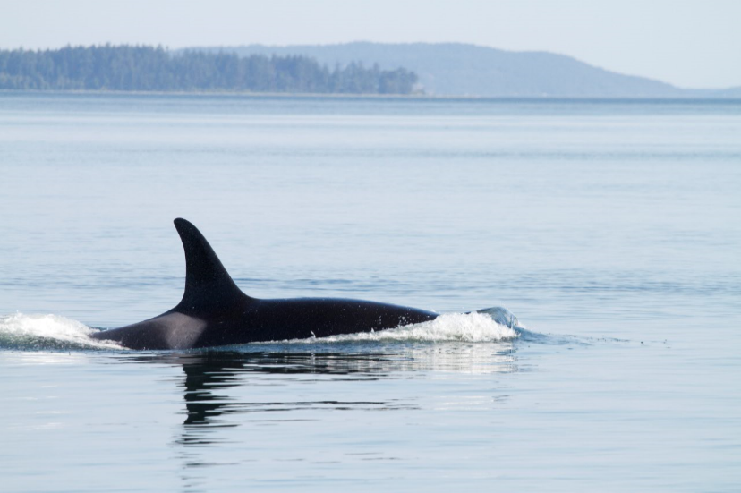
FIRST NATIONS COLLECTION
Recycle BC engagement and annual expansion:
Engage directly with First Nation collectors and through local government service areas
Provide new offers to communities with recycling capacity
Outreach with communities interested in establishing collection
Expansion of existing service areas to First Nation communities
Pilot initiatives such as bulk depot drop offs and mobile depots
First Nations Recycling Initiative:
Founded in 2017, managed by Recycle BC
Collaborative venture of 9 stewardship agencies
Publishes recycling guide, visits First Nation communities to assess recycling activities, organizes community clean up events

Slide 18
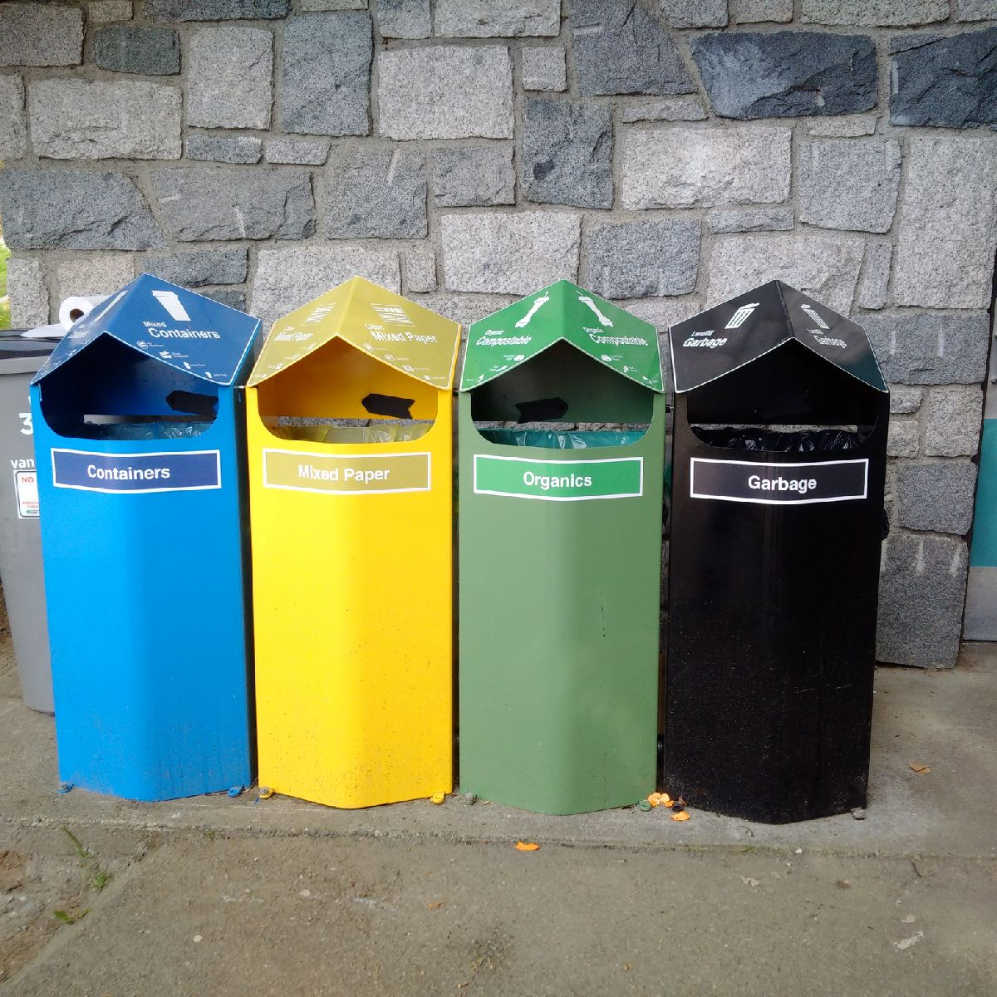
STREETSCAPE COLLECTION
Municipal property – sidewalks, plazas, town squares and parks
Eligible municipalities:
Urban commercial areas that generated high levels of PPP
>20,000 population
>200 people per square km
Multiple pilots and audits completed
Significant challenges include:
Poor sorting
Extremely high contamination
Liquids and food waste
Difficulty finding end markets
High GHG intensity for poor environmental outcomes

Slide 19
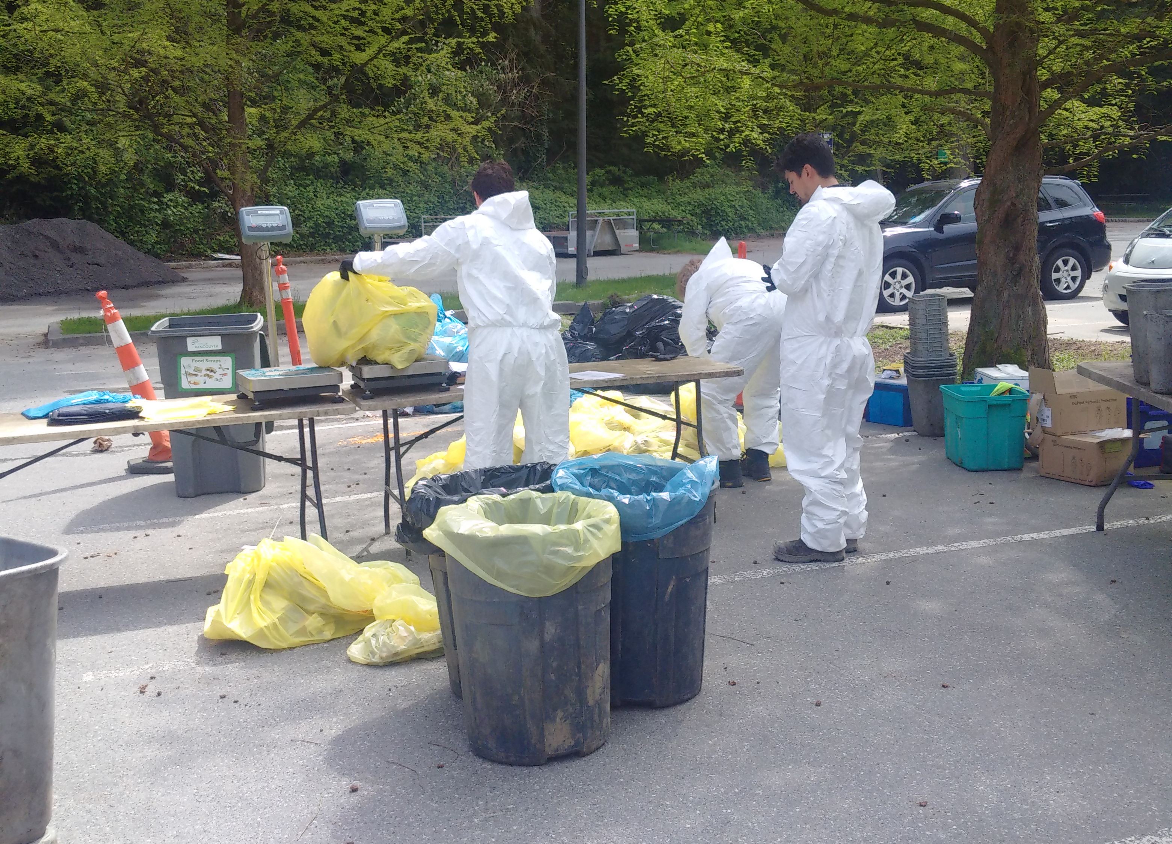
STREETSCAPE – NEXT STEPS
By Q4 2022 Recycle BC will establish:
Baseline contamination standard
Minimum recycling rate for end-of-life management
Practical audit methodology
Q1 2023:
Test audit methodology in community with single-use product bans and reasonable contamination rate
Q3 2023:
Prepare revised service and funding commitments
Stakeholder consultation
Eligible municipalities can request offer to join
2024-2028 – Onboarding as applicable

Slide 20
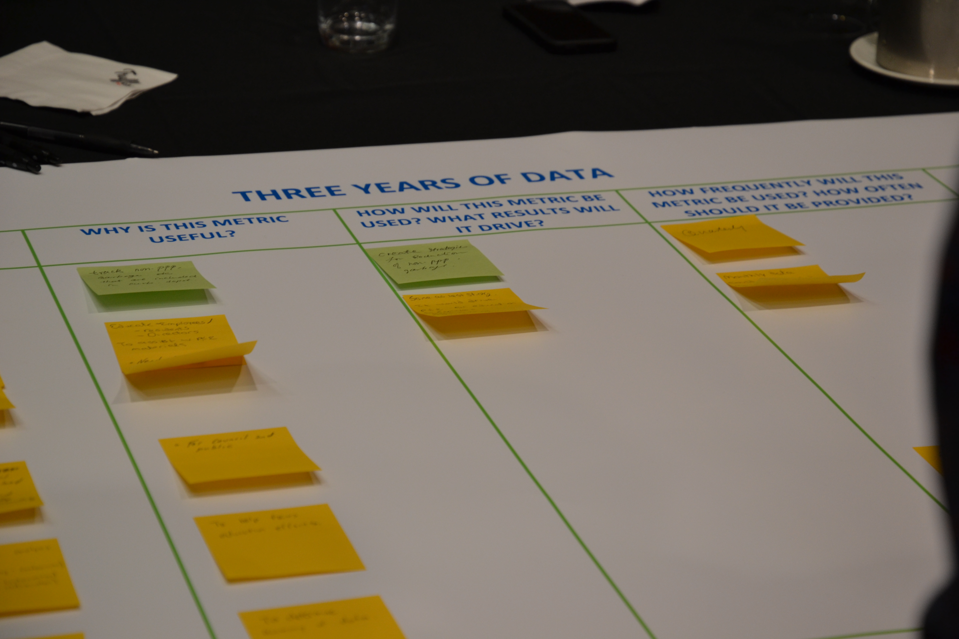
FINANCIAL INCENTIVE PROCESS
Recycle BC offers financial incentives to collectors to incentivize participation to ensure targets met
Curbside and Multi-Family: $ per household (plus $/tonne glass)
Depot: $ per tonne
At end of each agreement term:
Collection cost study and analyses to determine adjustments
Propose updated incentive rates/structure for consultation
Conduct consultation with stakeholders
Review feedback, prepare new agreements/incentive offers
Distribute new agreement terms
Collectors determine whether wish to renew agreement according to new terms

Slide 21
communications

Slide 22
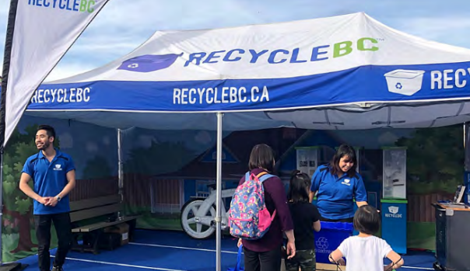
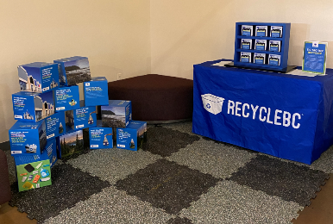
PROMOTION AND EDUCATION
Recycle BC’s objectives:
Increase awareness of program’s features and benefits
Encourage informed decisions on collection of PPP
Employed strategies:
Awareness campaigns
Strategic partnerships
Collector resources
Resident communication
Research
Strategies used to target areas of underperformance

Slide 23
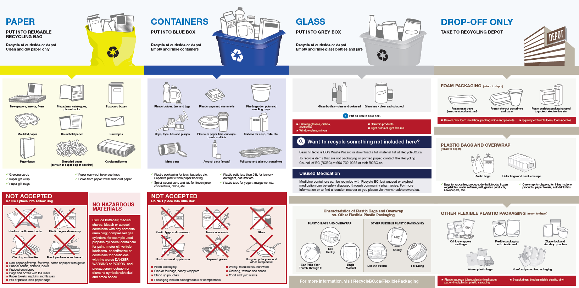
CONSISTENT MATERIAL LIST

Slide 24
Pollution prevention hierarchy

Slide 25
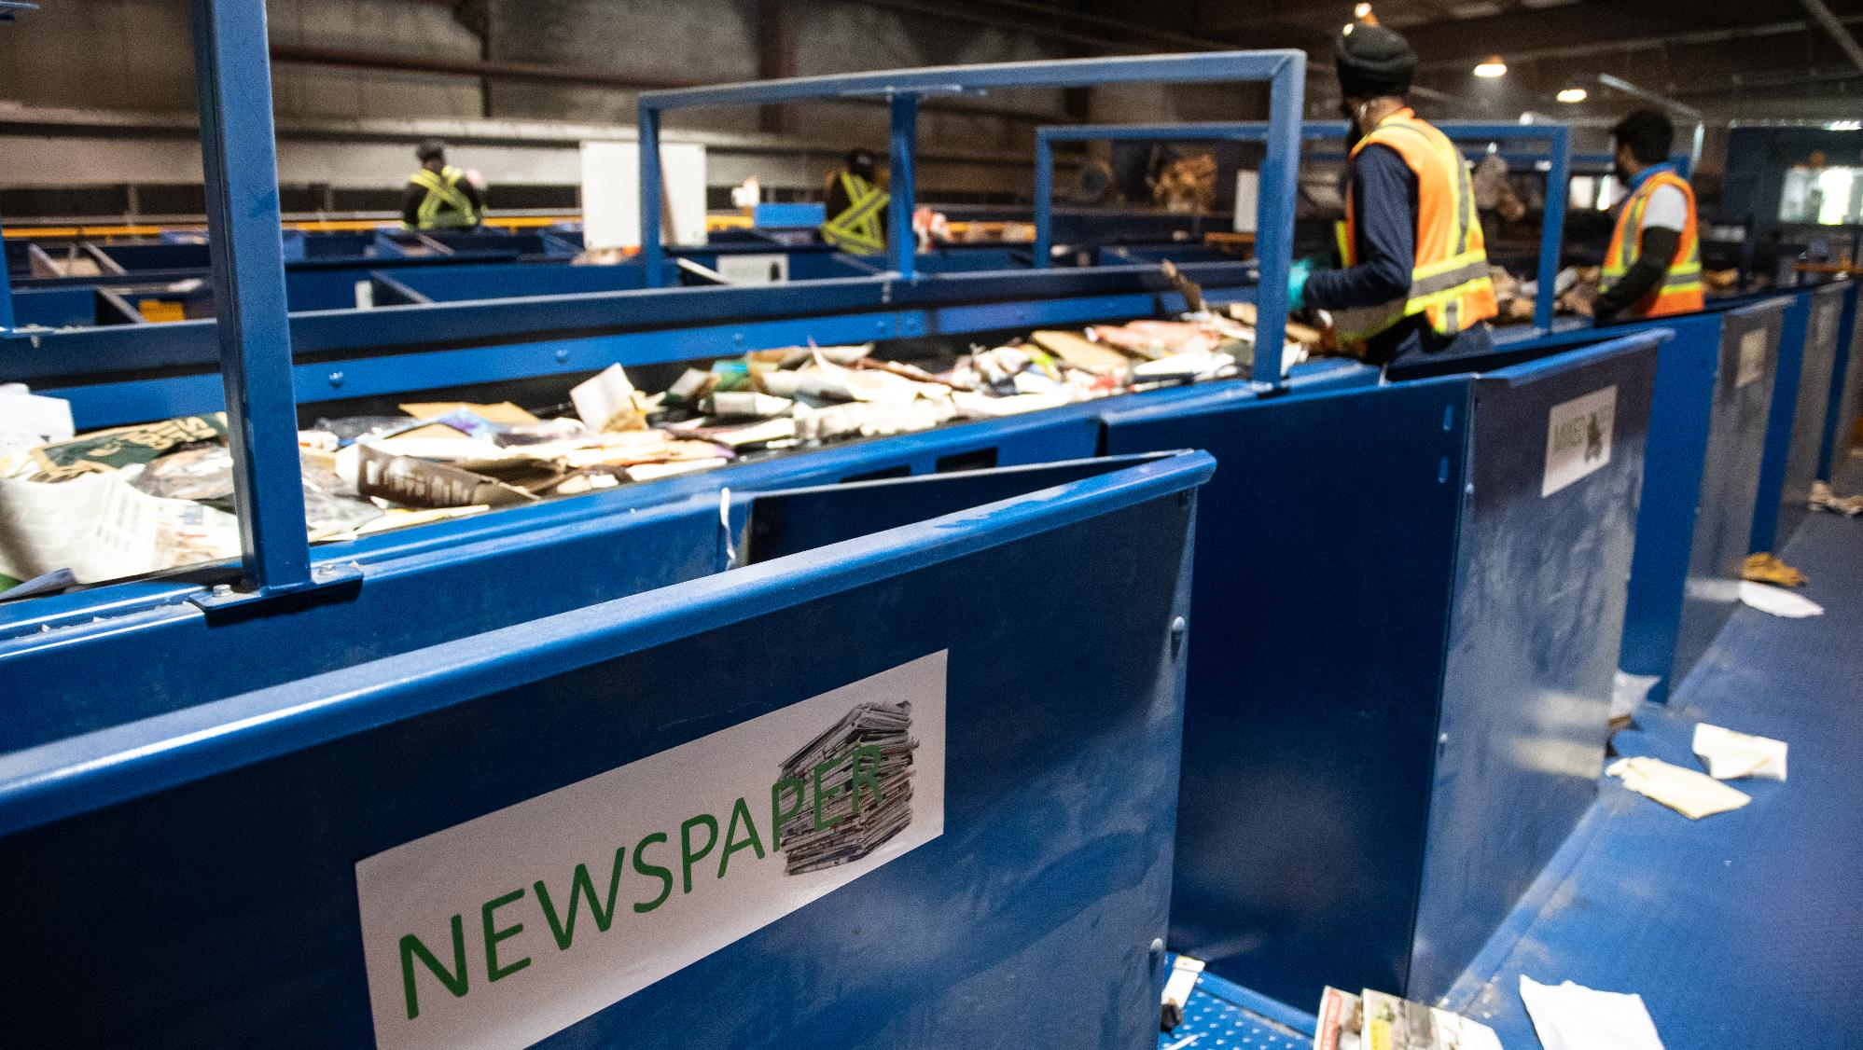
BACKGROUND
OVERVIEW
POST-COLLECTION RESPONSIBILITES INCLUDE:
Receiving of material after collection
Transport of material to material recovery facility
Sorting material into specific grades or types of materials
Marketing of materials as commodities to end markets
One province-wide system allows for economies of scale:
Create system to manage consistent materials
Investment in advanced sorting technology at select facilities
Quantities of material for sale to end markets
RFP for post-collection services March, 2020.
RFP focused on 5 key outcomes:
Investment in recycling infrastructure;
System efficiency with minimal redundancy;
Prioritization of local end-markets;
Clear and transparent business processes; and
Ongoing innovation and technology.

Slide 26
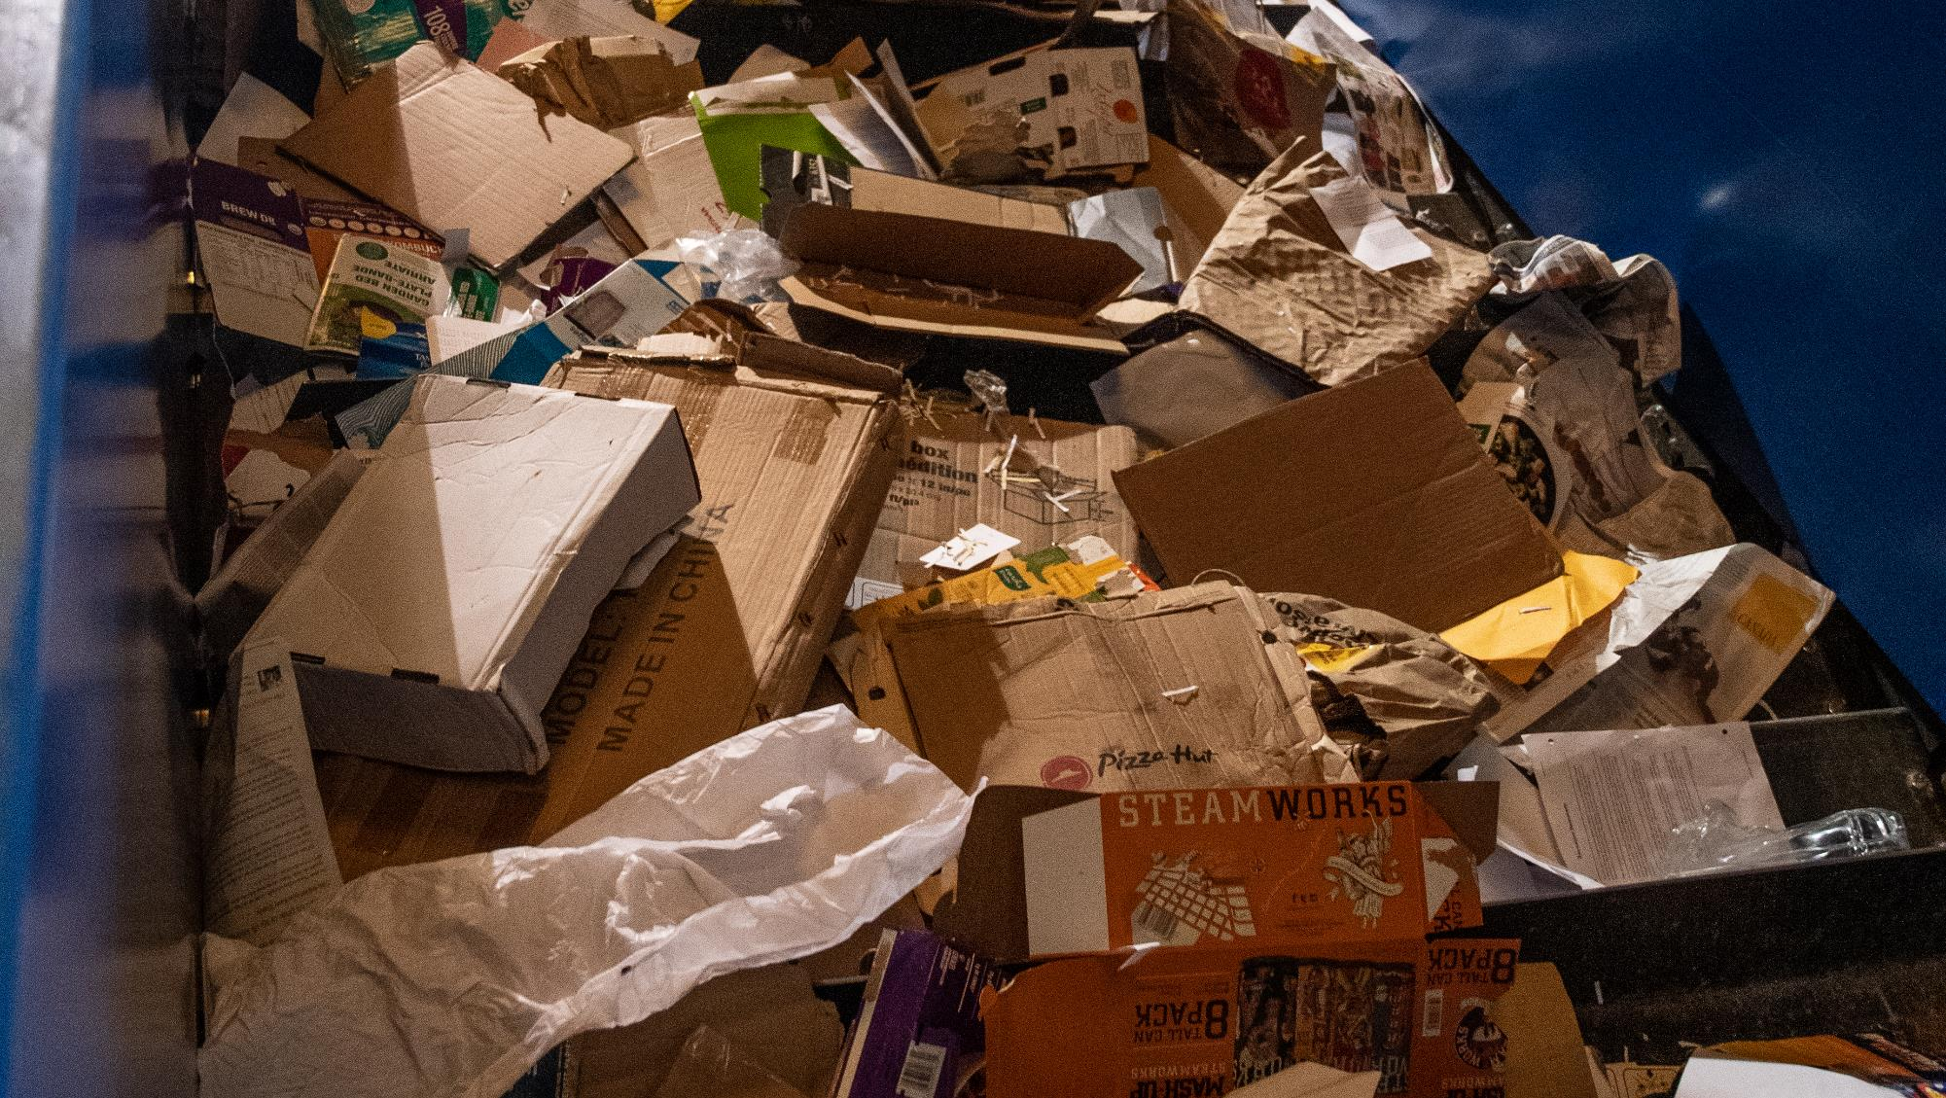
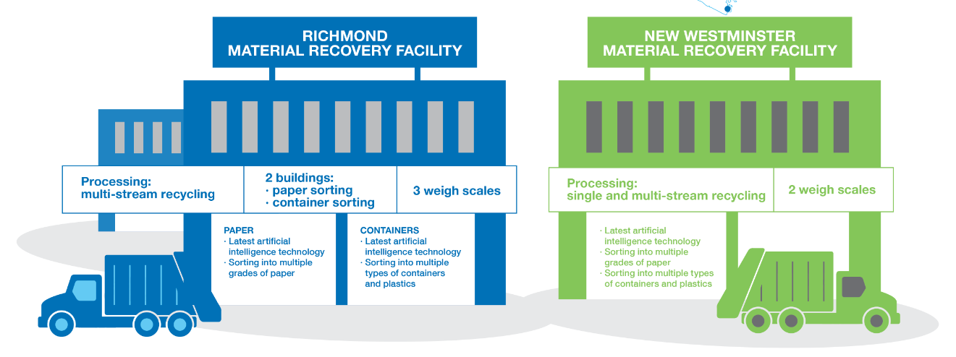
Latest sorting technology
Ability to sort into multiple grades of paper
Latest sorting technology
Ability to sort into multiple grades of containers and plastics
Latest sorting technology
Ability to sort into multiple grades of paper
Ability to sort into multiple grades of containers and plastics

Slide 27
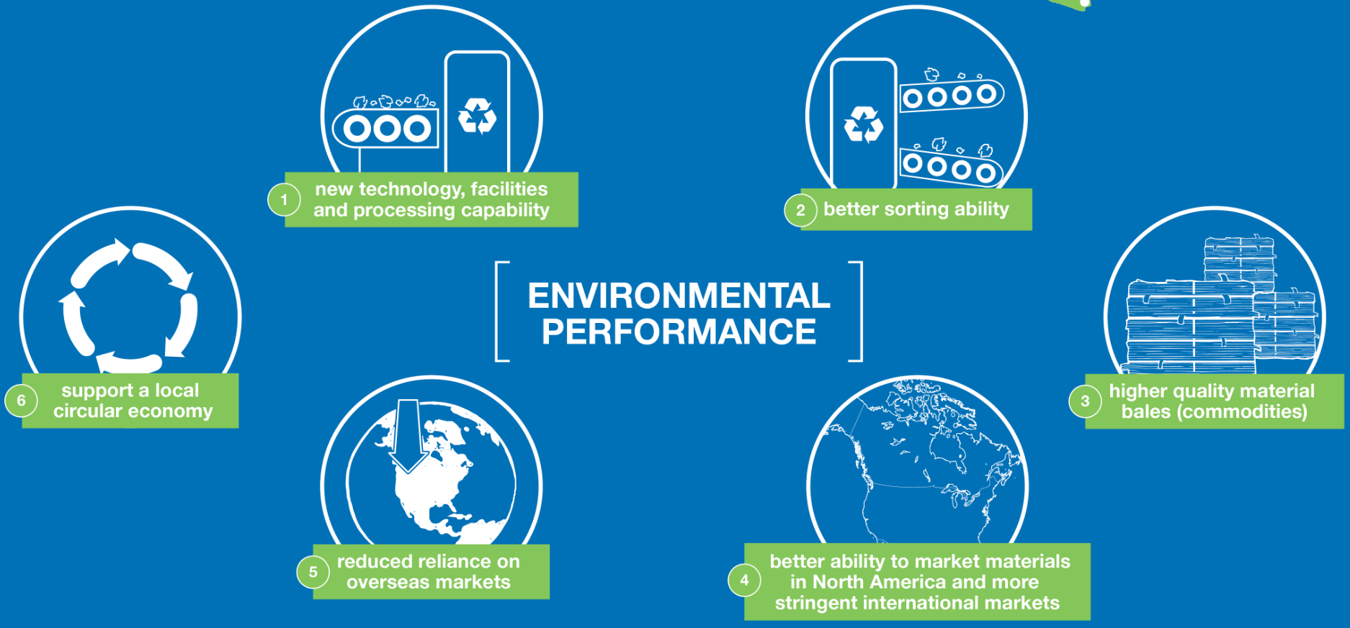

Slide 28
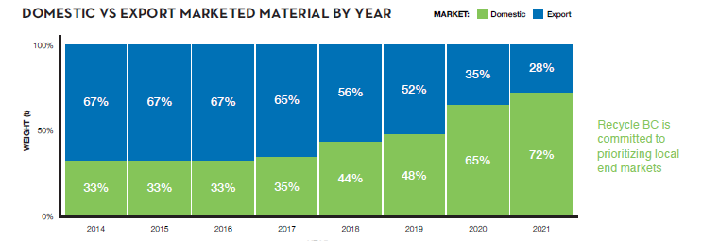
Localizing Recycling End Markets
97% of plastics collected in BC were sold to end markets in BC, where it was turned into pellets for new packaging and products. Where there was currently no recycling solution, like other flexible plastic packaging, packaging was recovered into engineered fuel
Paper was sold to end markets in BC, the US, and overseas
Glass was sold to BC end markets, and sent to a US plant for new bottles, with the remainder processed into sandblast grit or construction aggregate in BC
Metal containers were marketed to end markets in BC, Ontario, and the United States, and recycled into new packaging and sheet metal

Slide 29
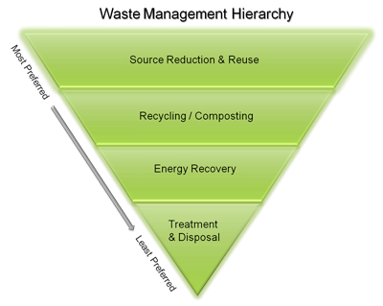
Pollution Prevention Hierarchy
Reducing environmental impacts:
Initiatives undertaken by producers
Weight based producer fees encourage reduction of PPP
Redesign:
Initiatives undertaken by producers
Cost allocation rewards easier to recycle materials
Regular review of fee structure to ensure accurate info on cost impacts of materials to encourage redesign and adoption of best practices
Canada Plastics Pact's Golden Design Rules

Slide 30
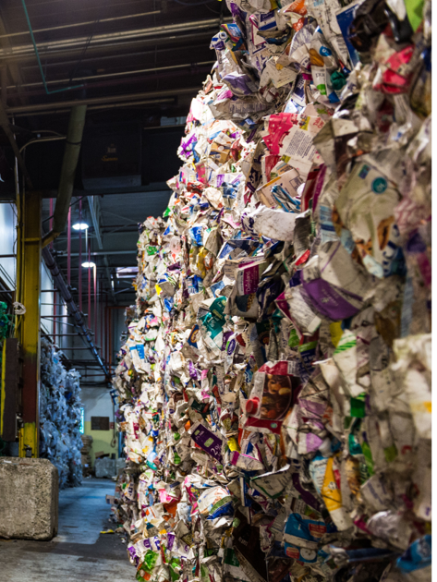
Pollution Prevention Hierarchy
Reuse:
Initiatives undertaken by producers
Cost allocation presumes materials enter marketplace once
Actively engaged in exploring reuse opportunities
Work with stakeholders to identify the value Recycle BC can bring to the reusable packaging market
Recycling:
Payment structure and operations focus on ensuring collected PPP can meet end-market requirements
Work with producers to improve PPP recyclability and increase recycled content

Slide 31
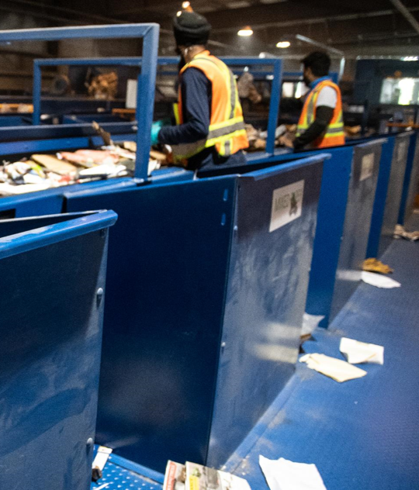
Pollution Prevention Hierarchy
Material Recovery:
Post-collection partner is incentivised to further process system residues to meet recovery end-market requirements for engineered fuel products and minimize the amount of residue sent to landfill
R&D to explore ways to recover material that is currently non-recyclable
Energy Recovery:
Recycle BC does not send PPP to waste-to-energy facilities
Disposal:
Non recoverable PPP is managed responsibly in regional landfills

Slide 32
Performance targets

Slide 33
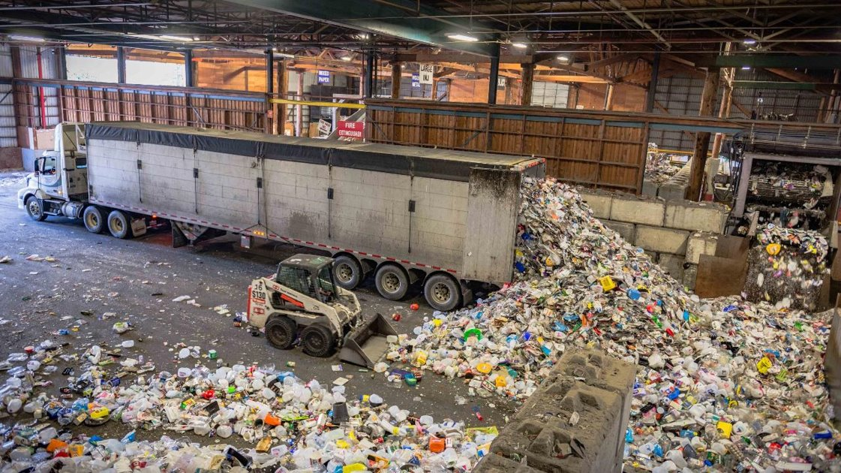
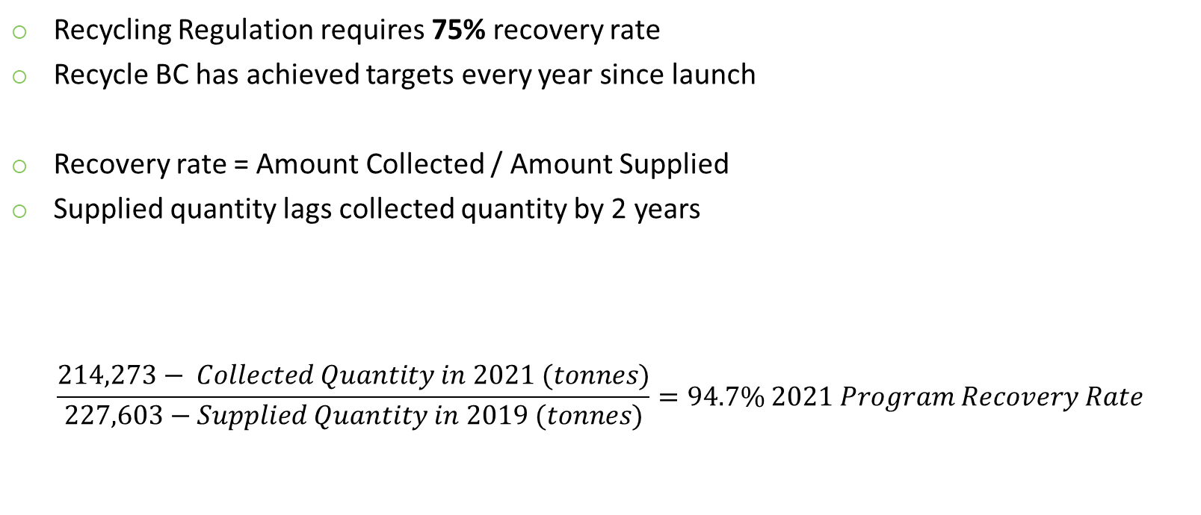
PROGRAM RECOVERY RATE
Recycling Regulation requires 75% recovery rate
Recycle BC has achieved targets every year since launch
Recovery rate = Amount Collected / Amount Supplied
Supplied quantity lags collected quantity by 2 years
$$\frac{214,273− Collected Quantity in 2021 (tonnes)}{227,603−Supplied Quantity in 2019 (tonnes)}=94.7\% 2021 Program Recovery Rate$$

Slide 34
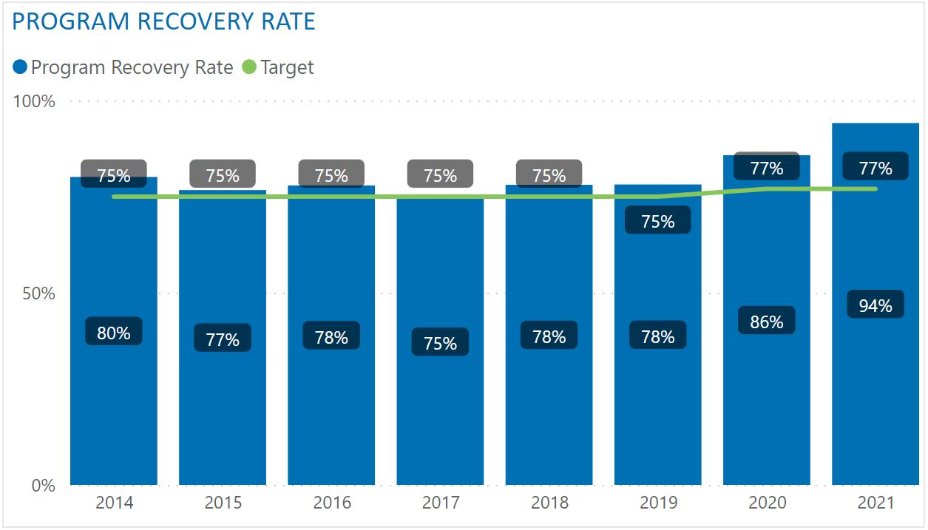
PROGRAM RECOVERY RATE – TO DATE

Slide 35
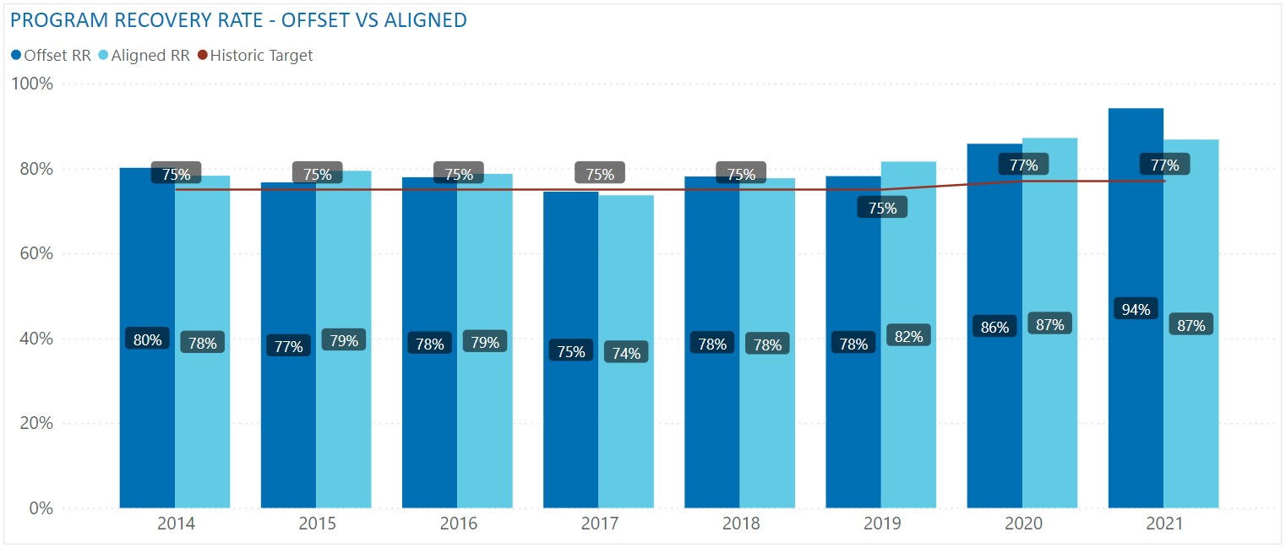
OFFSET RR VS ALIGNED RR
Two possible methodologies:
Offset RR - Collected quantity year and the supplied quantity year are offset by two years, used historically
Aligned RR - Collected quantity year is aligned with the supplied quantity year, reviewed but not recommended

Slide 36
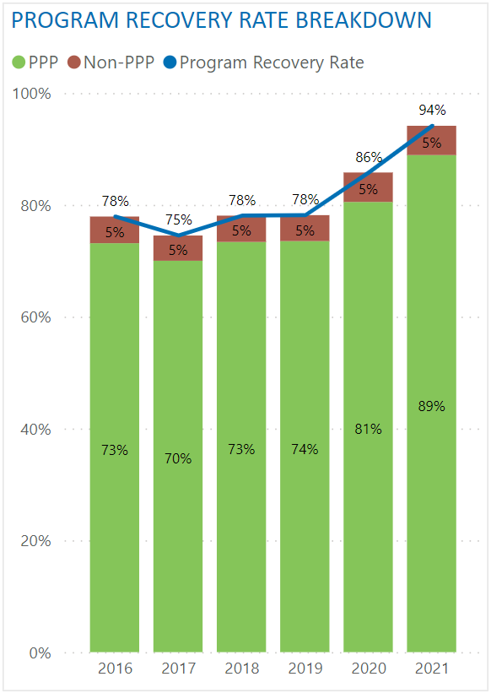
PROGRAM RECOVERY RATE – NON-PPP
Collected quantity is net of non-PPP
Non-PPP: material that is not packaging and paper product that has been incorrectly placed in recycling
Examples: food waste, construction waste, plastic products, electronics, hazardous waste
Removing non-PPP equates to a reduction of ~5% in recovery rate
Recycle BC proposes to net out non-PPP moving forward:
Better reflects recovery of Recycle BC material
Ensure contamination reduction does not negatively impact recovery rate
Better alignment with material performance targets

Slide 37
PROGRAM RECOVERY RATE – TARGETS
Historic targets (non-PPP included):
2018 | 2019 | 2020 | 2021 | 2022
75% | 75% | 75% | 77% | 77%
Proposed targets:
2023 | 2024 | 2025 | 2026 | 2027
78% | 79% | 79% | 80% | 80%
Equivalent targets if non-PPP was not removed:
2023 | 2024 | 2025 | 2026 | 2027
83% | 84% | 84% | 85% | 85%

Slide 38
MATERIAL CATEGORY PERFORMANCE TARGETS
Recycle BC began reporting material performance in 2017
Material Category |  | 2017 | 2018 | 2019 | 2020 | 2021 | 2022
Paper | Recovery Rate | 87% | 86% | 83% | 90% | 101%
 | Target | n/a | 90% by 2022
Plastic | Recovery Rate | 41% | 42% | 46% | 52% | 55%
 | Target | n/a | 50% by 2025 |  |  | 58% by 2025
Rigid Plastic | Recovery Rate | 50% | 54% | 56% | 64% | 67%
 | Target | n/a | 55% by 2022 |  |  | 73% by 2023
Flexible Plastic | Recovery Rate | 20% | 19% | 22% | 24% | 28%
 | Target | n/a | 22% by 2022 |  |  | 27% by 2023
Metal | Recovery Rate | 66% | 67% | 73% | 85% | 83%
 | Target | n/a | 67% by 2020 |  | 81% by 2022
Glass | Recovery Rate | 72% | 78% | 87% | 97% | 116%
 | Target | n/a | 75% by 2020 |  | 98% by 2022
 |  | Legend: | Target Achieved

Slide 39
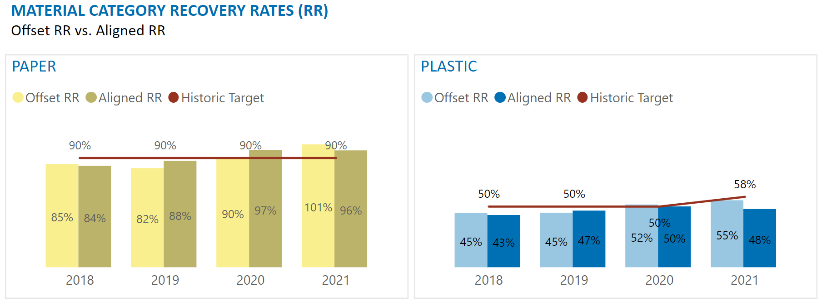
OFFSET RR VS ALIGNED RR
Two possible methodologies:
Offset RR - Collected quantity year and the supplied quantity year are offset by two years, used historically
Aligned RR - Collected quantity year is aligned with the supplied quantity year, proposal moving forward

Slide 40
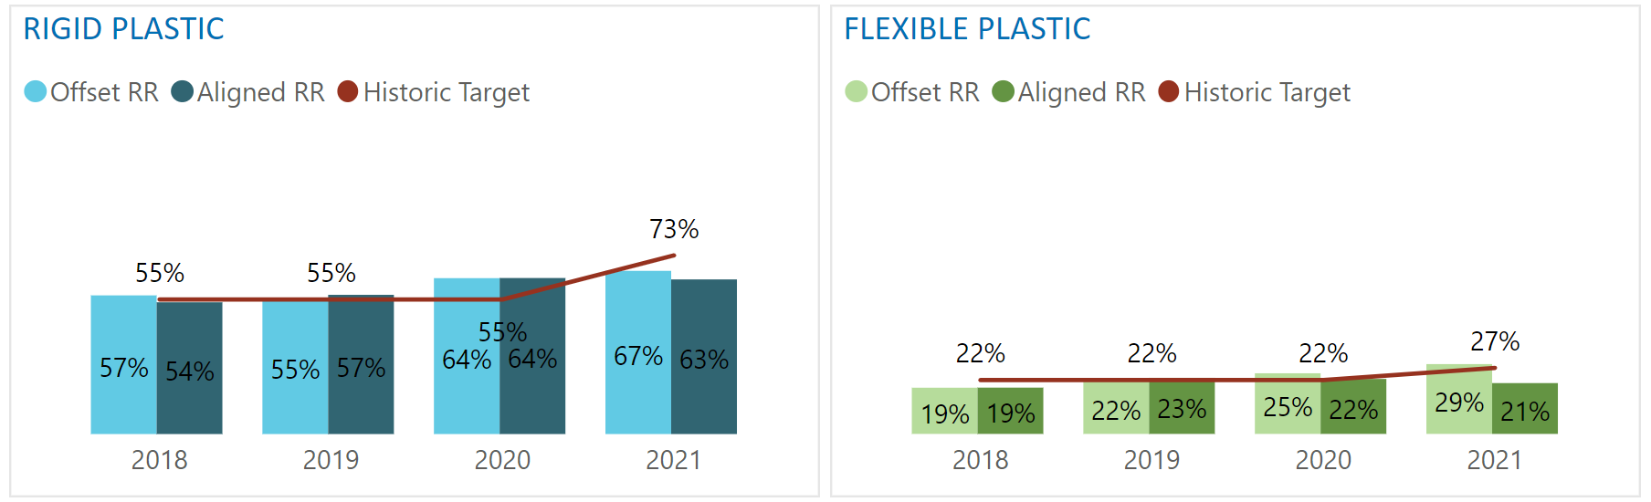
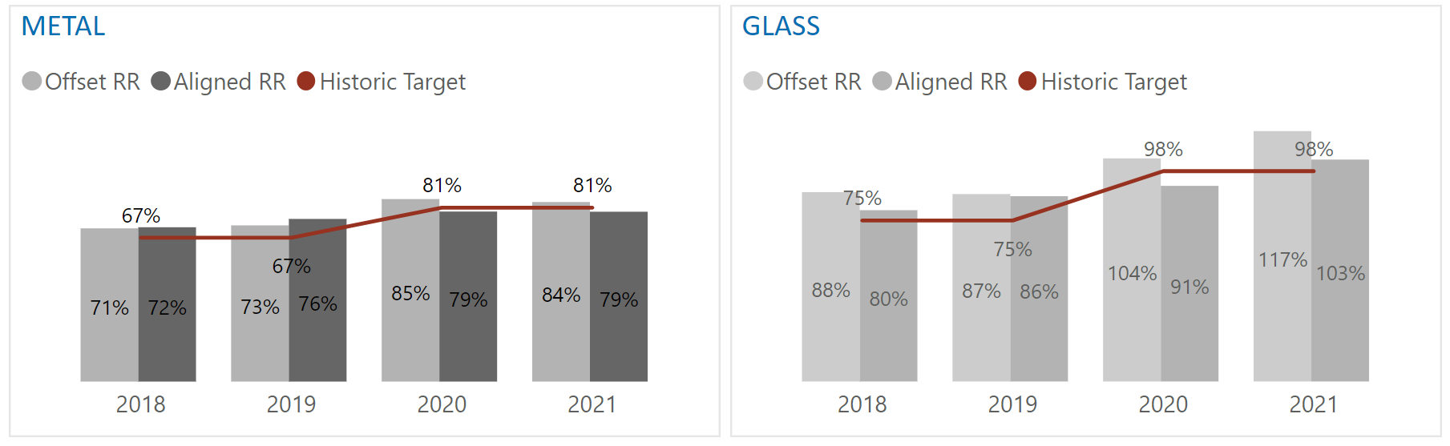
OFFSET RR VS ALIGNED RR
Aligning years allows same year-to-year comparison
Numbers in annual report will only be available for two years looking back
Example:
2022 annual report
Published in 2023
Material recovery rates for 2020: 2020 collected quantity and 2020 supplied quantity

Slide 41
MATERIAL CATEGORY PERFORMANCE TARGETS - NEW
Annual Report (AR) Year | 2023 | 2024 | 2025 | 2026 | 2027
Collection / Supply Year | 2021 | 2022 | 2023 | 2024 | 2025
Paper Target | 95% by 2025 Annual Report |  |  | 96% by 2027 Annual Report
Plastic Target | 55% by 2025 Annual Report |  |  | 56% by 2027 Annual Report
Rigid Plastic Target | 71% by 2025 Annual Report |  |  | 72% by 2027 Annual Report
Flexible Plastic Target | 24% by 2025 Annual Report |  |  | 25% by 2027 Annual Report
Metal Target | 88% by 2025 Annual Report |  |  | 89% by 2027 Annual Report
Glass Target | 98% by 2027 Annual Report
Once a material category performance target has been achieved for two consecutive years, the target will be adjusted using previously described methodology

Slide 42
MATERIAL CATEGORY PERFORMANCE METHODOLOGY
Variable | Definition | Short Form
Latest Material Specific Collected Quantity | Amount of collected quantity (tonnes) in the specific material category in the latest available full collection year. | Latest Collected Qty
Material-Specific Collection Growth | Material-specific growth in collection over the last three calendar years | Collection Growth
Program Collection Growth | Estimated growth in gross collection over three years (including the year of proposal) | Program Growth
Latest Material Specific Supplied Quantity | Amount of supplied material (tonnes) in the specific material category in the latest available full supply year. | Latest Supplied Qty
Material-Specific Supplied Growth | Material-specific growth in producer member supplied quantities based on the sales data pertaining to the latest available three fiscal years. | Supplied Growth
$$\frac{Latest Collected Qty x \left(1+Collection Growth\right) x \left(1+Program Growth\right)}{Latest Supplied Qty x \left(1+Supplied Growth\right)}$$

Slide 43
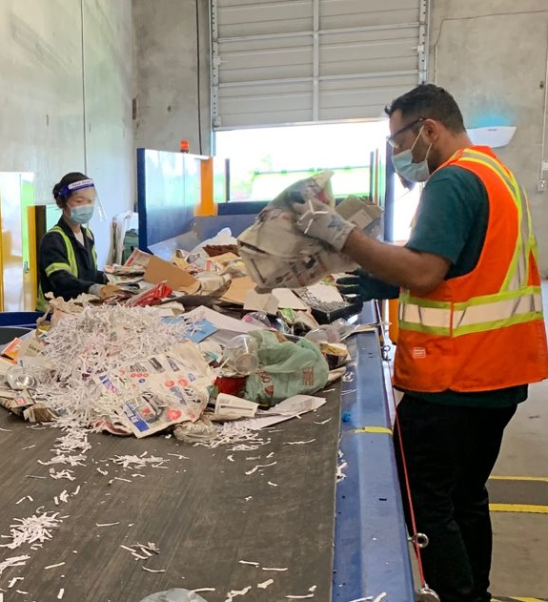
PROGRAM PLAN CONSULTATION
Stakeholder consultation October to December 2022
Additional virtual consultation sessions:
Recycle BC producer members
Producer associations
Recycle BC collectors and municipalities
First Nations
Regional Districts
Environmental and community groups
Written feedback accepted until Dec 31, 2022
consultation@recyclebc.ca

Slide 44
Questions & Discussion

Slide 45
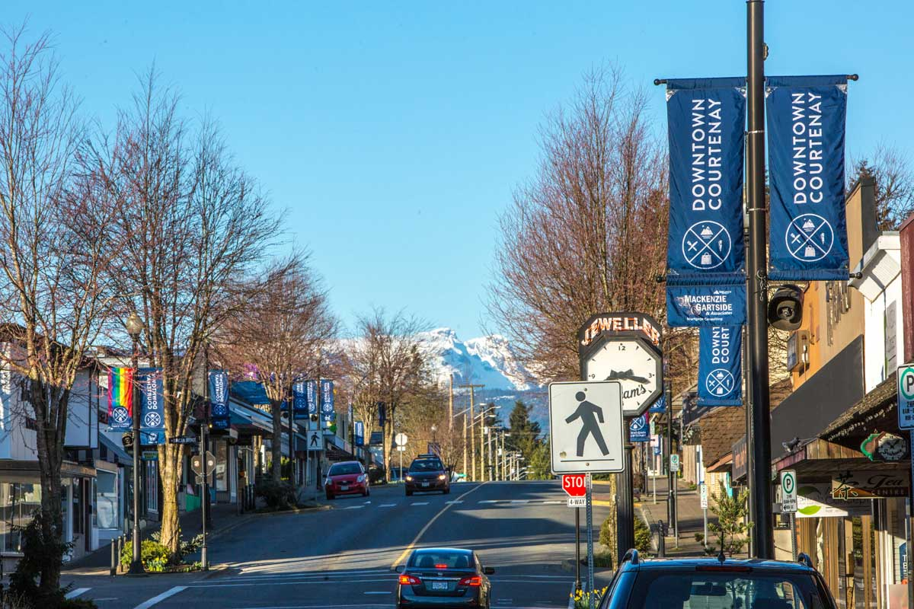
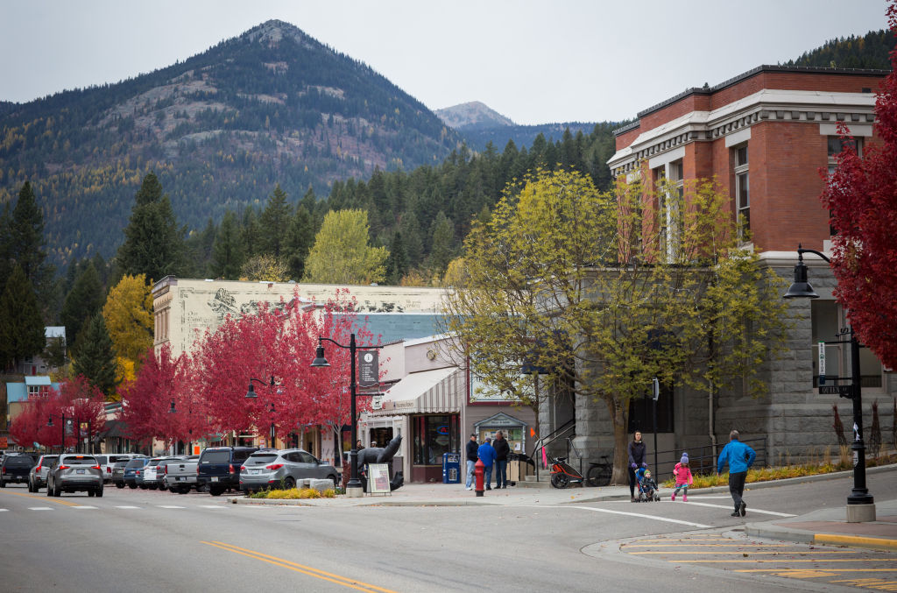
ICS ELIGIBILITY: MUNICIPALITIES
Municipalities with >50,000 population:
Local organization able and willing to meet all requirements
Municipalities with > 10,000 population:
Local organization able and willing to meet all requirements
Minimum population of 10,000 and maximum population of 49,999 residents
More than 5 km from Recycle BC depot in a larger municipality
Municipalities with >2,000 population:
Local organization able and willing to meet all requirements
Minimum population of 2,000 and maximum population of 9,999 residents
More than 15 km from a municipality with 10,000 residents
More than 15 km from Recycle BC depot

Slide 46

ICS ELIGIBILITY: SMALL & ISLAND COMMUNITIES
Small communities:
Local organization able and willing to meet all requirements
Minimum population of 1,000 residents within 30-minute service catchment
Garbage service and year-round grocery store available
More than 40 km from a municipality with 10,000 residents
More than 40 km from Recycle BC depot
Island communities:
Local organization able and willing to meet all requirements
Minimum population of 1,000 residents
Garbage service and year-round grocery store available

Slide 47
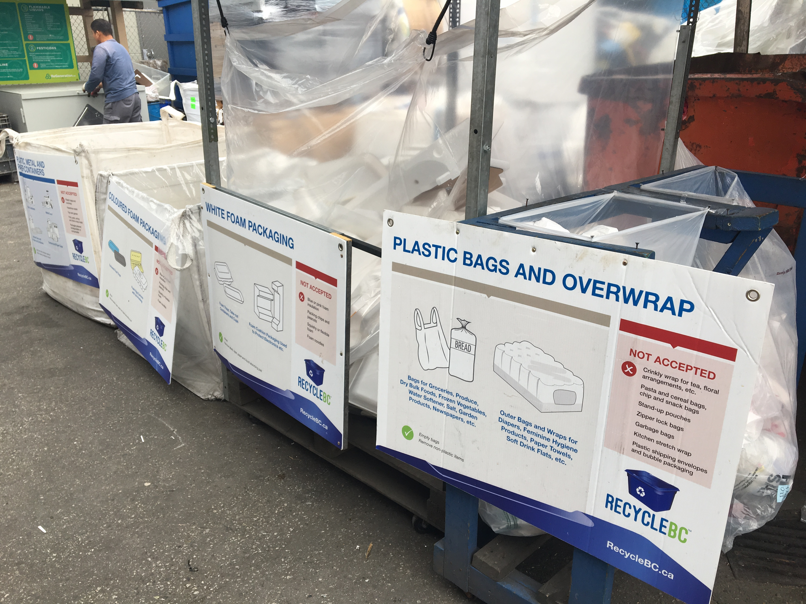
COST STUDY PROCESS
Completed in advance of new service agreements
Compares current costs to historic 5-year cost
Collectors provide data to independent third-party accountant
Overseen by Recycle BC Advisory Committee members
Objective: fair and reasonable incentive rates
Data includes:
Curbside
Multi-family
Streetscape
Promotion and education
Service administration

Slide 48
COST STUDY INPUTS
Collection costs, including differences by:
Collection channel and PPP categories
Geography and density
Collection attributes - # of streams, container types
Collector type
Unique drivers of cost – e.g. receiving facility location
Program data, including performance by channel
Operational metrics, including contamination
Impact of inflation
Proposed service requirement changes
Impact of existing incentive rates/structure on incentivizing best practices, efficiencies, high collection rates, GHG reductions
Not included – collection in communities that do not meet eligibility criteria

Slide 49
OFFSET RR VS ALIGNED RR
Two possible methodologies:
Offset RR - Collected quantity year and the supplied quantity year are offset by two years, used historically
Aligned RR - Collected quantity year is aligned with the supplied quantity year, reviewed but not recommended

