Slide 1
Recycle Bc & First nations
Draft Program Plan Consultation
November 15, 2022

Slide 2

Background & Context

Slide 3
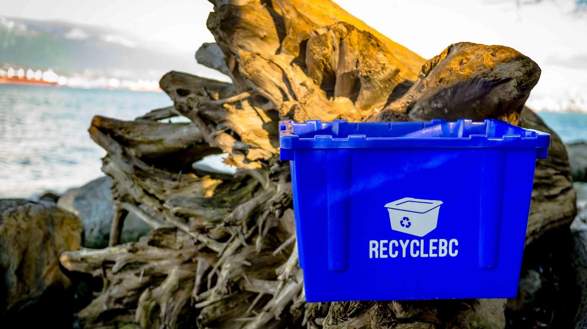
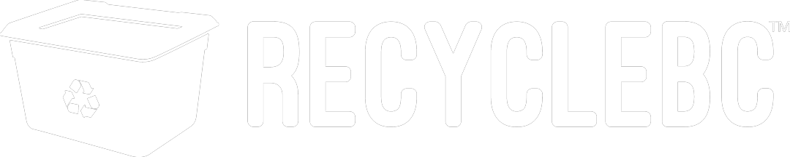
WHO WE ARE
Recycle BC is a not-for-profit organization responsible for residential packaging and paper recycling throughout British Columbia.
Recycle BC ensures household materials are collected, sorted and responsibly recycled.
Our program is funded by 1,200 businesses that include retailers, manufacturers and restaurants that supply packaging and paper products to BC residents, shifting costs away from homeowners.

Slide 4
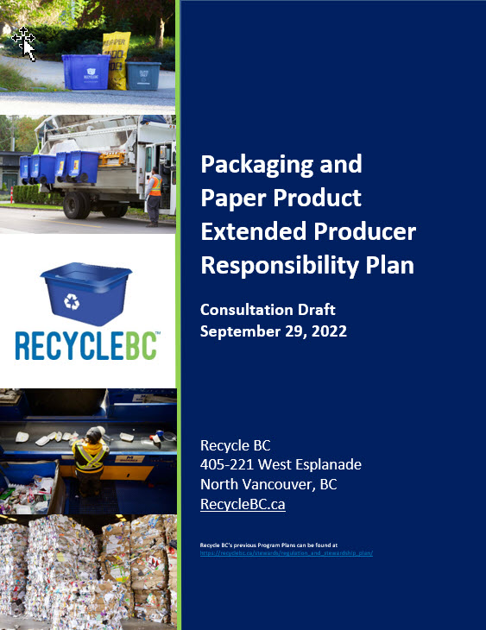
PROGRAM PLAN
Plan outlines objectives, commitments and targets
Operational roadmap
5-year period and renewal cycle
Evergreen format
Timelines
Sept 30, 2022: plan posted
Oct-Dec 2022: consultation period
April 2023: plan submission to MOECCS

Slide 5

EPR AGENCY
BC Recycling Regulation, amendments, guidance docs
Recycle BC administers plan on behalf of producer members
Program financing:
Member fees based on weight of PPP supplied
Materials covered:
Packaging
Paper product
Single-use products – Jan 2023
Packaging-like products – Jan 2023

Slide 6
Collection SYSTEM

Slide 7
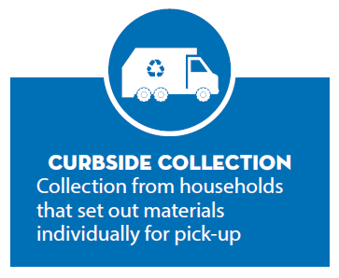
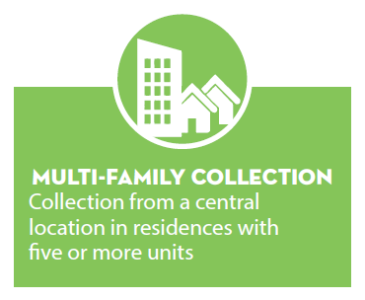
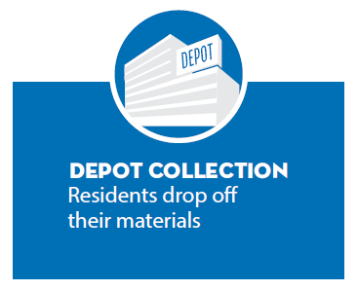
COLLECTION STREAMS

Slide 8
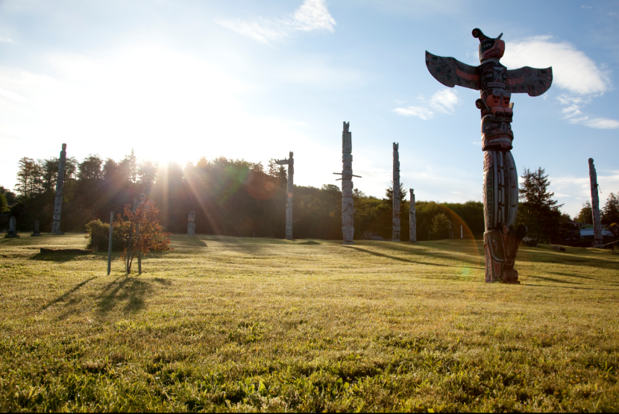

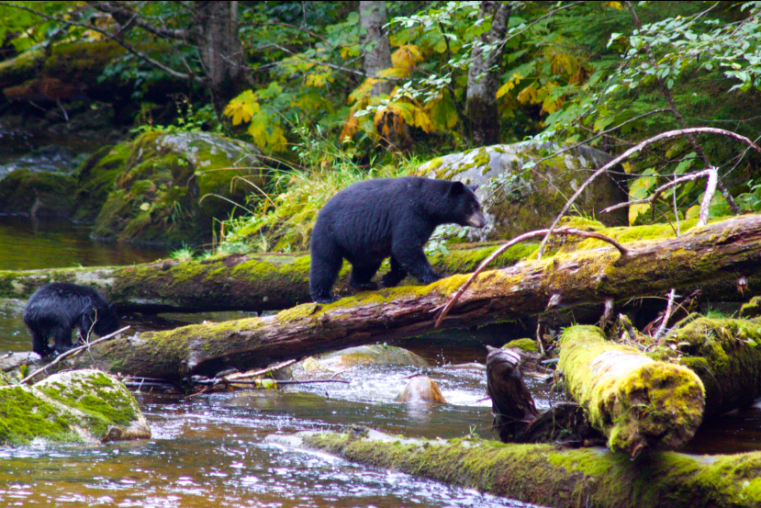
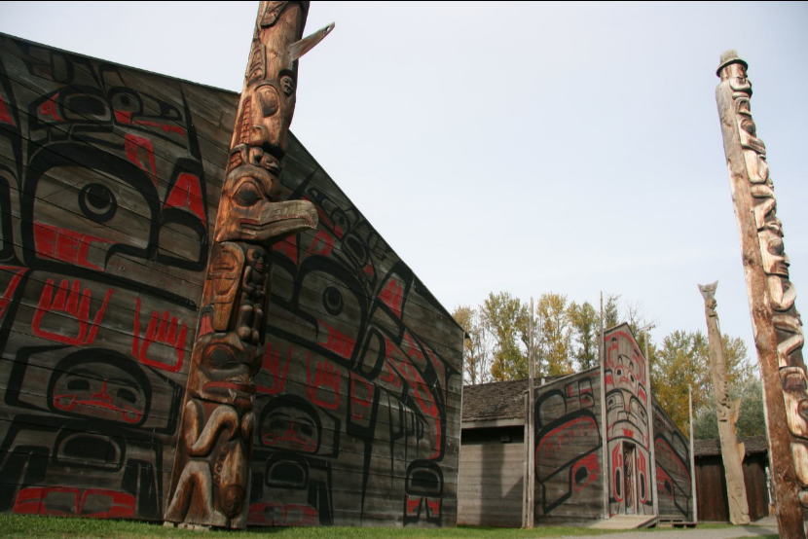
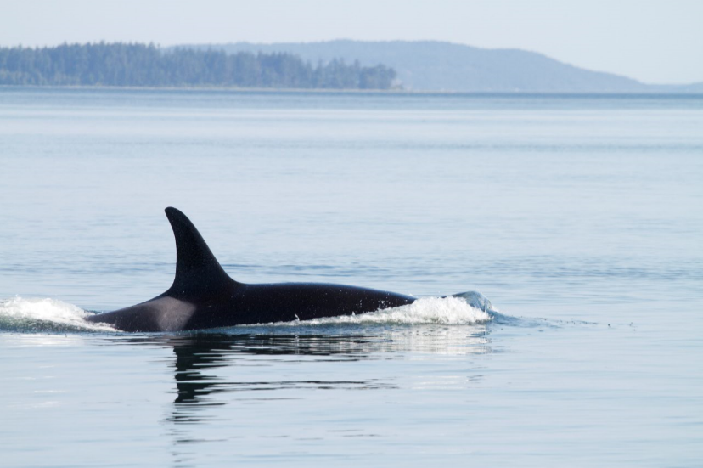
FIRST NATIONS COLLECTION
Recycle BC engagement and annual expansion:
Engage directly with First Nation collectors and through local government service areas
Provide new offers to communities with recycling capacity
Outreach with communities interested in establishing collection
Expansion of existing service areas to First Nation communities
Pilot initiatives such as bulk depot drop offs and mobile depots
First Nations Recycling Initiative:
Founded in 2017, managed by Recycle BC
Collaborative venture of 9 stewardship agencies
Publishes recycling guide, visits First Nation communities to assess recycling activities, organizes community clean up events

Slide 9
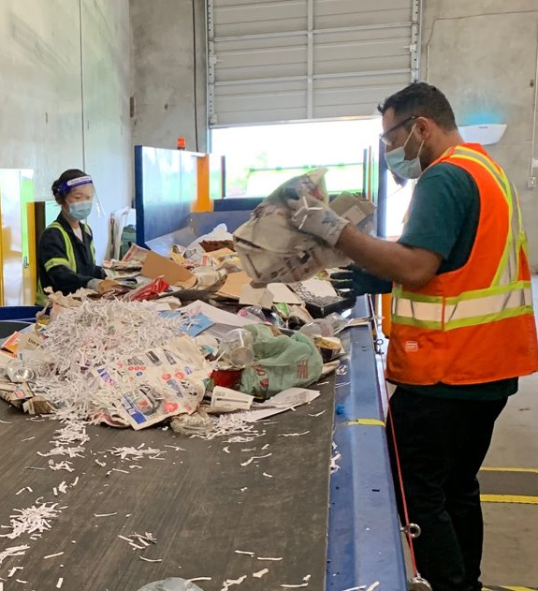
PROGRAM PLAN CONSULTATION
Stakeholder consultation October to December 2022
Additional virtual consultation sessions:
Recycle BC producer members
Producer associations
Recycle BC collectors and municipalities
First Nations
Regional Districts
Environmental groups
Written feedback accepted until Dec 31, 2022
consultation@recyclebc.ca

