Slide 1
Recycle Bc steward associations
Draft Program Plan Consultation
November 22, 2022

Slide 2

Background & Context

Slide 3
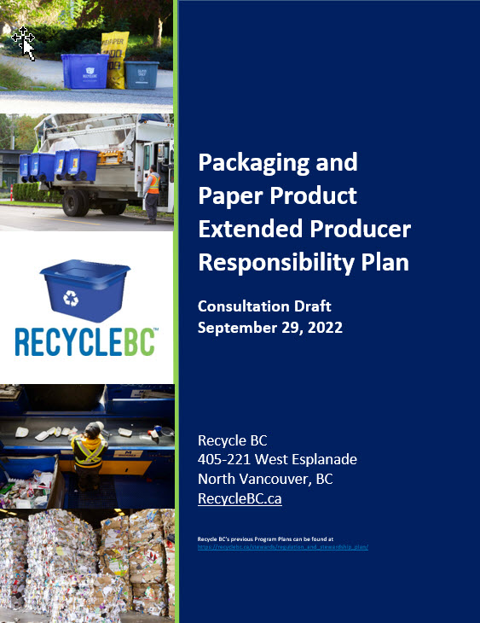
PROGRAM PLAN
Plan outlines objectives, commitments and targets
Operational roadmap
5-year period and renewal cycle
Evergreen format
Timelines
  Sept 30, 2022: plan posted
  Oct-Dec 2022: consultation period
  April 2023: plan submission to MOECCS

Slide 4
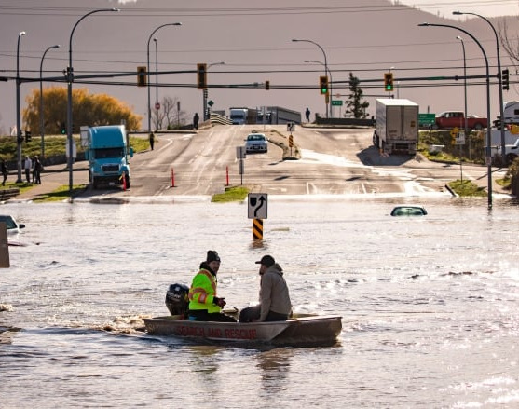
PLAN CONTEXT
8 years of operational success and full compliance
Upcoming launch of comparable provincial programs
Recent challenges:
  COVID-19 & supply chain disruptions
  Labour and transportation challenges
  Extreme weather events
  Public distrust
  Inflation
Opportunities for:
  Harmonization and collaboration
  Advancement and innovation
  Building program resiliency
  Driving the circular economy

Slide 5
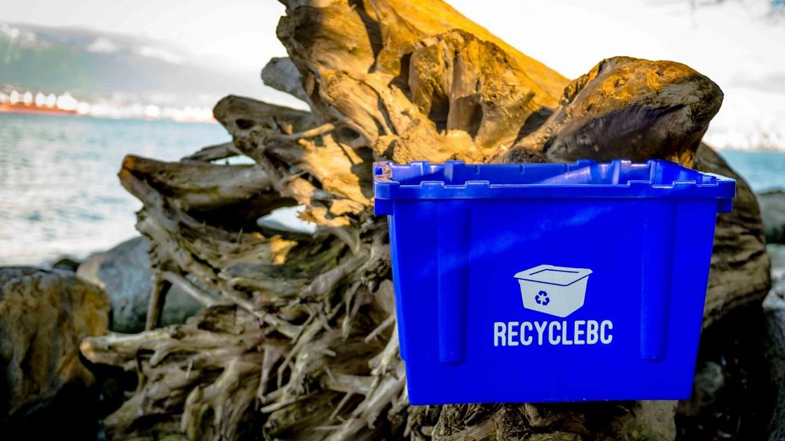
EPR AGENCY
BC Recycling Regulation, amendments, guidance docs
Recycle BC administers plan on behalf of producer members
Program financing:
  Member fees based on weight of PPP supplied
Materials covered:
  Packaging
  Paper product
  Single-use products – Jan 2023
  Packaging-like products – Jan 2023

Slide 6
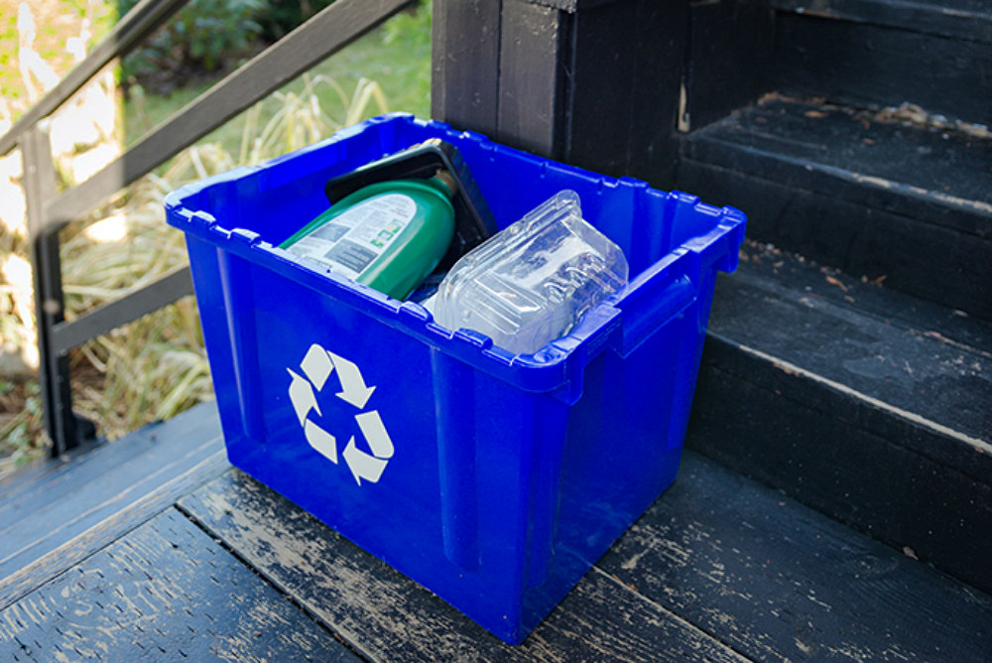
PRODUCER DEFINITION
Appendix A – Revised producer definition
Clarification on current program intent and practice
“Substantial connection to BC”
Intended to insulate members from risk
Table outlines application of program criteria
Goal: harmonization and consistency
CCME guidance

Slide 7
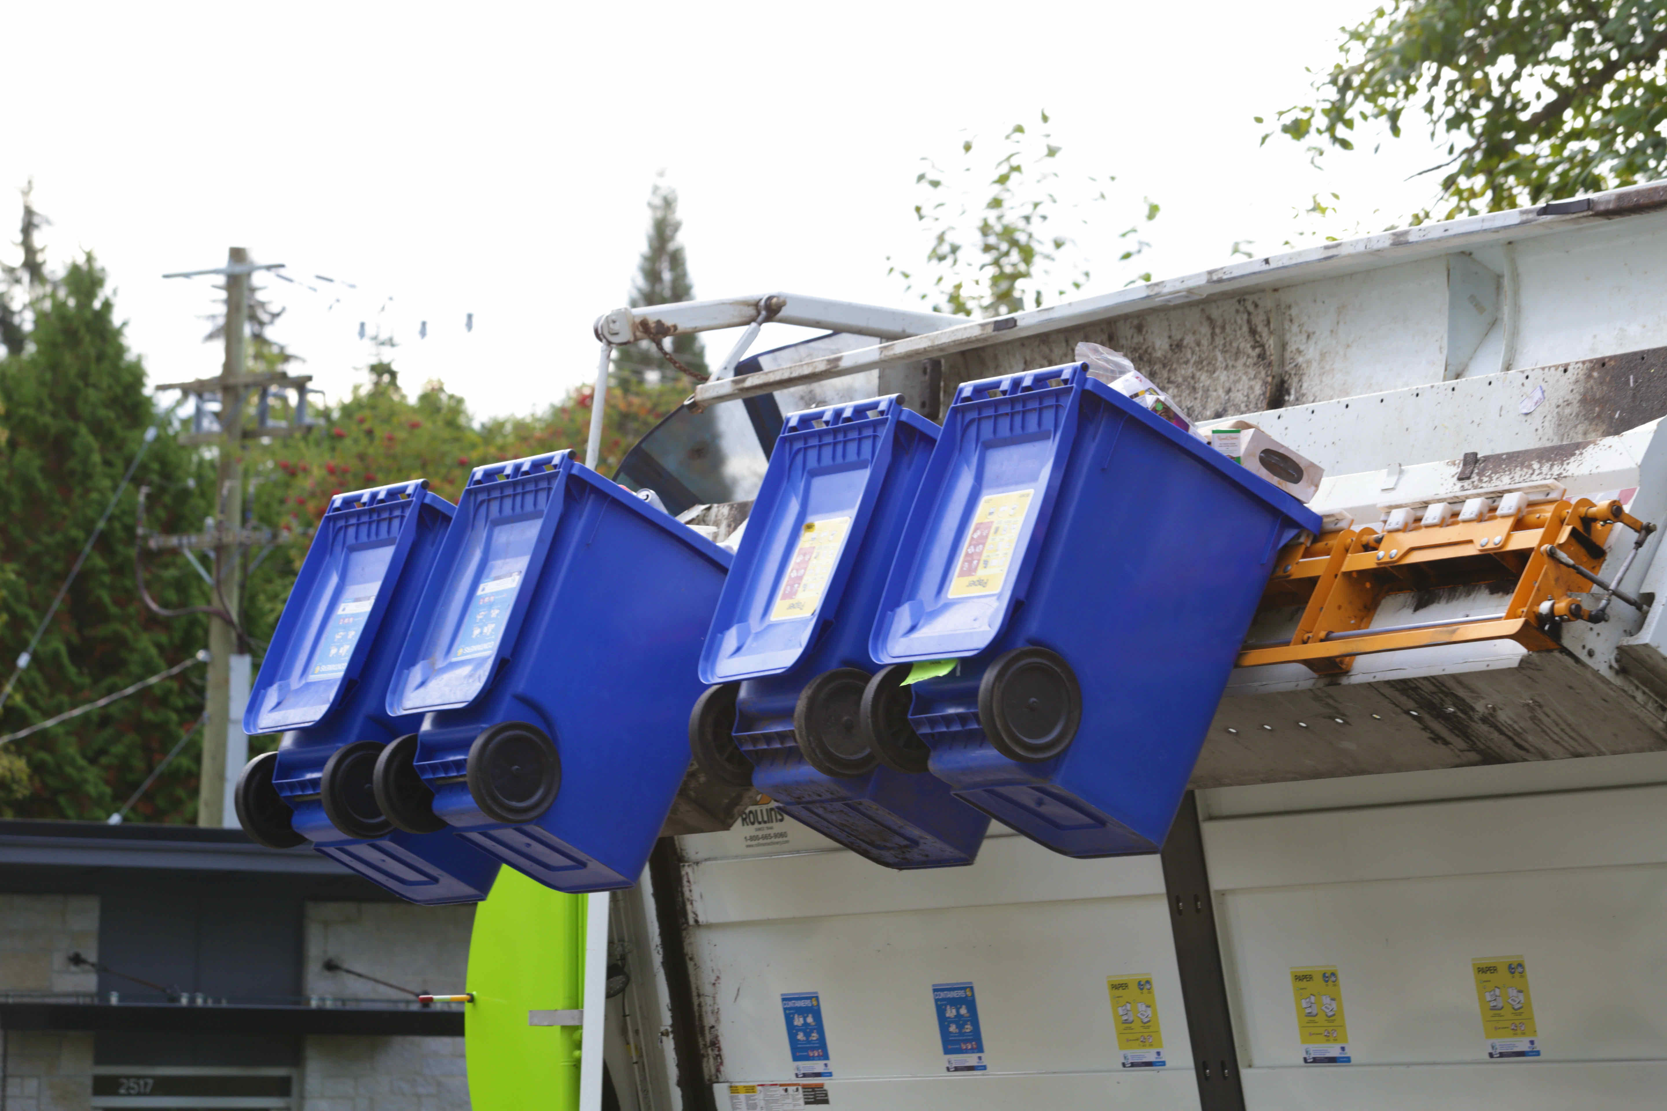
PROGRAM FINANCING
Fees designed to cover:
  Material management – collect, transport, process, market
  Resident awareness
  Administration
Cost allocation principles:
  All materials bear costs, irrespective if collected
  Costs applied to materials reflect their impacts to cost of managing system
  Commodity revenue applied only to materials that earn revenue

Slide 8
Collection SYSTEM

Slide 9
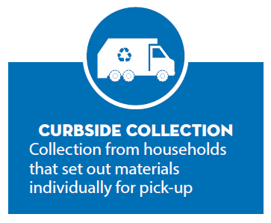
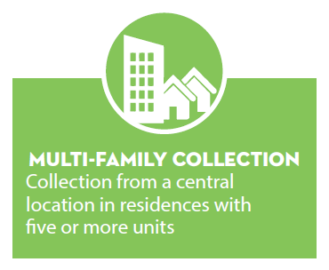
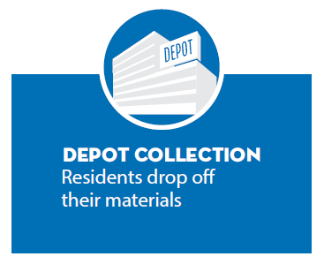
COLLECTION STREAMS

Slide 10
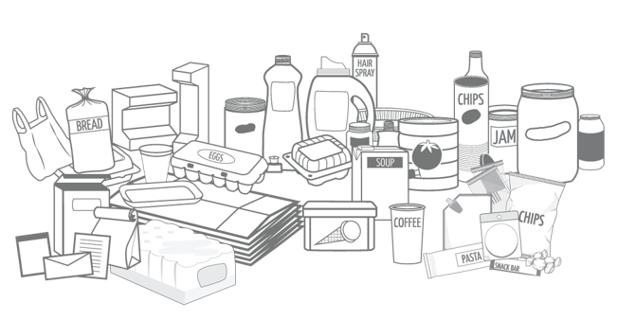
ACCEPTED MATERIALS
Compatible materials with viable end markets
List is expansive and harmonized
Not accepted PPP:
  Composition audits
  Research & analysis – barriers, best practices
  Engage with processors and end markets
  Pilots
Compostable PPP
  Once OMRR finalized, determine amount of compostable PPP recovered
  If significant and feasible – report annually and develop financial incentives

Slide 11
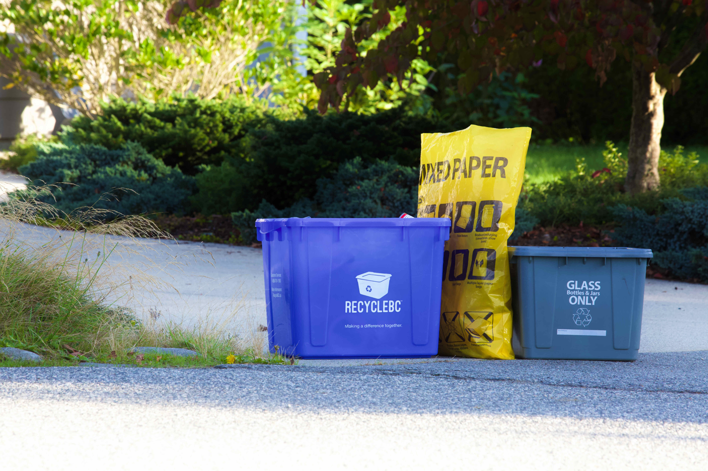
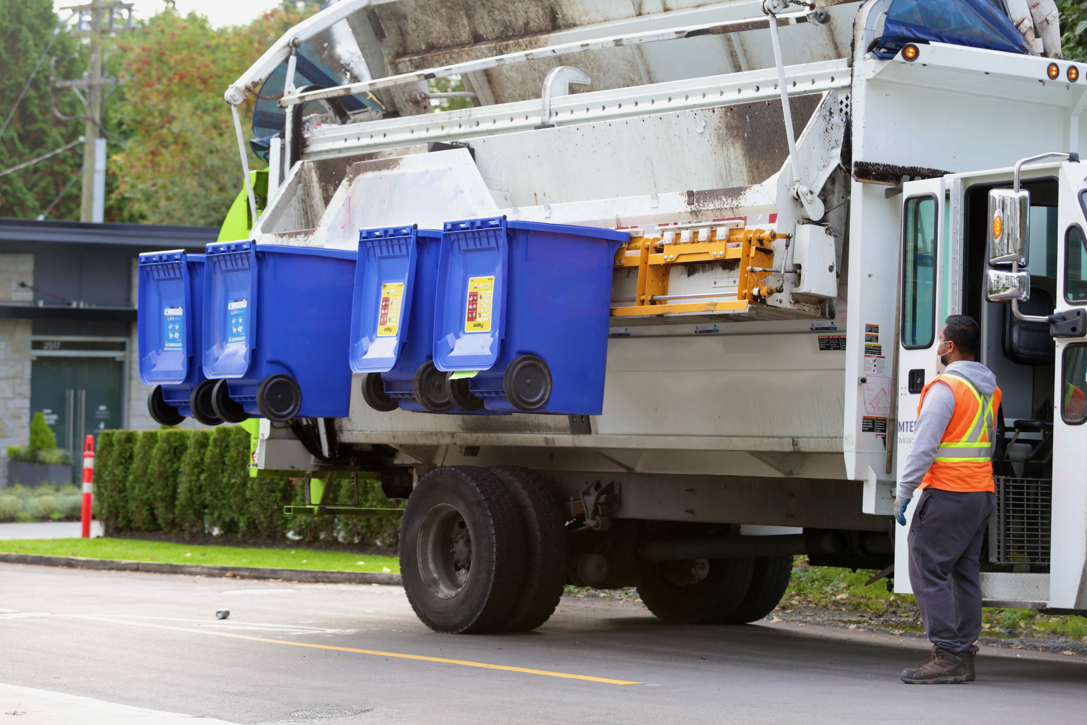
ELIGIBILITY CRITERIA
Curbside eligibility criteria
Multi-Family eligibility criteria

Slide 12
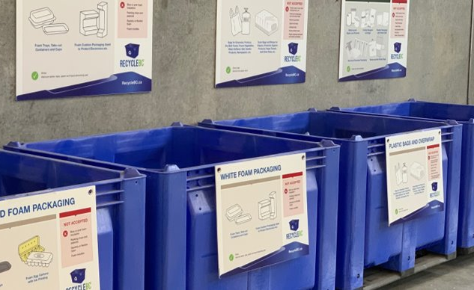
INTEGRATED RECYCLE BC COLLECTION SERVICES (ICS)
Focus on flexibility to meet changing demands and ensure reasonable levels of service
ICS: Service or combination of services that provide regular opportunities to collect all PPP categories:
  All categories accepted at curbside
  Depots, retail locations or mobile depots to augment curbside/MF collection
  All categories accepted at depots, retail locations or mobile depots
Methods may differ by community size, contractor availability, etc.
Goal is to provide service in all eligible communities and recruit as necessary annually

Slide 13
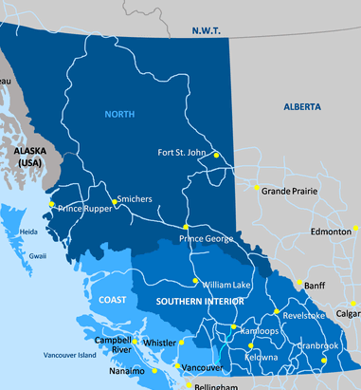
ICS ELIGIBILITY CRITERIA
Plan includes detailed criteria to outline communities eligible for Integrated Collection Services (ICS)
Eligibility criteria focuses on:
  Community population
  Distance to depot and larger service center
  Availability of garbage and grocery services
  Meaningful contribution to collection volumes
  Convenience without duplication of transportation
Depots are currently the primary ICS method

Slide 14




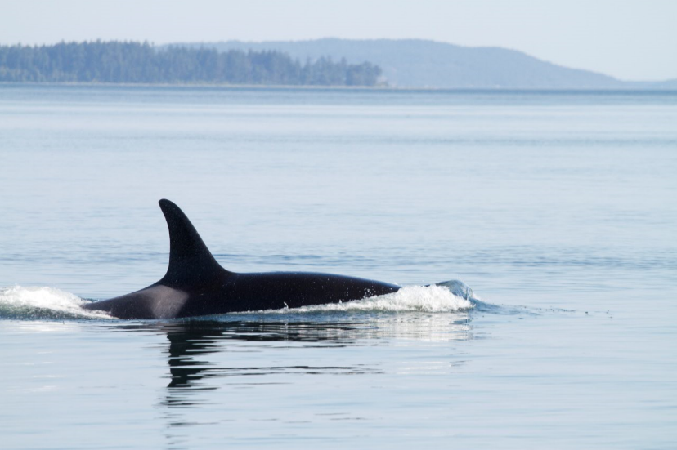
FIRST NATIONS COLLECTION
Recycle BC engagement and annual expansion:
  Engage directly with First Nation collectors and through local government service areas
  Provide new offers to communities with recycling capacity
  Outreach with communities interested in establishing collection
  Expansion of existing service areas to First Nation communities
  Pilot initiatives such as bulk depot drop offs and mobile depots
First Nations Recycling Initiative:
  Founded in 2017, managed by Recycle BC
  Collaborative venture of 9 stewardship agencies
  Publishes recycling guide, visits First Nation communities to assess recycling activities, organizes community clean up events

Slide 15
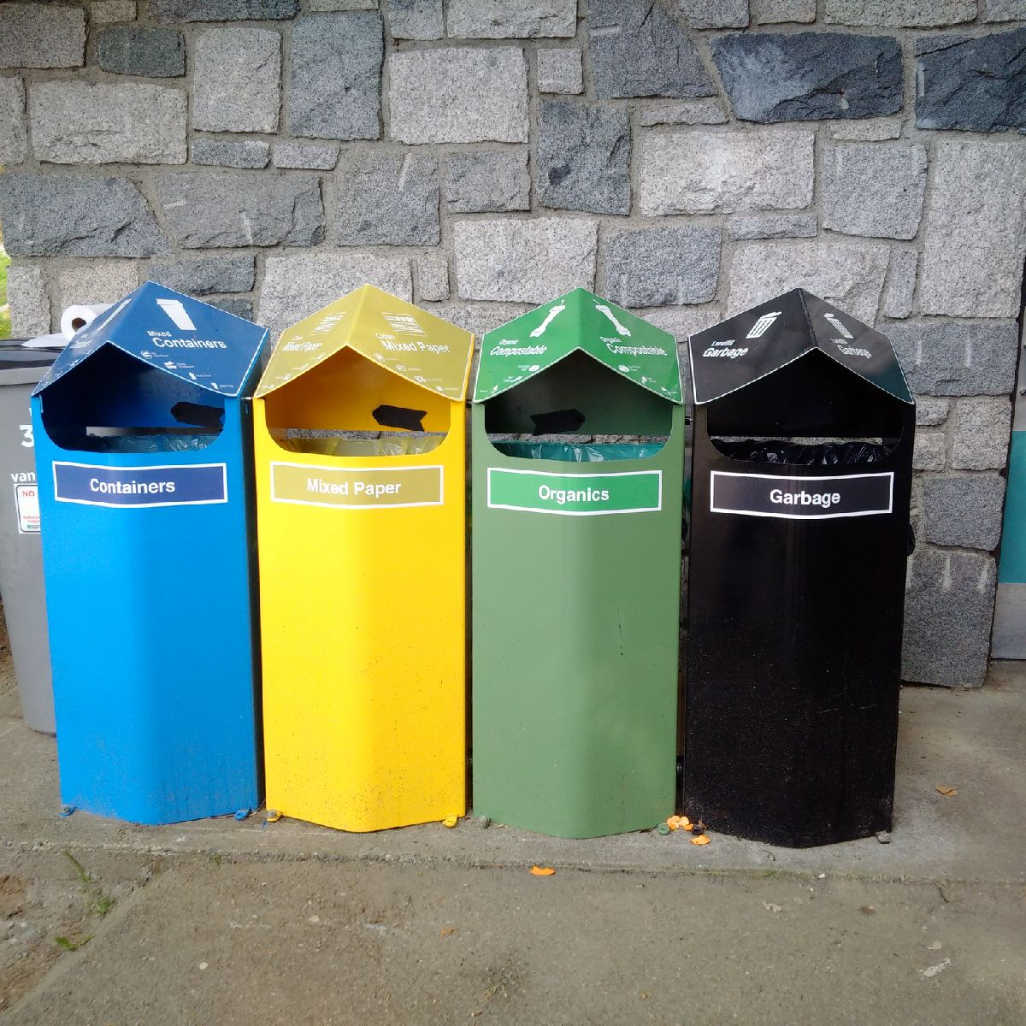
STREETSCAPE COLLECTION
Municipal property – sidewalks, plazas, town squares and parks
Eligible municipalities:
  Urban commercial areas that generated high levels of PPP
  >20,000 population
  >200 people per square km
Multiple pilots and audits completed
Significant challenges include:
  Poor sorting
  Extremely high contamination
  Liquids and food waste
  Difficulty finding end markets
  High GHG intensity for poor environmental outcomes
  Extremely high cost

Slide 16
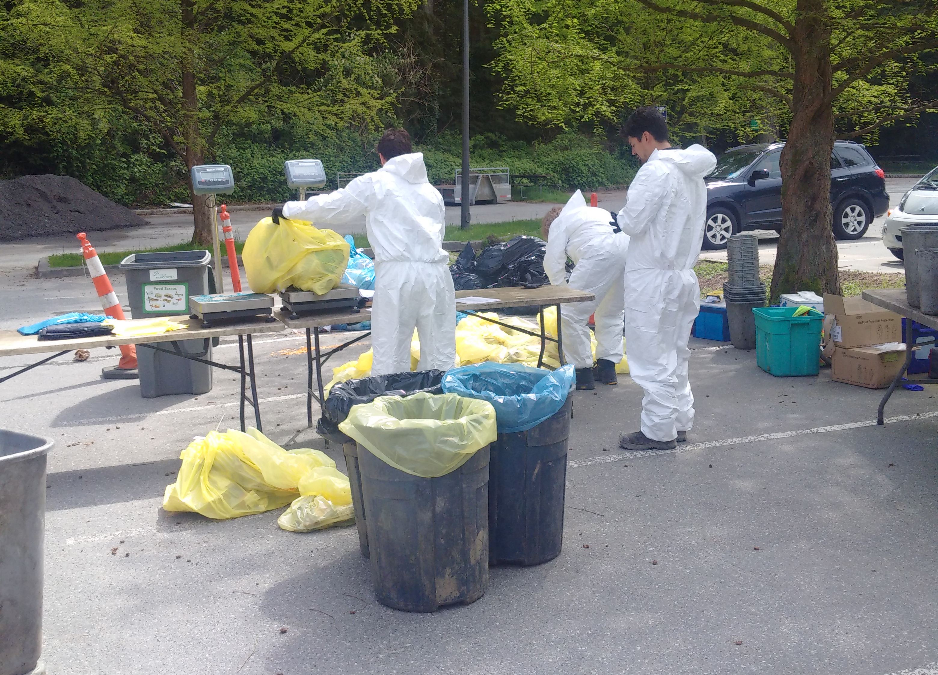
STREETSCAPE – NEXT STEPS
By Q4 2022 Recycle BC will establish:
  Baseline contamination standard
  Minimum recycling rate for end-of-life management
  Practical audit methodology
Q1 2023:
  Test audit methodology in community with single-use product bans and reasonable contamination rate
Q3 2023:
  Prepare revised service and funding commitments
  Stakeholder consultation
  Eligible municipalities can request offer to join
2024-2028 – Onboarding as applicable

Slide 17
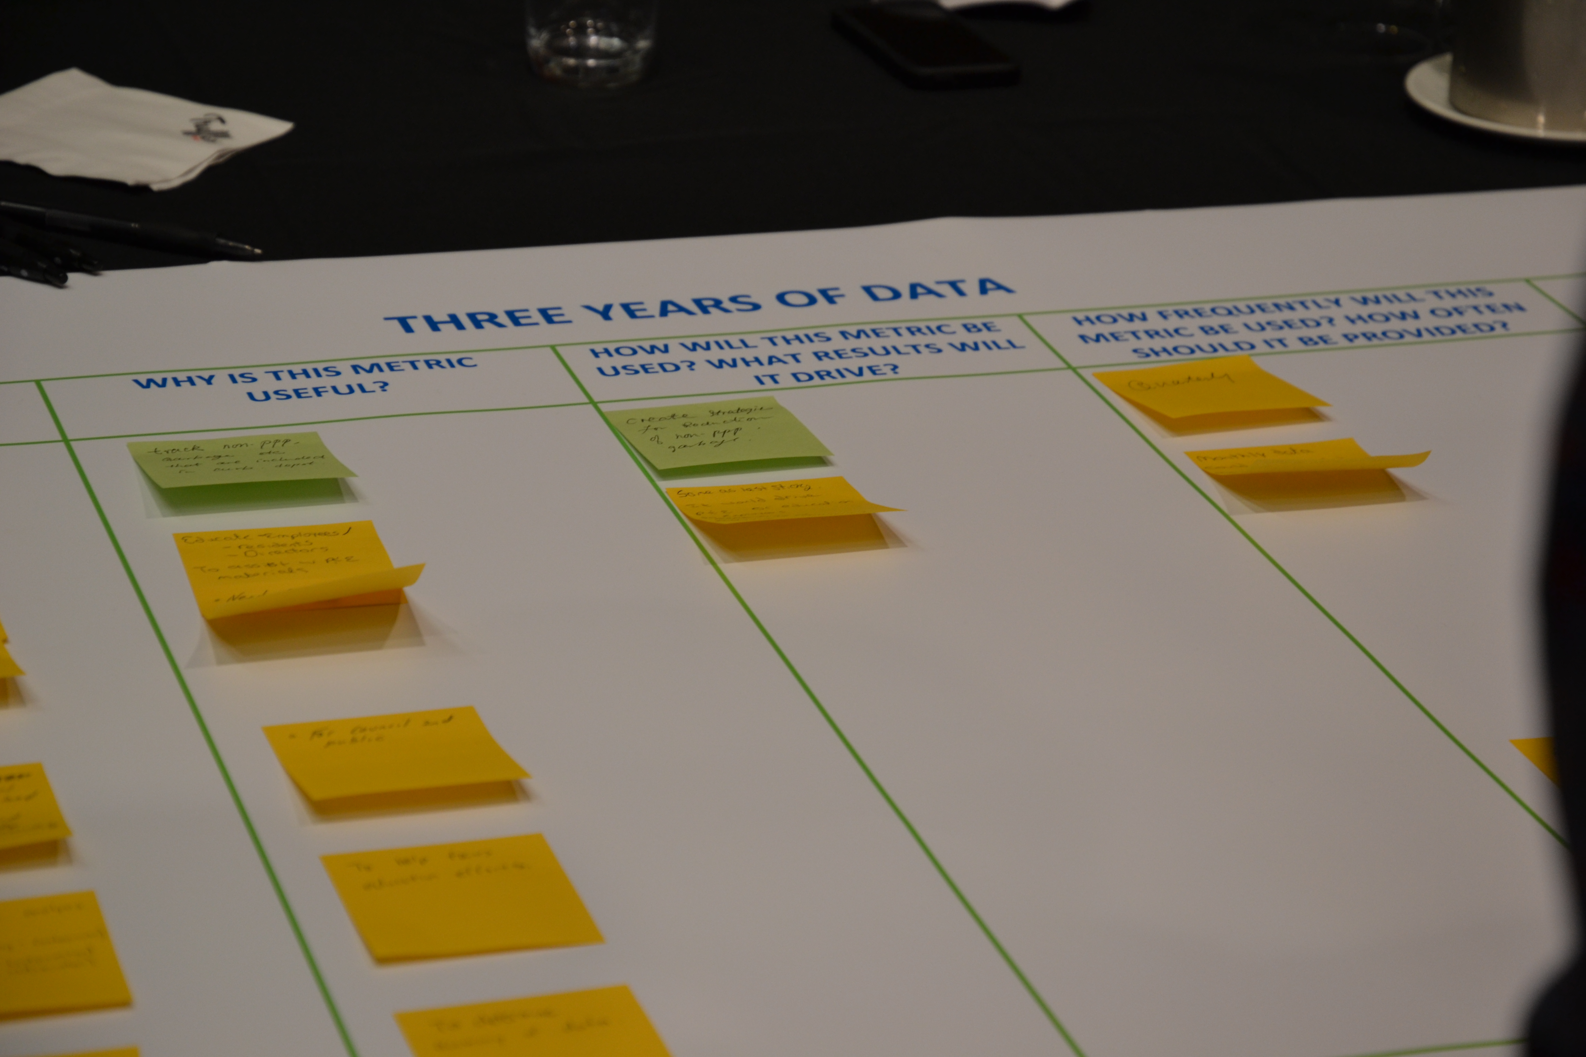
FINANCIAL INCENTIVE PROCESS
Recycle BC offers financial incentives to collectors to incentivize participation to ensure targets met
Curbside and Multi-Family: $ per household (plus $/tonne glass)
Depot: $ per tonne
At end of each agreement term:
  Collection cost study and analyses to determine adjustments
  Propose updated incentive rates/structure for consultation
  Conduct consultation with stakeholders
  Review feedback, prepare new agreements/incentive offers
  Distribute new agreement terms
  Collectors determine whether wish to renew agreement according to new terms

Slide 18
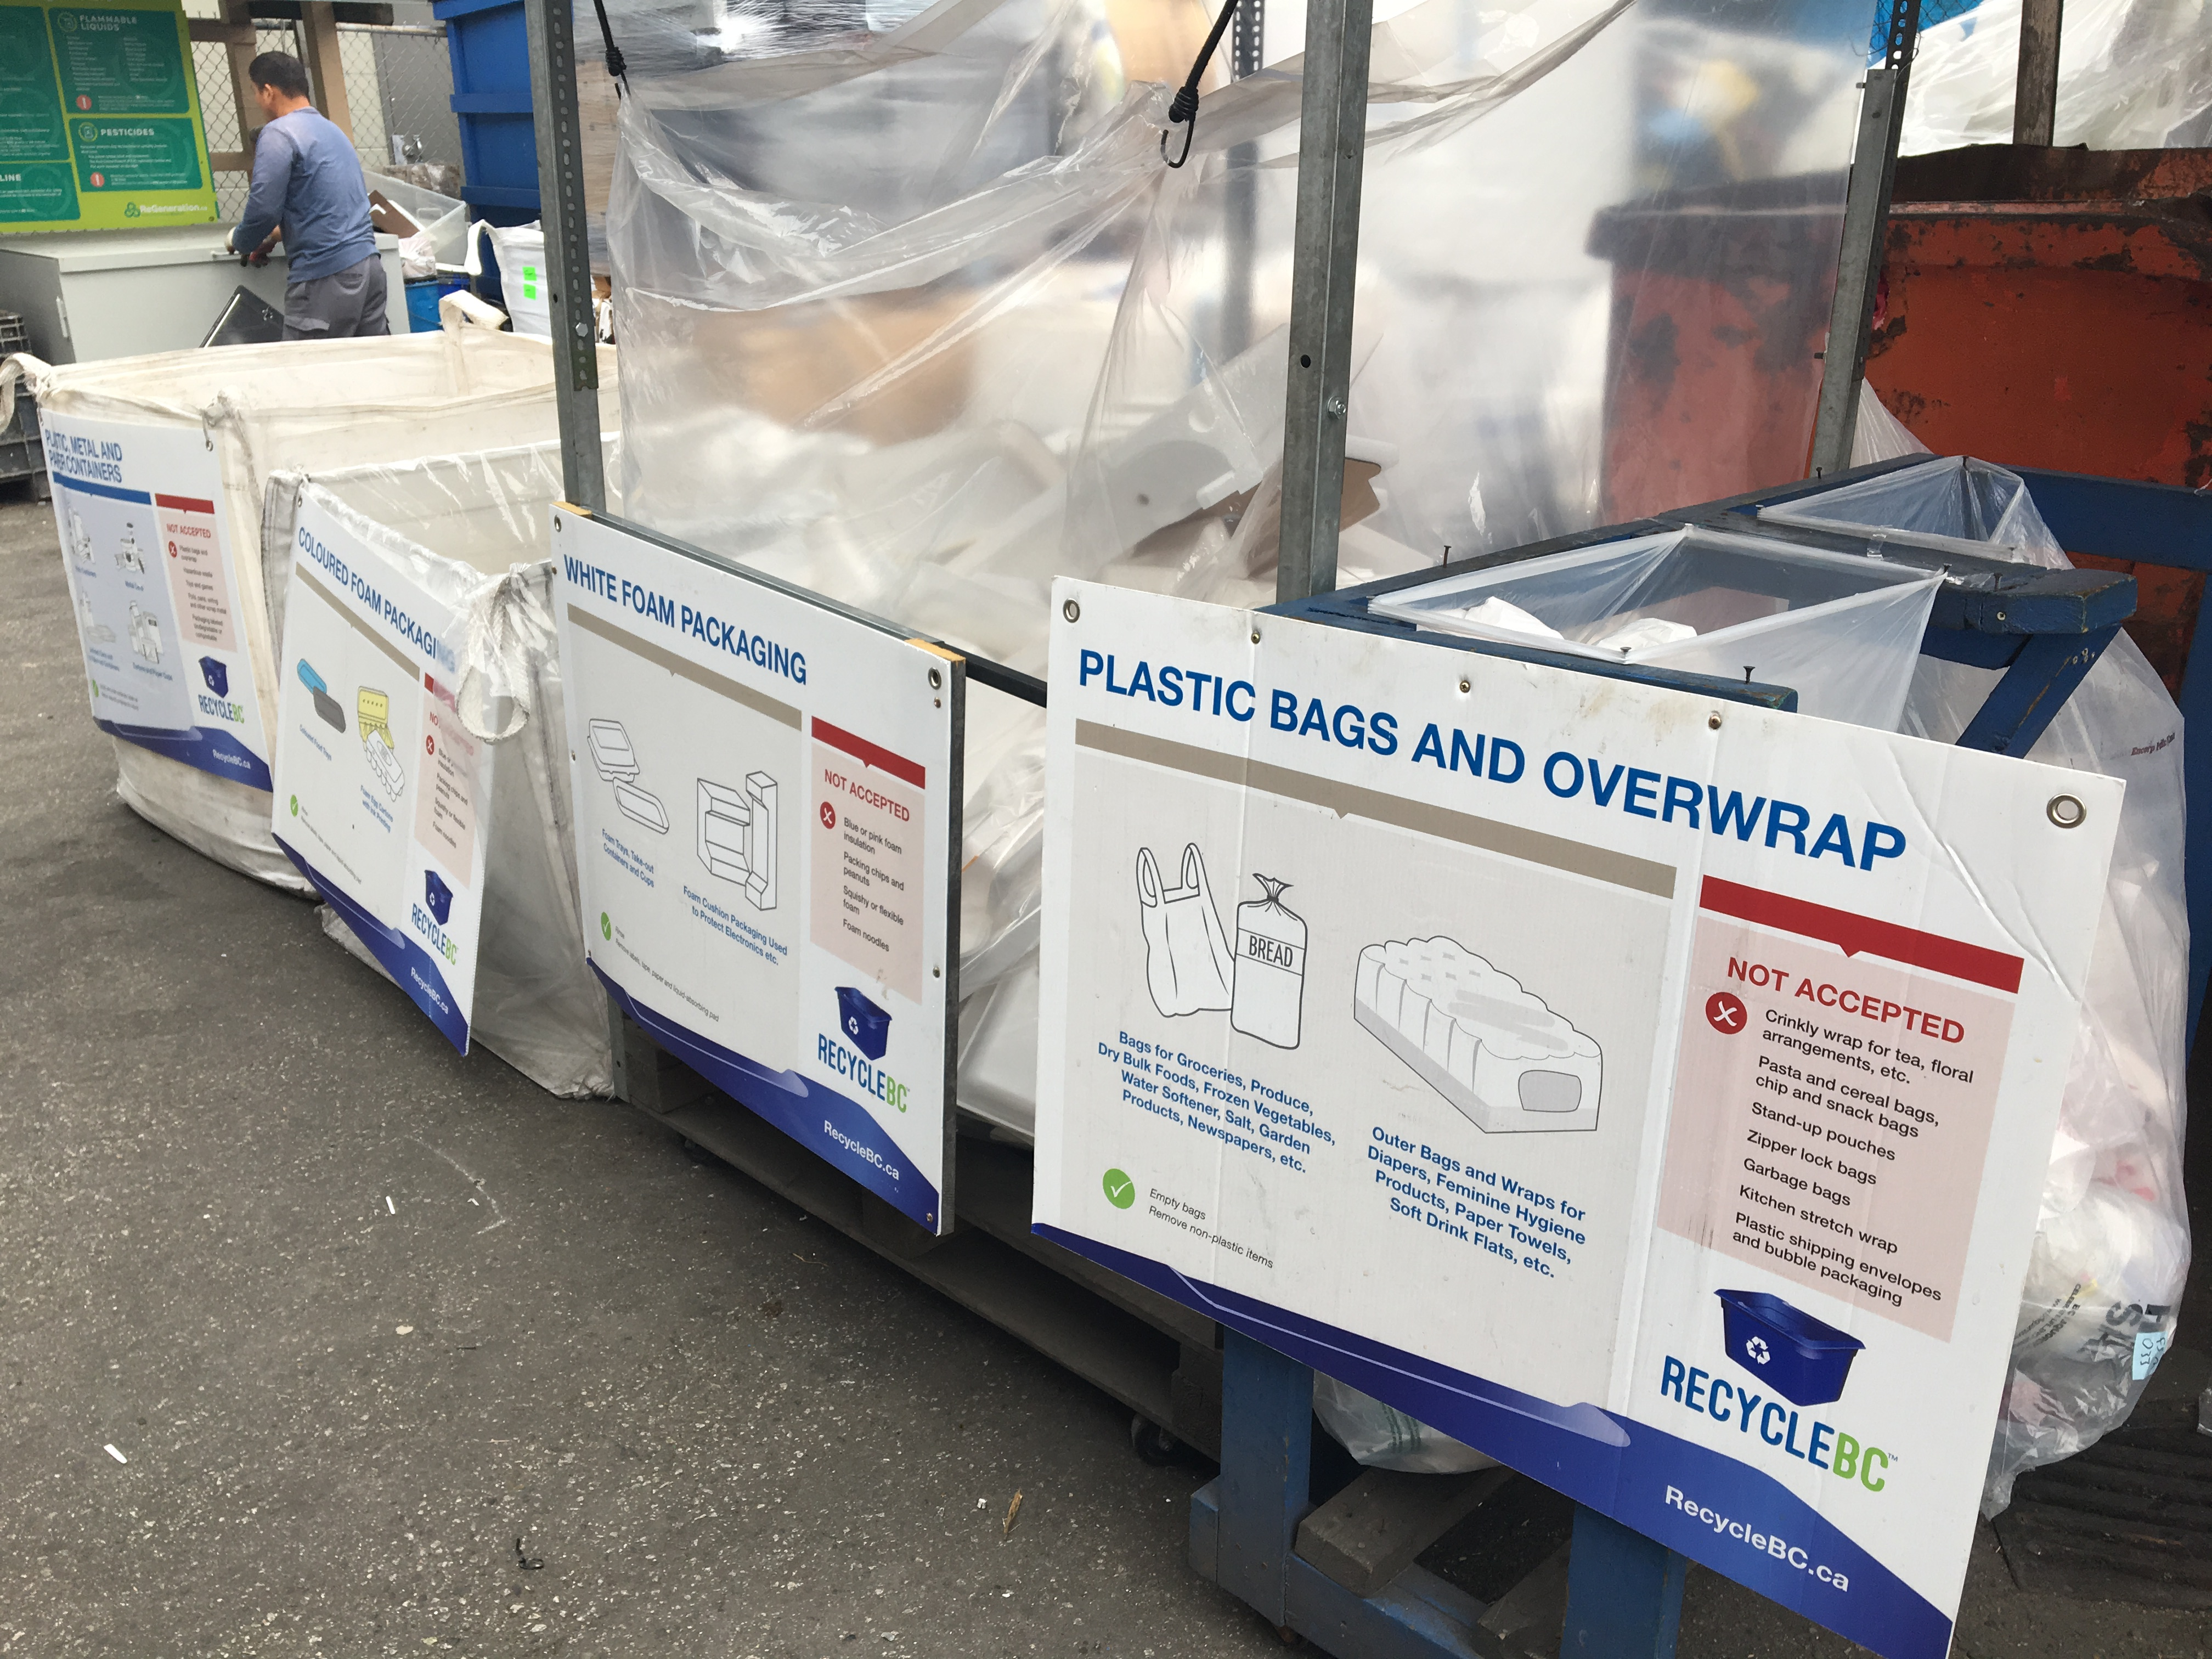
COST STUDY PROCESS
Completed in advance of new service agreements
Compares current costs to historic 5-year cost
Collectors provide data to independent third-party accountant
Overseen by Recycle BC Advisory Committee members
Objective: fair and reasonable incentive rates
Data includes:
  Curbside
  Multi-family
  Streetscape
  Promotion and education
  Service administration

Slide 19
communications

Slide 20
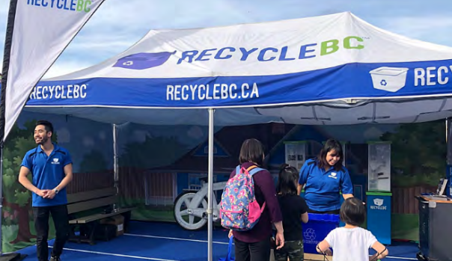
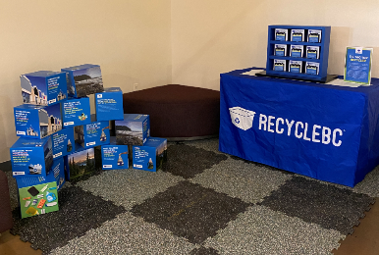
PROMOTION AND EDUCATION
Recycle BC’s objectives:
  Increase awareness of program’s features and benefits
  Encourage informed decisions on collection of PPP
Employed strategies:
  Awareness campaigns
  Strategic partnerships
  Collector resources
  Resident communication
  Research
Strategies used to target areas of underperformance

Slide 21
Pollution prevention hierarchy

Slide 22
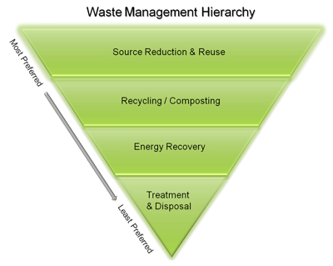
Pollution Prevention Hierarchy
Reducing environmental impacts:
  Initiatives undertaken by producers
  Weight based producer fees encourage reduction of PPP
Redesign:
  Initiatives undertaken by producers
  Cost allocation rewards easier to recycle materials
  Regular review of fee structure to ensure accurate info on cost impacts of materials to encourage redesign and adoption of best practices
    Canada Plastics Pact's Golden Design Rules

Slide 23
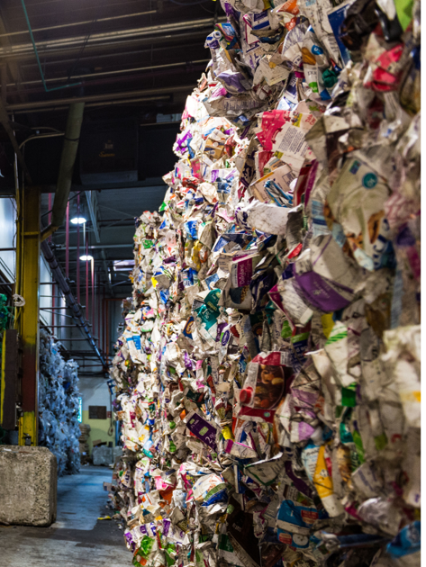
Pollution Prevention Hierarchy
Reuse:
  Initiatives undertaken by producers
  Cost allocation presumes materials enter marketplace once
  Actively engaged in exploring reuse opportunities
  Work with stakeholders to identify the value Recycle BC can bring to the reusable packaging market
Recycling:
  Payment structure and operations focus on ensuring collected PPP can meet end-market requirements
  Work with producers to improve PPP recyclability and increase recycled content

Slide 24
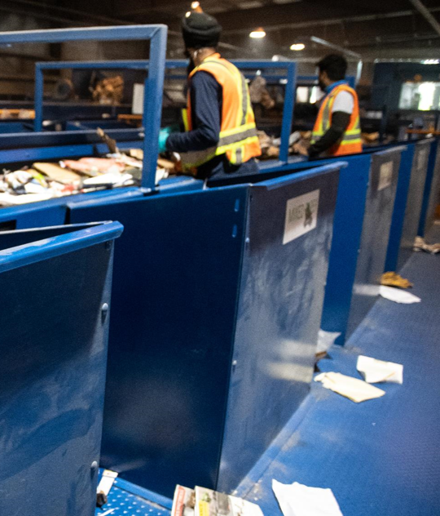
Pollution Prevention Hierarchy
Material Recovery:
  Post-collection partner is incentivised to further process system residues to meet recovery end-market requirements for engineered fuel products and minimize the amount of residue sent to landfill
  R&D to explore ways to recover material that is currently non-recyclable
Energy Recovery:
  Recycle BC does not send PPP to waste-to-energy facilities
Disposal:
  Non recoverable PPP is managed responsibly in regional landfills

Slide 25
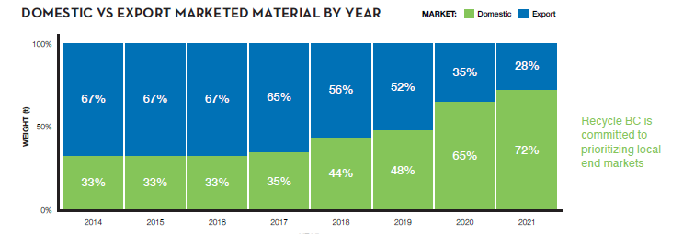
Localizing Recycling End Markets
97% of plastics collected in BC were sold to end markets in BC, where it was turned into pellets for new packaging and products. Where there was currently no recycling solution, like other flexible plastic packaging, packaging was recovered into engineered fuel
Paper was sold to end markets in BC, the US, and overseas
Glass was sold to BC End markets, and sent to a US plant for new bottles, with the remainder processed into sandblast grit or construction aggregate in BC
Metal containers were marketed to end markets in BC, Ontario, and the United States, and recycled into new packaging and sheet metal

Slide 26
Performance targets

Slide 27
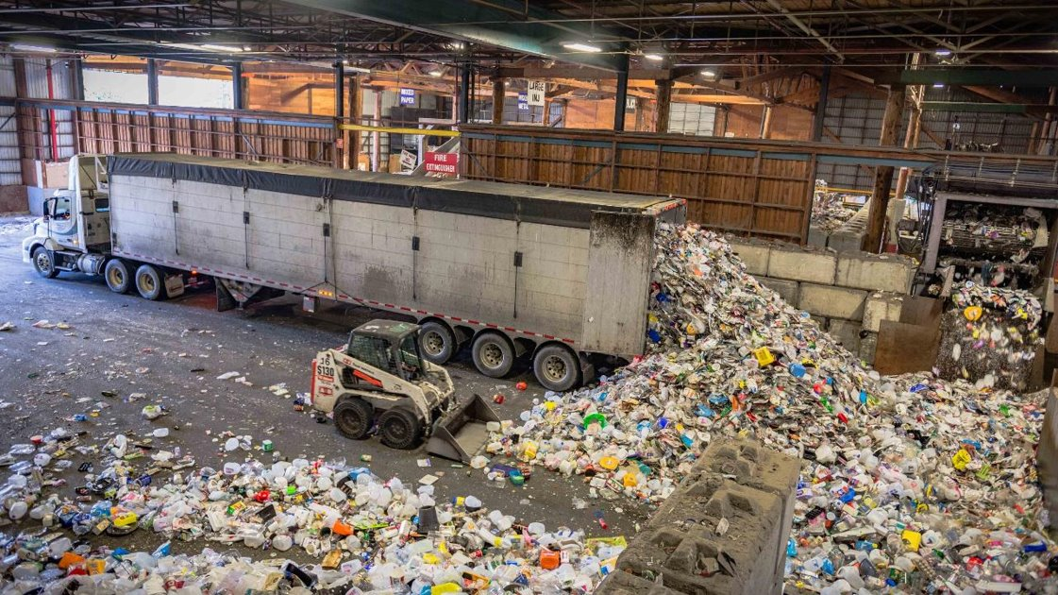
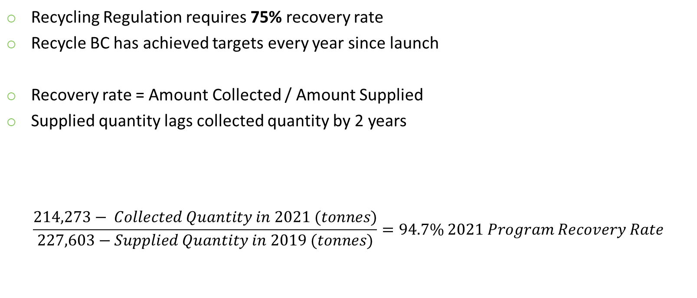
PROGRAM RECOVERY RATE
Recycling Regulation requires 75% recovery rate
Recycle BC has achieved targets every year since launch
Recovery rate = Amount Collected / Amount Supplied
Supplied quantity lags collected quantity by 2 years
$$\frac{214,273− Collected Quantity in 2021 (tonnes)}{227,603−Supplied Quantity in 2019 (tonnes)}=94.7\% 2021 Program Recovery Rate$$

Slide 28
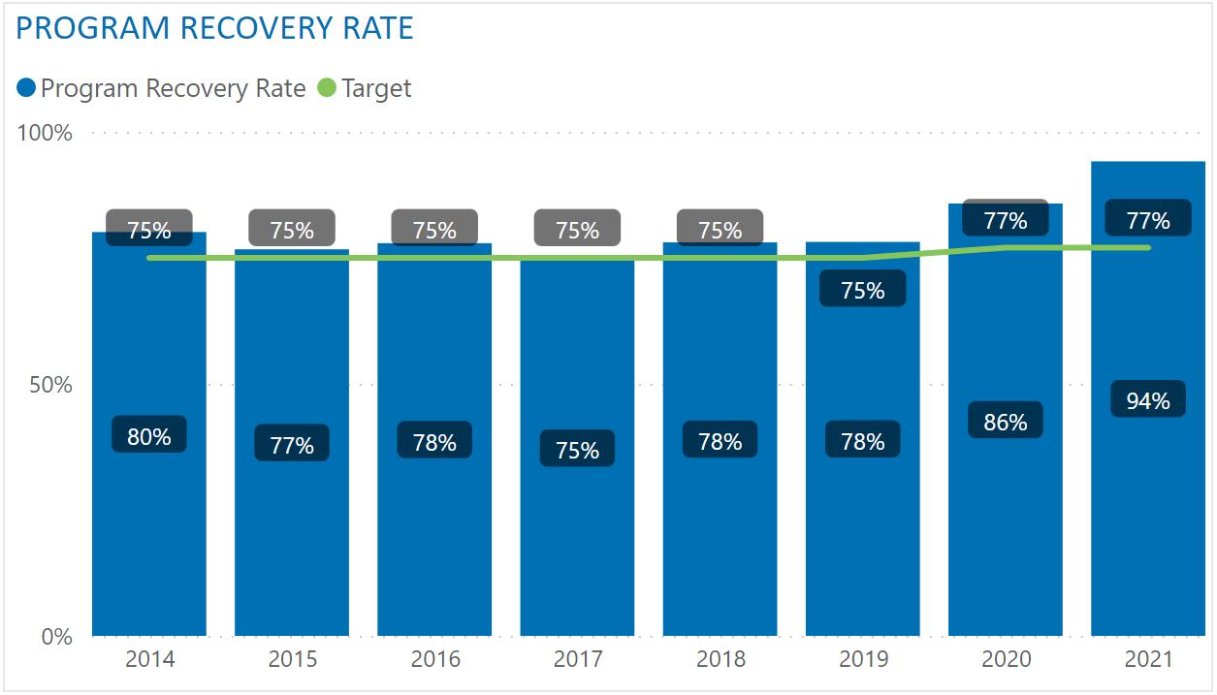
PROGRAM RECOVERY RATE – TO DATE

Slide 29
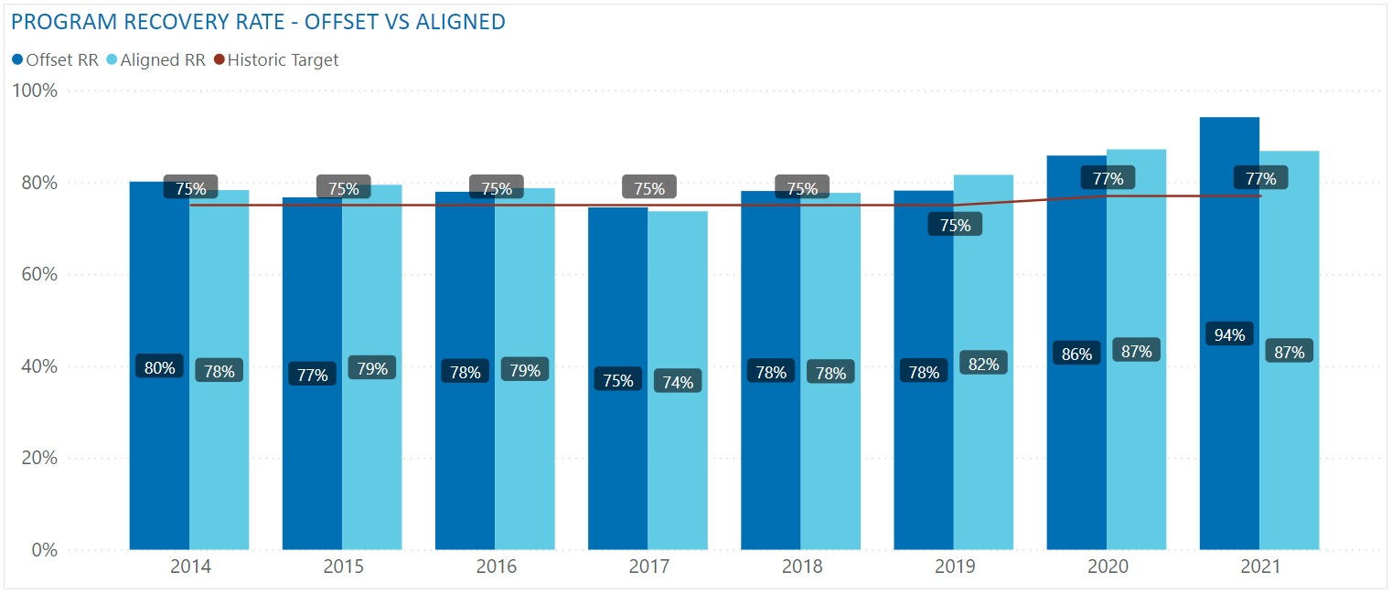
OFFSET RR VS ALIGNED RR
Two possible methodologies:
  Offset RR - Collected quantity year and the supplied quantity year are offset by two years, used historically
  Aligned RR - Collected quantity year is aligned with the supplied quantity year, reviewed but not recommended

Slide 30
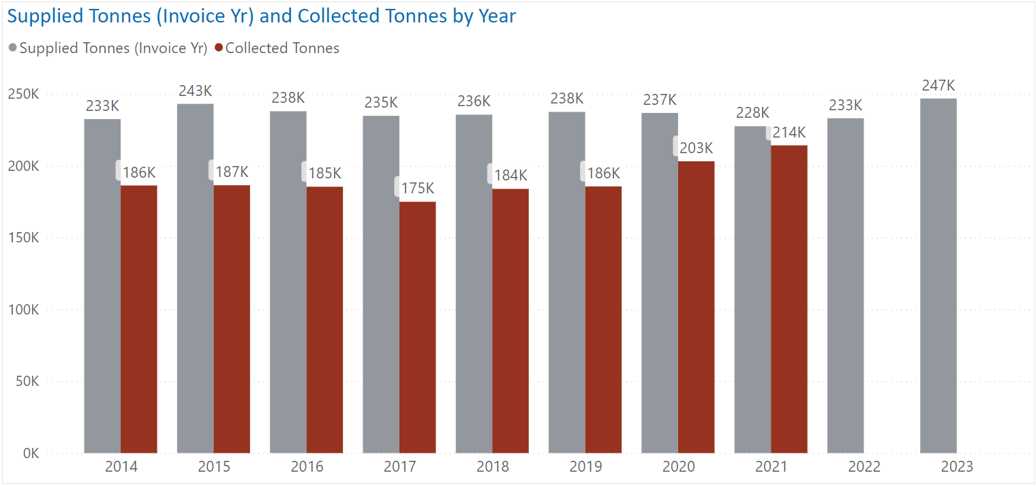
SUPPLY VS COLLECTED TONNES

Slide 31
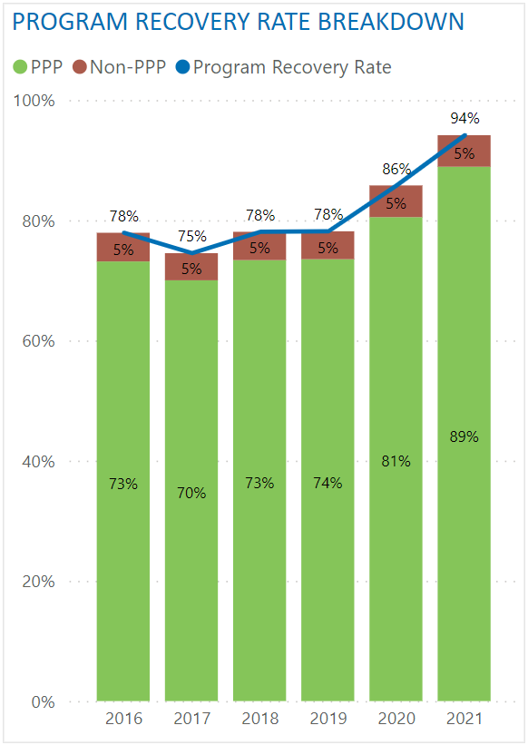
PROGRAM RECOVERY RATE – NON-PPP
Collected quantity is net of non-PPP
Non-PPP: material that is not packaging and paper product that has been incorrectly placed in recycling
Examples: food waste, construction waste, plastic products, electronics, hazardous waste
Removing non-PPP equates to a reduction of ~5% in recovery rate
Recycle BC proposes to net out non-PPP moving forward:
  Better reflects recovery of Recycle BC material
  Ensure contamination reduction does not negatively impact recovery rate
  Better alignment with material performance targets

Slide 32
PROGRAM RECOVERY RATE – TARGETS
Historic targets (non-PPP included):
2018 | 2019 | 2020 | 2021 | 2022
75% | 75% | 75% | 77% | 77%
Proposed targets:
2023 | 2024 | 2025 | 2026 | 2027
78% | 79% | 79% | 80% | 80%
Equivalent targets if non-PPP was not removed:
2023 | 2024 | 2025 | 2026 | 2027
83% | 84% | 84% | 85% | 85%

Slide 33
MATERIAL CATEGORY PERFORMANCE TARGETS
Recycle BC began reporting material performance in 2017
Material Category |  | 2017 | 2018 | 2019 | 2020 | 2021 | 2022
Paper | Recovery Rate | 87% | 86% | 83% | 90% | 101%
 | Target | n/a | 90% by 2022
Plastic | Recovery Rate | 41% | 42% | 46% | 52% | 55%
 | Target | n/a | 50% by 2025 |  |  | 58% by 2025
Rigid Plastic | Recovery Rate | 50% | 54% | 56% | 64% | 67%
 | Target | n/a | 55% by 2022 |  |  | 73% by 2023
Flexible Plastic | Recovery Rate | 20% | 19% | 22% | 24% | 28%
 | Target | n/a | 22% by 2022 |  |  | 27% by 2023
Metal | Recovery Rate | 66% | 67% | 73% | 85% | 83%
 | Target | n/a | 67% by 2020 |  | 81% by 2022
Glass | Recovery Rate | 72% | 78% | 87% | 97% | 116%
 | Target | n/a | 75% by 2020 |  | 98% by 2022
 |  | Legend: | Target Achieved

Slide 34
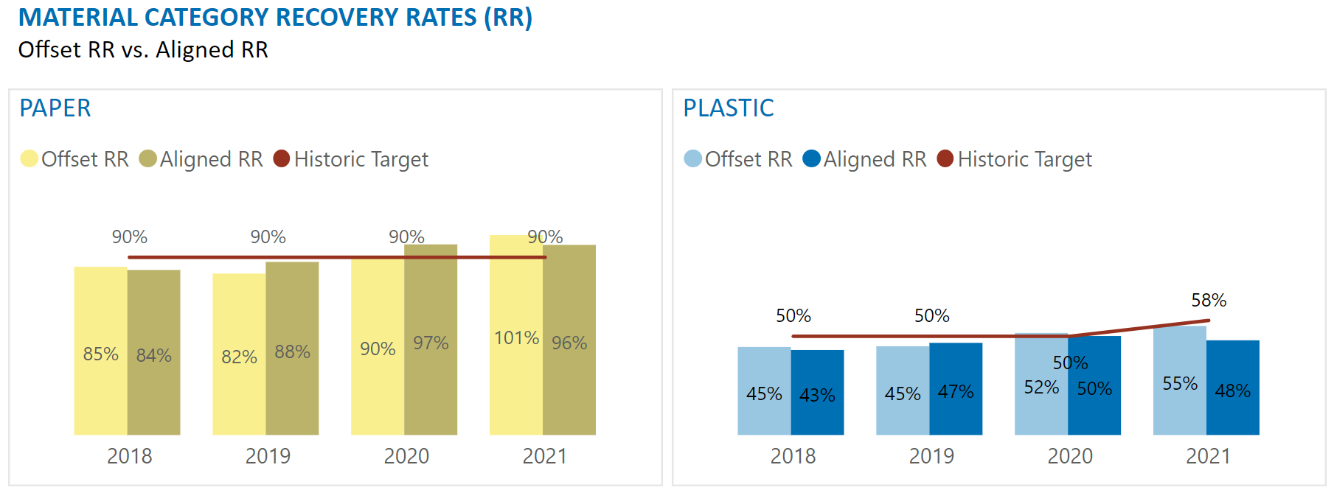
OFFSET RR VS ALIGNED RR
Two possible methodologies:
  Offset RR - Collected quantity year and the supplied quantity year are offset by two years, used historically
  Aligned RR - Collected quantity year is aligned with the supplied quantity year, proposal moving forward

Slide 35
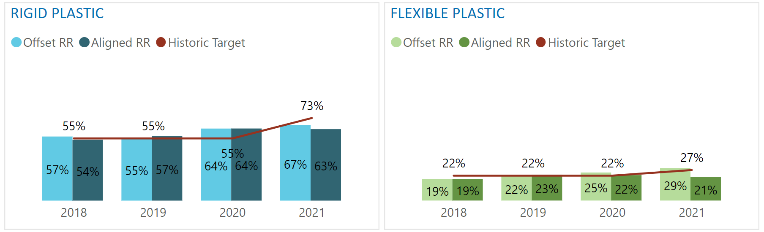
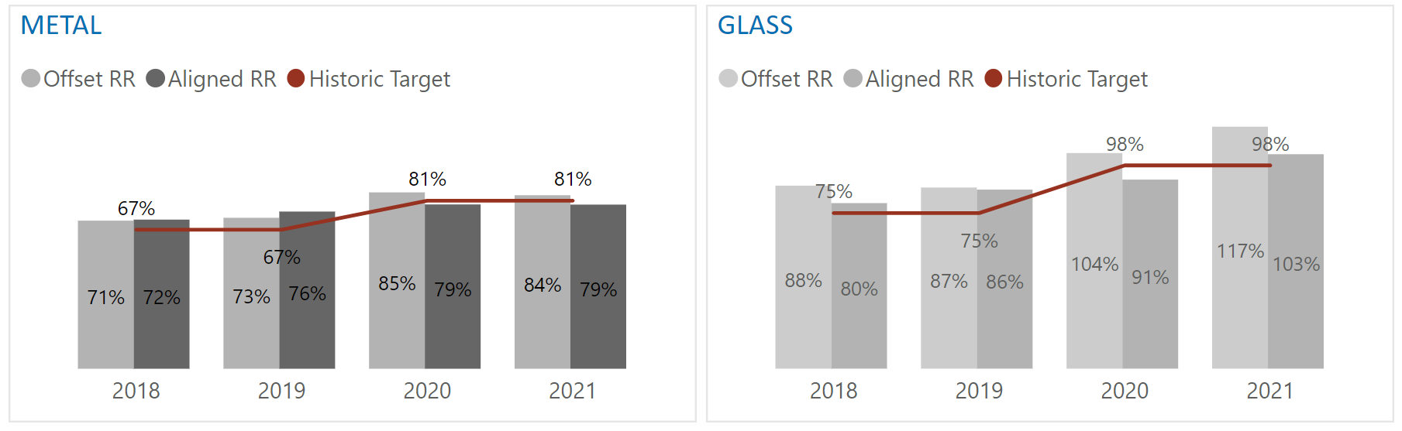
OFFSET RR VS ALIGNED RR
Aligning years allows same year-to-year comparison
Numbers in annual report will only be available for two years looking back
Example:
  2022 annual report
  Published in 2023
  Material recovery rates for 2020: 2020 collected quantity and 2020 supplied quantity

Slide 36
MATERIAL CATEGORY PERFORMANCE METHODOLOGY
Variable | Definition | Short Form
Latest Material Specific Collected Quantity | Amount of collected quantity (tonnes) in the specific material category in the latest available full collection year. | Latest Collected Qty
Material-Specific Collection Growth | Material-specific growth in collection over the last three calendar years | Collection Growth
Program Collection Growth | Estimated growth in gross collection over three years (including the year of proposal) | Program Growth
Latest Material Specific Supplied Quantity | Amount of supplied material (tonnes) in the specific material category in the latest available full supply year. | Latest Supplied Qty
Material-Specific Supplied Growth | Material-specific growth in producer member supplied quantities based on the sales data pertaining to the latest available three fiscal years. | Supplied Growth
$$\frac{Latest Collected Qty x \left(1+Collection Growth\right) x \left(1+Program Growth\right)}{Latest Supplied Qty x \left(1+Supplied Growth\right)}$$

Slide 37
MATERIAL CATEGORY PERFORMANCE TARGETS - NEW
Annual Report (AR) Year | 2023 | 2024 | 2025 | 2026 | 2027
Collection / Supply Year | 2021 | 2022 | 2023 | 2024 | 2025
Paper Target | 95% by 2025 Annual Report |  |  | 96% by 2027 Annual Report
Plastic Target | 55% by 2025 Annual Report |  |  | 56% by 2027 Annual Report
Rigid Plastic Target | 71% by 2025 Annual Report |  |  | 72% by 2027 Annual Report
Flexible Plastic Target | 24% by 2025 Annual Report |  |  | 25% by 2027 Annual Report
Metal Target | 88% by 2025 Annual Report |  |  | 89% by 2027 Annual Report
Glass Target | 98% by 2027 Annual Report
Once a material category performance target has been achieved for two consecutive years, the target will be adjusted using previously described methodology

Slide 38
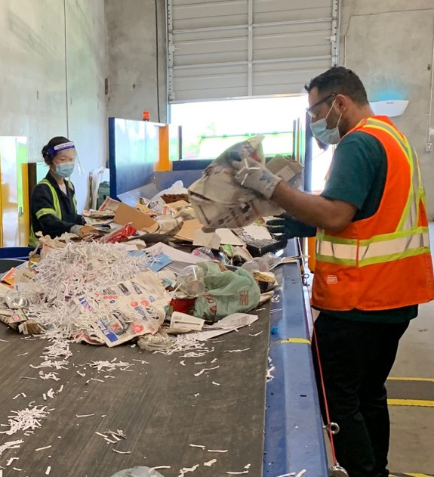
PROGRAM PLAN CONSULTATION
Stakeholder consultation October to December 2022
Additional virtual consultation sessions:
  Recycle BC producer members
  Producer associations
  Recycle BC collectors and municipalities
  First Nations
  Regional Districts
  Environmental groups
Written feedback accepted until Dec 31, 2022
  consultation@recyclebc.ca

Slide 39
Questions & discussion

